Slide 1
Program Planning: Build a Logic Model
Click through the steps

Slide 2
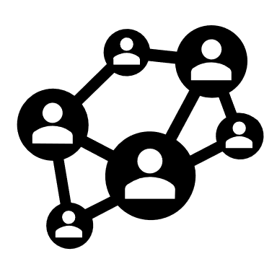
Why build a logic Model?
A logic model provides a framework for linking program activities with outcomes and goals.
It helps you answer the question: “Do these program activities lead to the desired outcomes and goals?”
The framework helps test if the program theory is accurate—if the program activities make sense.

Slide 3
PROGRAM THEORY - LOGIC MODEL
Inputs:
Staff experience
Staff training
Curriculum
Setting
Activities
Group activities
Community projects
Excursions/Field trips
Outputs:
# Sessions
# Projects
Length of involvement
# Youth involved
Outcomes:
Knowledge
Commitment
Skills
Intentions
Impact/Goal:
Youth self-efficacy
Independence
Work readiness
Life skills

Slide 4
Step 1 - goal
Start with the end (goal) in mind and work backwards:
What is the goal?
Who will benefit from it? What is the priority population?
Example:
Young people (14-16 years of age) in my community (town, neighborhood) are able to apply for and hold down summer jobs.

Slide 5
Step 2 - outcomes
Determine the competencies and behaviors that young people need to meet this goal.
What are the knowledge areas, skill sets, qualities, intentions we want to see?
Example:
Knowledge of work ethics
Communication and social skills
Interview skills
Self-efficacy

Slide 6
Step 3 - activities
Think about what you know about research and best practices to determine your intervention or program activities.
What type of programming will lead to the desired behavior? Think about content/curriculum, learning strategies such as experiential learning, group learning, and role plays.
Consider the length and frequency of program activities.
Example: Work Readiness Program
The program will include activities to explore young people’s interests/talents and jobs for youth in the community. It will give young people opportunities to practice communication, social, and problem- solving skills (role play, scenarios) and engage them in resume writing and interview skills practice. It may involve facilitating a job placement in the summer.
6-month program, meeting twice a week (ends beginning of summer).

Slide 7
Step 3 - part 2
Based on the best practices you identified you can determine the type and number of activities you will offer.
Example:
6-month program, 1-hour sessions twice a week (January through June):
# of sessions on exploration of individual interests/talents and available jobs
# of sessions on workplace ethics (guest speakers)
# of sessions on communication in the workplace
# of sessions on social and problem-solving skills
One month of job shadowing
# of sessions on resume writing, completing application forms
# of sessions on interview practice

Slide 8
Step 4 - inputs
Think about your own capacity and what’s needed in terms of resources and staff to do the program.
What is our staff and agency capacity?
Do we have curricula/resources/ activity material?
Do we need training?
Do we have community partners we can collaborate with?
Depending on your internal resources you may need to adjust scope of the program.

Slide 9
Step 5 - outputs
Finally, we want to think about how we can measure what we do. This will help determine if we are moving in the right direction, or if we have to make adjustments in our programming.
Are we reaching the number of youth we want to reach?
Are we delivering all the program components?
Are young people staying engaged?
Outputs:
Number of sessions
Type of sessions
Length of session
Frequency of sessions
Number of youth attending

Slide 10
Work Readiness Program – Does it Make Sense?
Inputs:
Staff experience
Staff training
Curriculum
Community partners
Activities
6-month program: Group activities
Job shadowing
Guest speakers
Outputs:
# Sessions
Length of involvement
# Job shadowing placements
# Youth involved
Outcomes:
Knowledge of workplace ethics
Skill sets gained: Communication, social, problem-solving, resume writing, interview skills
Impact/Goal:
Youth self-efficacy
Work readiness skills
Summer employment

Slide 11
Resources
Community Tool Box: Developing a Framework or Model of Change https://ctb.ku.edu/en/4-developing-framework-or-model-change
University of Wisconsin-Madison, Division of Extension: Logic Models https://fyi.extension.wisc.edu/programdevelopment/logic-models/

