Slide 1
Introducing the supervisor’s pyd toolkit
Jutta Dotterweich, ACT for youth May 25, 2021

Slide 2
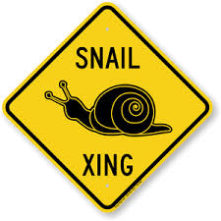
Zoom keeping
Audio.
You control the volume. Please mute yourself during the presentation.
Experiencing delays?
Try closing out the other
programs running on your
computer
Questions?
Use chat function. Post to Everyone.

Slide 3
Checking-in
After last week’s BWIAH Provider Meeting 2021 - how do you feel right now?
Chat in one word.
ONE WORD!

Slide 4
objectives
Why a Supervisor’s PYD Toolkit?
Applying PYD to youth programs and organizations
Tour of the toolkit

Slide 5
PYD History in new York state
NYS Advancing Youth Development Partnership
1998 - 2012
Act for Youth 2000 - now
New PYD Curriculum 2015
PYD Online Courses 2016
Creating Inclusive Program Environments 2020

Slide 6
HOW CAN I EMPOWER YOUTH WHEN I DON’T FEEL EMPOWERED?
Youth Worker/ Youth Program Staff

Slide 7
Key takeaways
Educating frontline staff does not establish a youth development approach in an agency
Training alone is not sufficient to integrate and sustain a youth development approach
Youth empowerment requires staff empowerment

Slide 8
Adopting innovative approaches
Innovative practice
Change of current practice
Organizational support structure
Knowledge
Competencies
Leadership
(technical & adaptive)
Organizational Infrastructure
Implementation Drivers

Slide 9
Establish Organizational support - Supervisor PYD toolkit
Resources
Strategies
Tools
Goals
Establish new practices
Develop competent staff
Allocate fiscal and other resources to support new practices and policies
Align agency mission with PYD goals

Slide 10
Positive Youth Development (PYD) is a philosophy or approach that guides communities in the way they organize programs, supports, and opportunities so that young people can develop to their full potential.

Slide 11
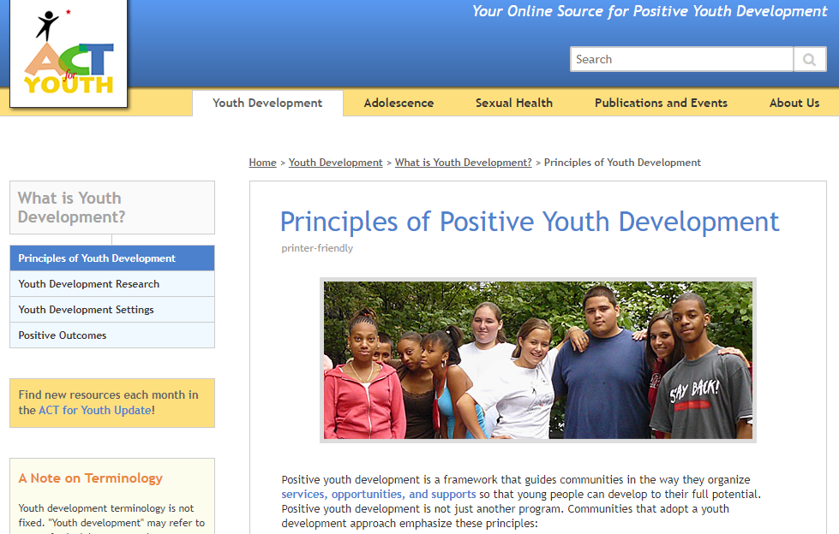
Building positive outcomes for youth
Youth voice and engagement
Developmentally appropriate/long-term
Inclusive/universal
Community- based/working together
Principles of Positive Youth Development - What is Youth Development? - ACT for Youth

Slide 12
Creating Positive Outcomes for youth by changing…
Community
Organizations
Programs
Adults

Slide 13
What does pyd mean for youth programs and organizations?
Positive Relationships
Positive Environments
Positive
Experiences
Young people experience quality programming:
Learn new skills
Expand their horizon
Connect with adults
Actively participate –
have a voice
Young people experience positive relationships with adults:
Focus on caring, support, learning, inclusion, and agency
Opportunities for youth-adult partnerships
Youth
Young people experience positive environments:
Setting is welcoming, safe, and inclusive
They feel a sense of belonging; they feel valued
The agency is part of their web of community supports

Slide 14
Positive Relationships
Positive Environments
Positive
Experiences
Promoting
Practice of developmental relationships
Practice of youth-adult partnerships
Integrating PYD principles into supervision process:
Using a strengths-based approach
Reflective practice
Promoting and providing organizational support for
Quality programming
Ongoing program improvement
Developing quality staff
Youth
Establishing policies and practices for youth development settings
Safe and inclusive program settings
Opportunities for youth and staff input
Promoting community connections/ collaborations
Supervisor
Strategies

Slide 15
Questions? Comments?

Slide 16
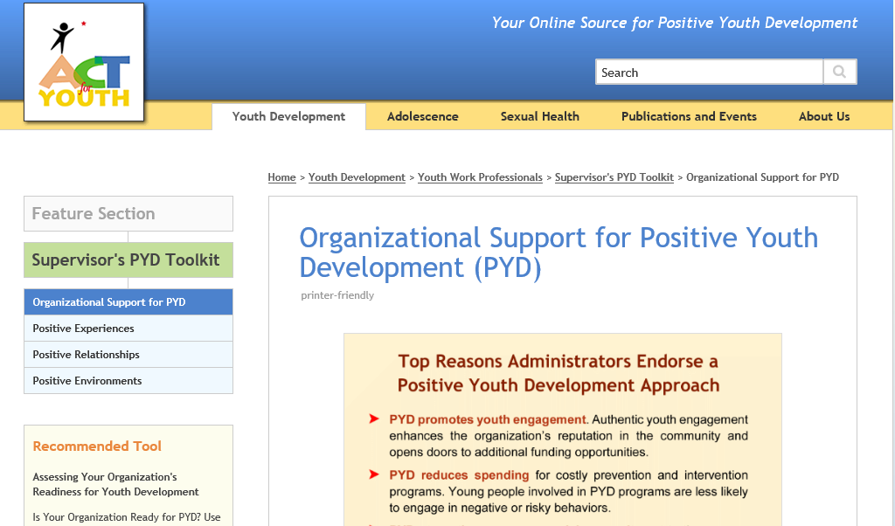
Brief Tour>>
http://www.actforyouth.net/youth_development/professionals/supervisors/

Slide 17
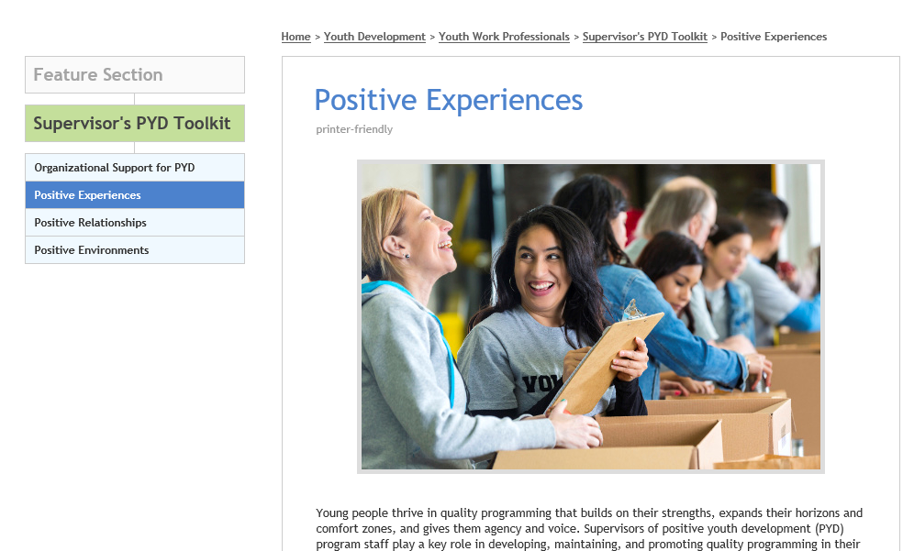
http://www.actforyouth.net/youth_development/professionals/supervisors/experiences.cfm

Slide 18
http://www.actforyouth.net/youth_development/professionals/supervisors/relationships.cfm

Slide 19
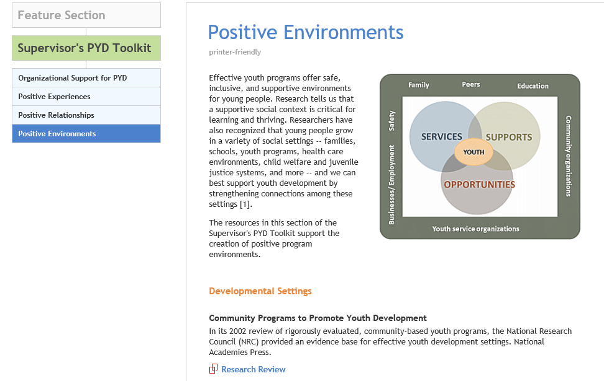
http://www.actforyouth.net/youth_development/professionals/supervisors/environments.cfm

Slide 20
Questions? Comments? Thank you!

