Slide 1
Adolescent
Risk Taking
Why do Adolescents take risks?
What can Adults and Communities do to keep them safe?
Notes:
Developed by Jutta Dotterweich for community educators, this presentation may be used to provide information on adolescent development and risk taking to parents, youth workers, and other community sectors. The talk and the resources included can be tailored to the target audience.
Personal Introduction…
Welcome,
We all have been concerned about adolescents and their behavior as parents, teachers, neighbors and/or public officials at times. In this brief presentation I would like to share with you the most up-to-date thinking about adolescent risk taking, the implications for adolescent behavior outcomes, and what we as adults in our teen lives can do to keep them safe.
Warm up activity:
Ask participants to reflect on their adolescent years and the risk taking they have done.
Show YouTube video http://www.youtube.com/watch?v=w4vW3fsJ8pk
Then ask them to talk in small groups and share their past experience. Ask volunteers to share episodes with the whole group.
___________________________________________________________________
This presentation was produced by
Jutta Dotterweich, ACT for Youth Center of Excellence, Cornell University
(contact: jd81@cornell.edu) on behalf of the Risk and Thriving in Adolescence Program Work Team, Cornell University Cooperative Extension, College of Human Ecology, October 2012

Slide 2
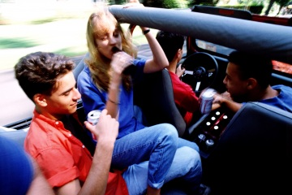

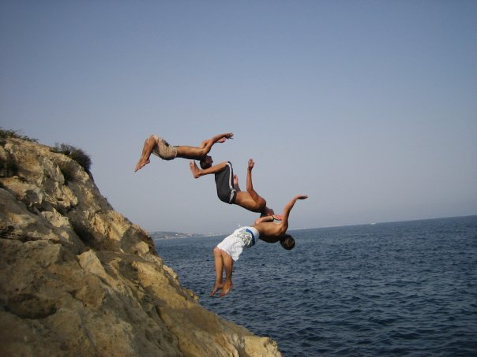

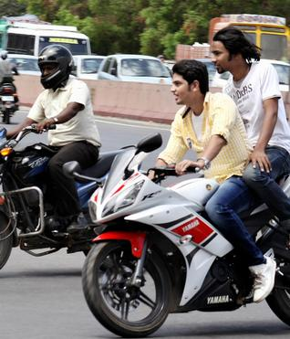

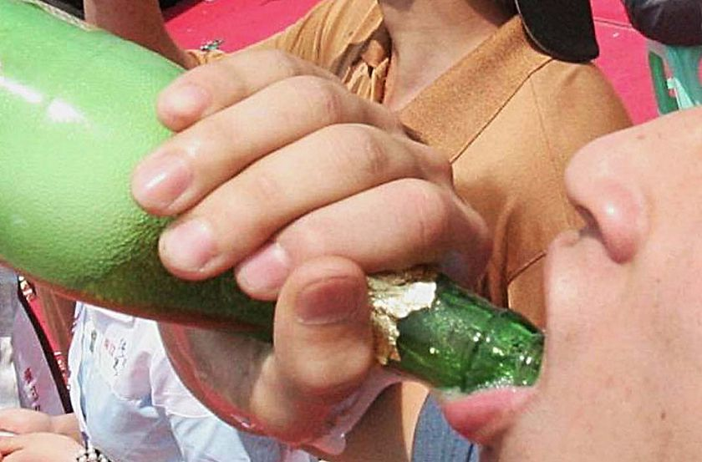
Risk Taking Behaviors
Notes:
What do I mean by adolescent risk taking? Behaviors such as …

Slide 3
The Health Paradox of Adolescence
Adolescence is physically the healthiest period of the lifespan
  Improvements in strength, speed, reaction time, reasoning abilities, immune function
  Increased resistance to cold, heat, hunger, dehydration, and most types of injury
Yet: overall morbidity and mortality rates increase 200% from childhood to late adolescence
Primary sources of death/disability are related to problems with control of behavior and emotion
Notes:
During adolescence (most commonly defined as the years between 13 and 21) we are usually in our best physical shape. Young people gain in strength and speed. They react and process quickly. Their bodies are increasingly resistant to external and internal stressors; thus, they are less likely to get sick.
At the same time, however, we see an enormous increase in morbidity and mortality from childhood to late adolescence – a 200% increase.
As you can see in this graph, incidents of injury and mortality are starting to increase
rapidly by age 13, peaking around age 20 and leveling off by age 25.
Causes for injury, disability or death are most commonly connected to behavior control/ impulse control problems.
How do we explain this paradox?

Slide 4
What Triggers Risk Taking?
Raging hormones?
Immature thinking?
Inexperience?
Curiosity?
Boredom?
Notes:
More than any other age group, teenagers are prone to take risks, to seek fun, excitement and sensation. They do not worry about the consequences – so it seems.
What triggers this behavior? What do you think?

Slide 5

Risks are…
Adults: The possibility of suffering harm or loss, Danger
Youth: Any venturesome undertaking, especially one with an uncertain outcome
Notes:
To some degree it might be a matter of perspective and definition. You could say that youth and adults look at risks through a different lens.
As adults we look at risk as the possibility of suffering harm or loss. Or, we define risk as danger (Webster dictionary).
Young people see risk as an adventure, an undertaking that promises excitement. Outcomes are often uncertain. The more uncertain, the more exciting.

Slide 6
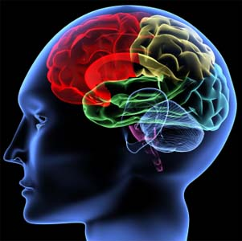
Why do teens take risks?
Growth spurt of adolescent brain (starting in puberty )
↑ skill efficiency
Frontal Lobe: Cognitive control & decision-making still under construction
↑ Activity in limbic system (emotional brain): Pleasure and sensation seeking increase
Notes:
So why do teens take risks? Recent findings in adolescent brain research tell us that the adolescent brain has enormous potential for both learning and vulnerability.
With the onset of puberty the brain experiences another growth spurt. This time growth involves fine-tuning and hardwiring connections that are made between different areas and centers of the brain. It follows the principle “use it or lose it” – connections that are used are made stronger, and connections that are not used are lost. As a result the brain works more efficiently. This is a great time for skill development and learning.
However, different centers in the brain develop on different time lines. The frontal lobe, the center for rational decision making and judgment, is not fully developed. It is actually the last part of the brain to fully develop (by age 25).
The limbic system responsible for social emotional behavior is activated as well. It drives the need to feel good, seek pleasure and also sensation, seek rewards.
___________
Source:
Steinberg. 2007. Risk Taking in Adolescence
http://www.temple.edu/psychology/lds/documents/Risk-TakinginAdolescenceCDPS.pdf
Resources:
Linda Patia Spear. 2010. The Behavioral Neuroscience of Adolescence
Norton, NY
Reyna et al (ed). 2012. The Adolescent Brain. APA, Washington

Slide 7

Maturation Imbalance
Adolescent cognitive skills and capacities are comparable to adults
Lack of experience has impact on their deliberation process (Reyna)
When the emotional (limbic) system is aroused, pleasure and reward seeking will be dominant
Notes:
While adolescents have cognitive skills comparable to adults, they don’t have the same ability to make rational decisions, especially when emotionally aroused.
Contrary to popular belief that adolescents do not understand or think about the positive and negative consequences of risk behaviors, research has shown that they do know about the consequences and are able to weigh the consequences. Actually they often take too much time deliberating the consequences, while adults based on experience often make gut decisions about risk situations.
(Reyna)
When emotional aroused, adolescent are more likely to engage in risky behaviors seeing pleasure and reward, and they are less likely to avoid harm.
This imbalance between the cognitive and emotional brain is biologically driven and normative. This raises the questions: Can we do anything about that? What can we do to keep young people safe?
___________
Fact sheet on Reyna’s research:
Eric Wargo: Adolescents and Risks: Helping Young People Make Better Choices
http://www.actforyouth.net/resources/rf/rf_risk_0907.pdf

Slide 8
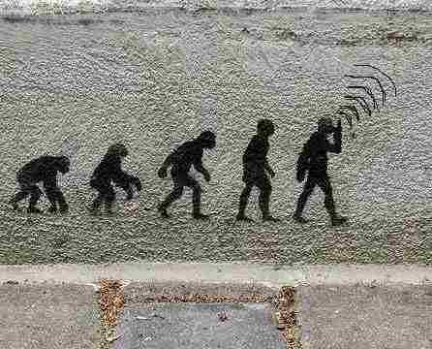
Hardwired to Take Risks
“The teen brain is
neither broken nor
defective. Rather, it
is wonderfully
optimized to promote
our success as a
species.”
~Jay Giedd, MD
Notes:
Before we address these questions it is good to keep in mind that this is not a deficiency.
As Jay Giedd, National Institute of Health, put it:
“The teen brain is neither broken nor defective. Rather, it is wonderfully optimized to promote our success as a species.”
Risk taking has been beneficial to our survival. All social mammals exhibit similar kind of risk taking behaviors during adolescence.
It is time to leave the family (no in-breeding).
It is time to try out new things including food; look for different, new environments
_______________
Jay Giedd has done years of research on adolescent brain development using new technologies to map brain activity (functional MRIs).
Teen Brain - Frontline Special on PBS
http://www.pbs.org/wgbh/pages/frontline/shows/teenbrain

Slide 9

Risk Taking - Risky Behaviors
Increased injury/morbidity
Negative behavior outcomes: teen pregnancy, substance abuse, delinquency, school drop out, violence
Trying out new things, developing own identity
Civic engagement; create social change
Early adapters; innovation focused
Notes:
Risk taking in adolescents continues to be a good thing. It motivates or drives young people to try out new skills and roles to find out who they are and where they are going. It also motivates many young people to be civically engaged and mobilize to create social change. Social activism is often driven by young people. Young people are also at the forefront for developing and adopting innovations.
On the other side, risk taking can transition into incidents of morbidity and mortality and to negative behavior outcomes such as teen pregnancy, substance abuse, delinquency, drop out and violence
___________________
Institute of Medicine and National Research Council. 2011. The Science of Adolescent Risk-Taking. Committee on the Science of Adolescence. Workshop report.
http://www.nap.edu/catalog.php?record_id=12961

Slide 10
Moderating Factors
Temperamental dispositions
Youth who mature early (early onset of puberty) are more likely to engage in risky behaviors
Peer group increases risk taking
Environmental stress
Notes:
Although many young people navigate through adolescence without coming to harm,
many others do not. There are moderating factors that can facilitate or buffer the transition from positive risk taking to maladaptive risky behaviors and negative behavior outcomes.
Temperamental dispositions (for example, individuals who are inhibited by nature or prone to high anxiety might not be at risk for harmful activities)
Young people who start puberty at an earlier age are more likely to engage in risky behaviors
Acting within a group increases risk taking (group acceptance might be a reward for engaging in risky behavior)
Environmental stress such as discrimination, poverty, etc., might increase risk taking and negative behavior outcomes

Slide 11

Social Toxicity or Stress
HOMOPHOBIA
VIOLENCE
SEXUAL EXPLOITATION
Social factors that poison youths’
well-being and healthy development
HEALTH THREATS
SEXISM
DISRUPTED FAMILY RELATIONSHIPS
POVERTY
RACISM
LACK OF BENEVOLENT ADULT AUTHORITY
Notes:
James Garbarino coined the phrase “social toxicity,” which describes all the social factors that impact negatively young people’s healthy development and might facilitate sliding from risk taking to risky behaviors.
Most of them are well known. Here are few key points:
Racism – resulting in a gap in academic performance (generally speaking, African American and Hispanic youth do less well) and other inequalities; discrimination; they are overrepresented in special education classes and prisons
Poverty – we know that young people growing up in poverty have fewer opportunities and support; they often face additional problems such as violence & disrupted family relationships (single parenting, domestic violence)
Sexual exploitation – internet, marketing, body image
Homophobia
Health threats – drugs/alcohol, AIDS
Lack of benevolent adults in authority – lack of role models that promote positive social and moral values (most current role models are about accumulation of wealth)
Violence – growing up in violent neighborhood, exposure to gangs, guns
_________________
Source:
James Garbarino. 1999. Raising Children in a Socially Toxic Environment.
Jossey-Bass

Slide 12

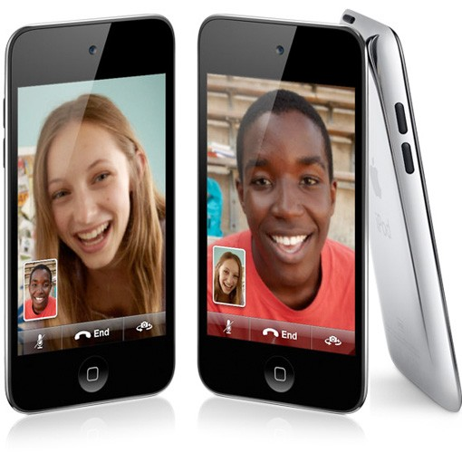


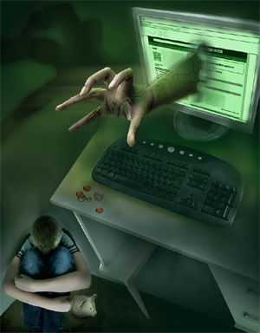
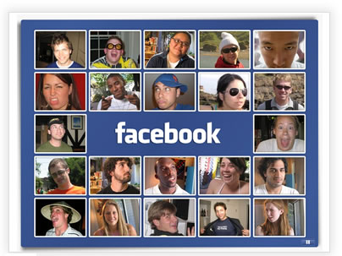

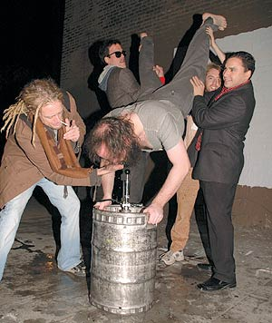

Risks are changing…
Other
Notes:
Risks depend on social context. Over time risks change. It is fair to say that risk taking 20 years ago looked dramatically different than it does now.
There is a tendency to normalize risk. When enough people do something it is no longer considered risky. This alters the bar for what is considered “normal” in ways that permit unhealthy habituation.
The internet, for one, has greatly influenced risk taking over the past 10-15 years
Examples
- Cyberbullying
- Sexting

Slide 13
Home Media Ecology - 1975
Product Route to home Display Local storage
TV stations phone TV Cassette/ 8-track
broadcast TV radio
broadcast radio stereo Vinyl album
News mail
Advertising newspaper delivery
phone paper
Radio Stations non-electronic
Tom Wolzien, Sanford C. Bernstein & Co
Notes:
This is an interesting study demonstrating the incredible changes that have occurred when we look at home media use. In 1975 there were only a few ways to bring information and entertainment into the home: Phone, TV, radio, mail. Usually it was one way – information coming into the house.

Slide 14
Home Media Ecology – Now
Product Route to home Display Local storage
cable VCR
TV stations phone/DSL TV
Info wireless radio DVD
“Daily me” broadcast TV PC Web-based storage
content iPod /MP3 server/ TiVo (PVR)
Cable Nets broadcast radio stereo PC
Web sites satellite monitor web storage
Local news mail headphones CD/CD-ROM
Content from express delivery pager
individuals iPod / storage portable gamer MP3 player / iPod
Peer-to-peer subcarriers / WIFI cell phone pagers - PDAs
Advertising newspaper delivery phone cable box
Radio stations PDA/Palm game console
game console paper
Satellite radio non-electronic storage sticks/disks
Adapted from Tom Wolzien, Sanford C. Bernstein & Co
Notes:
Now – actually by 2000 – there are many, many ways to get information and entertainment. And it is bi-directional. We can access and select. By now there are probably additional tools available for information flow and storage.

Slide 15

Young Adults and Social Media
93% of teens 12-17 go online; 63% of these online teens go online daily
73% of these online teens use an online social networking site
31% of social networking teens have “friends” on their social networking profile whom they have never met personally
71% of 12-17 year olds have cell phones
http://www.pewinternet.org/topics/Teens.aspx
http://www.youtube.com/watch?v=ZTLGFIl5KCg
Notes:
And young people are expert users of the new digital media. They are connected all the time. A recent study found that teenagers are connected via computer, smart phone, etc., 11 hours a day.
The Pew Internet Project is monitoring social media use and trends for all age groups. The slide shows 2009 statistics, the statistics for cell phone and online use have increased.
The digital revolution has raised many questions. Many research projects are underway focusing on the influence of social media on mental health, social behavior and skills, learning, etc. For now we know that the technology is changing rapidly; and we know that it won’t go away.
__________________
To demonstrate the power and speed of the social media revolution you could show this YouTube video http://www.youtube.com/watch?v=ZTLGFIl5KCg

Slide 16
Context Matters
Laws/Norms
Economics
Peer
Family
Role models
School
Youth
Church
Work
Neighborhood
Media/Internet
Notes:
Going back to questions we raised earlier: What can we do about risk taking if it is biological and normative? What can we do to keep adolescents safe?
Neuroscientists recommend to externally control and reduce harm by monitoring or changing policies (↑age to drive, drink alcohol etc) – remember that young people’s cognitive self-regulation matures fairly late (by mid 20s).
Another strategy that holds promise is nurturing young people’s emotional self-regulation by giving them opportunities to practice social emotional skills, problem solving skills and other similar skill sets.
With these two strategies in mind, I would like to explore what families, youth programs and communities can do to support young people in this emotionally charged period of transition into adulthood.
Using an ecological model of human development, we know that young people grow up in interaction with families (care takers), schools, youth programs and communities/neighborhoods. All these social domains influence young people, mediate their behavior, and young people in turn have impact on these social groups. Drawing from the positive youth development approach we will look at what adults can do to keep adolescents safe.

Slide 17
Safety Net:
Services Opportunities Supports
Community
Family
Services
Supports
YOUTH
Youth Programs
Opportunities
School
Notes:
Drawing from the youth development approach we can design a safety net that builds on all community sectors or social domains to provide young people with services, supports and opportunities they need to develop their potential and develop the skills they need to navigate adolescence and enter adulthood.
Services are those undertakings done ­to or for youth intended to enhance health, safety, performance, and other forms of essential well being and physiological functioning. These are the traditional primary, secondary, and, to some extent, tertiary intervention services provided by public health systems, school districts and recreational projects / facilities. These are critical but when they stand alone are inadequate for fostering well being.
Supports are tangible resources that are done with young people that facilitate access to interpersonal relationships and resources. Supports promote a positive climate within which development occurs. Emotional support facilitates a sense of safety, nurturing, and friendship. Motivational support provides positive expectations, guidance, and developmentally appropriate boundaries. Strategic support facilitates access to needed resources and information.
Opportunities are things done by young people. Youth are provided meaningful and real opportunities to practice and expand on what they know and learn – either through work, service, or advanced learning. Although youth ideally encounter a diverse array of different types of opportunities, not all opportunities are created equal. Those which are sustained and in which youth are encouraged to exercise meaningful decision making roles ultimately demand and foster the greatest number of competencies in young people.
___________________
Source: Pittman, K. J. et al. (2003) Preventing Problems, Promoting Development, Encouraging Engagement: Competing Priorities or Inseparable Goals? http://www.forumforyouthinvestment.org/node/105

Slide 18
Families
Parent-child closeness & communication
Modeling healthy behaviors
Clear boundaries and expectations
Monitoring
Know peers
Increase connection to school
Encourage engagement in social and skill building activities/programming
Notes:
Let’s take a closer look at what parents or caregivers can do. Research tells us that it is essential to keep communication lines open. Staying connected, spending time, listening, and expressing that they care are critical elements.
- Parents often do not realize that they are very influential, and young people do look at them for guidance. Being a positive role model is important – in terms of relationships and social skills but also in regard to healthy behaviors such as alcohol consumption, smoking, etc.
- Clear boundaries and expectations are important. Although young people might argue over boundaries, boundaries represent support and safety, and help decision-making.
- Monitoring – For example, monitoring of electronic devices at night (not allowing them in the bedroom) will increase length of sleep. Due to the increased brain activity, adolescents need long hours of sleep (for the brain to re-generate). Lack of sleep will negatively impact their functioning and decision-making.
- Knowing their child’s friends is another way of monitoring and staying connected.
- We know from research that school connectedness is a good predictor for positive behavior outcomes. Young people who feel connected to school do better and are less likely to engage in risk behaviors such as violence, substance abuse, risky sexual behaviors, and delinquency. Encouraging school attendance, supporting graduation and career goals are important.
Finally, thinking back about the need for social-emotional self-regulation, it is good to get young people involved in extra-curricular social or civic activities in or out of school. This will give them a chance to learn and practice communication, conflict resolution, coping skills; it will give them a chance to expand their experiences, learn about themselves, their emotions and how to handle different challenges.
______________________
Source: Child Trends and NAHIC. 2006.
The Family Environment and Adolescent Well-Being http://www.childtrends.org/Files/Child_Trends-2006_06_01_FR_FamilyEnvironmen.pdf

Slide 19
Youth Programs
Integrate social-emotional skill building in program activities
  Target multiple skill sets such self-regulation, problem solving, conflict resolution
  Use multiple instruction strategies such as modeling and coaching
  Involve peer educators
Integrate mindfulness and contemplation skills
  Moment meditations
  Self inquiry/reflection activities
  Provide opportunities to identify personal stressors and coping mechanism
  Critical thinking /media and cultural literacy
Creative (multisensory) methods to engage
Positive risk taking opportunities
  Leadership opportunities
  Outdoor education
  Civic engagement
Notes:
We just talked about the need to provide opportunities to learn social emotional self-regulation – a venue to help young people deal with the urge to take risks. If we look at youth programs with that in mind, programs can
• provide ample opportunities for practicing (through role-playing and group problem-solving) social emotional skills, anger management, conflict resolution, creative expressions. Programs might want to link with non-traditional partners such as arts centers etc.
• integrate reflection activities, involve youth in planning; ask youth how they arrived at the thoughts or conclusions they are expressing; critical thinking skills
have them take a perspective, other people’s perspective – diversity activities, purpose exercises; service learning
look for community role models, cultural and historical role models (civic engagement findings)
• lead by example
• use new technology – you tube, blogging, etc.
Multiple intelligence http://literacyworks.org/mi/assessment/findyourstrengths.html
• build in positive risk taking: leadership, public speaking, civic engagement, outdoor education and team building
____________________
Sources:
Child Trends. Preventing Multiple Risk Behaviors… http://www.childtrends.org/files/Child_Trends-2011_10_01_RB_RiskyBehaviors.pdf
Durlak and Weissberg. 2007. The impact of after-school programs that promote personal and social skills http://casel.org/wp-content/uploads/ASP-Full.pdf

Slide 20
Community Strategies
Make community safe and supportive
Positive role models
Opportunities for civic engagement
Range of recreational, vocational, social opportunities – extra support during transitions
Notes:
On the community level, we can take a look at how we provide a safe and supportive environment for all youth
- Review norms (including unofficial ones, such as it is accepted to have tailgate parties at school football games with lots of alcohol use or excessive prom parties)
- Review safety issues, in particular neighborhoods (sometimes policies are not enforced in troubled neighborhood)
- Review youth-police relationship (that is a promising area to engage young people in a meaningful way to make changes in the neighborhood)
- Schools – monitor dark areas, etc. (another great area for youth engagement)
- Create community-wide efforts (Search Institute, America’s Promise)
- Create opportunities for multigenerational exchanges; emphasize positive adult role models
- Civic engagement opportunities for youth – youth advisory groups, youth coalitions attached to local government, internship positions to gather youth input
- Youth philanthropy. For example, United Way has a youth board that gives out money
- Give youth who got into trouble a second chance; provide funding for recreational opportunities, service learning opportunities
Resources listed on slide 25

Slide 21

Resources
McNeely, C. et al. 2009.
The Teen Years Explained: A Guide to Healthy Adolescent Development. Johns Hopkins University School of Public Health http://www.jhsph.edu/adolescenthealth/_includes/Interactive%20Guide.pdf

Slide 22
Resources for Families
National Institute of Mental Health. The Teen Brain http://www.nimh.nih.gov/health/publications/the-teen-brain-still-under-construction/index.shtml
University of Minnesota Extension. Teens and Risk Taking http://www.extension.umn.edu/family/families-with-teens/fact-sheets/teens-and-risk-taking.pdf
University of Minnesota Extension. Parent Resources http://www.extension.umn.edu/family/families-with-teens/resources-parents.html#teen
American Academy for Pediatrics. Healthy Children http://www.healthychildren.org/English/ages-stages/teen/Pages/default.aspx
Search Institute – Family Assets http://www.search-institute.org/system/files/Family_Assets_Framework.pdf

Slide 23
Resources for Youth Programs
Child Trends www.childtrends.org
-Assessing Self-Regulation http://www.childtrends.org/Files/Child_Trends-2010_10_05_RB_AssesSelfReg.pdf
-What Works for Promoting and Enhancing Social Skills
http://www.childtrends.org/files/child_trends_2011_03_02_RB_WWSocialSkills.pdf
Johns Hopkins Public School of Health
  Mindfulness Makes a Difference…
  http://www.jhsph.edu/research/centers-and-institutes/center-for-adolescenthealth/_includes/Yoga%20Brief%206%20pg%20interactive%20FINAL.pdf

Slide 24
University of Illinois Extension. Emotional Intelligence Activities
  http://my.extension.uiuc.edu/documents/257080502080208/Emotional_Intelligence_13-18.pdf
Zeldin & Collura: Being Y-AP Savvy
  (Primer for Youth-Adult Partnerships)
  http://ecommons.library.cornell.edu/bitstream/1813/19325/2/YAP-Savvy.pdf
ACT for Youth www.actforyouth.net
Youth Development Resources Manual, Narrated Web Presentations, Youth Trends and Data Sources
Step it Up 2 Thrive http://www.stepitup2thrive.org
Key contributors: Benson (Search Institute), Carol Dweck (motivation) and Richard Lerner (competencies)
Harvard Family Research Project http://www.hfrp.org/
Out-of-school time, research and evaluation, data base, bibliography

Slide 25
Community Resources
Search Institute
www.search-institute.org
Ready by 21
http://www.readyby21.org
America’s Promise Alliance
http://www.americaspromise.org
Centers for Disease Control
Sample: Teen Drivers http://www.cdc.gov/Motorvehiclesafety/Teen_Drivers/index.html

