Slide 1
Revisiting the Guiding Principles of a Trauma-Informed Approach in 2021 Michele Luc, Trainer ACT for Youth Center for Community Action

Slide 2
Zoom Keeping/Netiquette
Audio:
Mute when not speaking
Recording will be available on the ACT site
Delays?
Close other browsers
Participation:
Zoom reaction features ➡️
If using cell or someone else’s link, “rename yourself”
Notes:
Audio: On web meetings, you have control of your audio, but we may mute as well on our end if we hear background noise.
Delays: We will be sharing slides and screens and animated content, so closing other browsers will help.
Recording: Web meeting recordings & PPT slides will be uploaded to the ACT site usually within a week.
Participation:
Engage non-verbally in the presentation by using the reaction buttons at the bottom of your screen.
Using your full name helps us keep track of attendance.

Slide 3
AGENDA
Welcome/Check-in
Overview of guiding principles of a trauma-informed approach
Trauma related to current events
Incorporating TIA in work with youth

Slide 4
Group Agreements/Rules of Engagement
Be willing to share while being mindful of what is shared
Make space, take space
Chat responsibly
Values-neutral statements
Self-care
Notes:
Sharing: We encourage people to share either verbally or in the chat, but be mindful of how much you share, particularly re: personal or sensitive information.
Make space, take space: Just like in our in-person meetings, we encourage you to be mindful of how much or how little you are sharing, and make space (step back) to allow others to share OR take space (step up) and share your opinions, experiences and questions with the group.
Values: When commenting, try to use values-neutral & ”I” statements.
Chat Box: Lots of people, so lessen the side talk when possible, chat responsibly, use the reaction features or send direct messages.
Self-care: Take care of yourself, particularly when controversial, heated or triggering content is being covered. This may include taking a break or leaving the session (the recording/PPT will be available on the ACT site following the presentation). This also includes taking bio breaks. Do what you need to do.

Slide 5
Trigger Warning – Today’s content can bring up a lot for people, including traumatic experiences---past or present.

Slide 6
SELF CARE NOTE: Do what you need to do to take care of yourself
During the session
Take a quick break from the session
Get up/stretch
Eat or drink something
Leave the session----it will be available later
After the session
Talk to someone (personal, professional)
Reflection & Journaling
Get moving---Exercise, dance, go for a walk
Rest

Slide 7
Need to talk to someone immediately?
NYS/OMH Mental Health Support Hotline: 1-844-863-9314
NYC Well (Talk.Text.Chat 24/7):1-888-NYC-WELL / https://nycwell.cityofnewyork.us/en/
National Suicide Prevention Lifeline (Lifeline) at 1-800-273-TALK (8255), or text the Crisis Text Line (text HELLO to 741741).
Are you experiencing anxiety due to the coronavirus emergency? https://omh.ny.gov/omhweb/covid-19-resources.html
Coping with Traumatic Events (National Institute of Mental Health): https://www.nimh.nih.gov/health/topics/coping-with-traumatic-events/index.shtml

Slide 8
QOTD
In the chat box, what is one thing that brings you comfort or
makes you feel safe

Slide 9
What is Trauma?
Trauma results from an event, series of events, or set of circumstances that is experienced by an individual as physically or emotionally harmful or life threatening and that has lasting adverse effects on the individual’s functioning and mental, physical, social, emotional or spiritual well-being.

Slide 10
Types of Trauma
Acute – A singular event (e.g. natural disaster, a violent attack, an accident)
Chronic – An on-going issue or series of events (e.g. long-standing abuse, hunger, poverty, alcohol or substance abuse in the home)

Slide 11
The Three E’s
An Event is objective and measurable. Traumatic events include abuse (physical, emotional, sexual); domestic or community violence; an accident or natural disaster; and war or terrorism
An Experience is subjective and difficult to measure because it relates to how someone reacts to an event. It is often thought to be life threatening or physically or emotionally overwhelming, and intensity can vary among people and over time
Effects are the reactions a person has to an event and the ways an experience changes or alters that person’s ongoing and future behavior.
Notes:
From the article, “Implementing a Trauma-Informed Approach for Youth Across Service Sectors”. https://youth.gov/docs/Trauma_Informed_Approach_508.pdf

Slide 12
A Trauma-Informed Approach…
Realizes the widespread impact of trauma and understands potential paths for recovery.
Recognizes the signs and symptoms of trauma in clients, youth, families, staff, and others involved with the system.
Responds by fully integrating knowledge about trauma into policies, procedures, practices, and settings.
Resists re-traumatization of youth/clients as well as staff.
Q. Why is this important?

Slide 13
6 Guiding Principals of a Trauma-Informed Approach

Slide 14
There are six guiding principles to consider when looking through a trauma-informed lens:
Safety
Trustworthiness
Choice
Collaboration
Empowerment
Cultural, Historical & Gender Considerations

Slide 15
SAFETY
Throughout an organization & program, the staff and the people they serve feel physically and psychologically safe; the physical setting is safe and interpersonal interactions promote a sense of safety.

Slide 16
TRUSTWORTHINESS
Organizational & program operations and decisions are conducted with transparency and with the goal of building and maintaining trust among youth, family members, staff, and others involved with the organization/program.

Slide 17
CHOICE
The program aims to strengthen the experience of choice for youth and recognizes that every person’s experience is unique and requires an individualized approach.

Slide 18
COLLABORATION
There is true leveling of power differences between youth and staff inc. programmatic & administrative staff.
Collaboration recognizes that growth & healing happens in the meaningful sharing of power and decision making

Slide 19
EMPOWERMENT
Throughout the program/organization, the strengths of youth are recognized, built on, and validated, and new skills are developed as needed.

Slide 20
CULTURAL, HISTORICAL & GENDER CONSIDERATIONS
The program/organization incorporates policies, protocols, and processes that are responsive to the racial, ethnic and cultural needs of individuals served; are gender-responsive; and incorporate a focus on historical trauma.

Slide 21
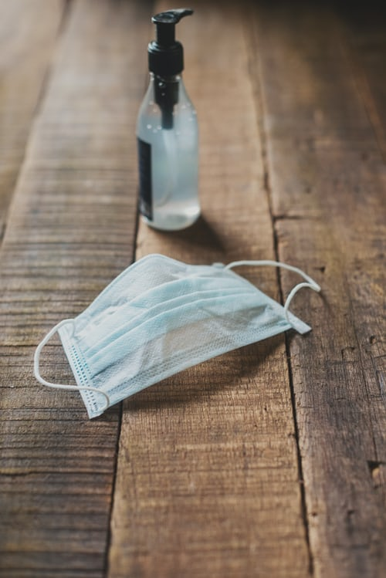
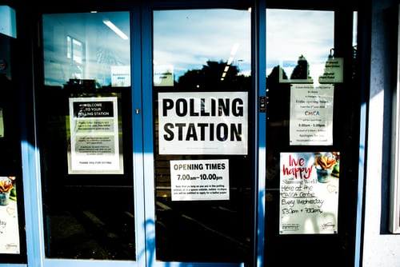
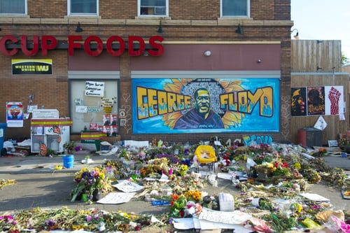
TRAUMA & CURRENT EVENTS

Slide 22
CORONAVIRUS/COVID-19
Illness/hospitalization inc. lingering symptoms
Loss of life
Isolation / limited or no contact with loved ones
Loss of jobs
Working & learning remotely
Closing of businesses
Financial uncertainty & distress
Social distancing
Postponement &/or cancellation of major events (concerts, weddings, conferences, graduations, funerals)

Slide 23
COVID-19 in 2021
Highs & lows
Decrease in hospitalizations & deaths vs. 2020
Spikes after major events (e.g. Spring Break)
Signs of returning back to “normal” (businesses opening back up, some people returning back to work/office and school)
New variant strains of the virus
Multiple vaccines have been created
Vaccine hesitancy for various reasons inc. historical trauma

Slide 24
HISTORICAL TRAUMA
The cumulative emotional and psychological wound-ing, as a result of group traumatic experiences, transmitted across generations within a community.
Often associated with racial & ethnic population groups in the US who have suffered major intergenerational losses/trauma and assaults on their culture and well-being.
E.g. Tuskegee Syphilis Experiment (often linked to vaccine hesitancy)
-SAMHSA, 2016; Yehuda et al., 2016

Slide 25
RACIAL TRAUMA
Traumatic events that occur as a result of witnessing or experiencing racism, discrimination, or structural prejudice (also known as institutional racism) can have a profound impact on the mental health of individuals exposed to these events.
Racial trauma (also known as race-based traumatic stress) refers to the stressful impact or emotional pain of one’s experience with racism and discrimination (Carter, 2007).
E.g. Recent spate of attacks against Asians

Slide 27
INCORPORATING A TRAUMA-INFORMED APPROACH (TIA) INTO YOUR WORK WITH YOUTH

Slide 28
As we know now, many young people have experienced or live with trauma. In particular, LGBTQ youth, youth in the foster care or juvenile justice system, young people of color and young people living in poverty are more likely to experience trauma.

Slide 29
A trauma-informed approach can help create a greater sense of safety and empowerment among participants, allowing them to be more open to learning the information you are there to share, and avoid possible re-traumatization.

Slide 30
Incorporating a TIA in In-Person EBPs
Make sure you discuss with the teacher or site coordinator what the process is for students who need to excuse themselves.
Prior to starting the program, know what support services are available to students.
If going into a school, let the guidance/counseling office know you’re starting programming soon, in case they see an increase in visits to their offices.

Slide 31
Incorporating a TIA in In-Person EBPs
Is the space itself welcoming? What is the “emotional temperature” in the room? Does it feel open or confined?
If school policy allows, explain that if someone gets uncomfortable, they can leave the room to take care of their needs.
Notes:
Do the images in the room reflect the group you are working with and express inclusivity? (e.g. a rainbow flag, positive images of youth of diverse backgrounds)

Slide 32
Incorporating TIA in In-Person & Virtual Programs
Mention at the start of the program that this can be sensitive information, or even stressful for some people.
Give participants to option to participate or opt-out, that includes whether to show their video or not.
Does the language being used feel safe & empowering for all participants? Is it inclusive?
Notes:
For example, using binary and heteronormative terms can make a young person feel as though this is yet another place they are not welcome or seen. Consider changing “boy/girlfriend” to “partner” and “male/female” to “person with a penis or person with a vagina.” (Cultural & Gender)
Is the language being used empowering? When talking about the “responsibilities of choosing to have sex,” are you also affirming that we know many young people have sexual experiences that are not a choice?

Slide 33
Incorporating TIA in Virtual Programs
Re-establishing/re-creating group agreements developed by the youth (safety, empowerment)
Start sessions with a light check-in e.g. 1-10 check-in (safety, empowerment)
Routines – Provide consistent programs that youth can participate in to create a sense of normalcy. (Trustworthiness)
Give youth the option to participate or opt-out of an activity or a full session (choice)

Slide 34
Incorporating TIA in Virtual Programs
Ask youth what topics they would like to discuss & how they’d like to cover it (choice, empowerment)
Provide opportunities for youth to work together e.g. sharing their feelings about a topic or developing online content. Breakout rooms, if allowed, can be helpful to do this (collaboration, empowerment)
Discuss current events and how it’s impacting them, their peers and their families e.g. racial injustice, COVID-19, etc. (cultural, historical, gender considerations, empowerment)
Allow participants to self-identify e.g. pronouns & name used during the session (choice, cultural/gender considerations, empowerment)

Slide 35
Anything Else?
How can or have you incorporated a TIA in your work with youth ---either in person or in your virtual programs?

Slide 36
Light Within the Darkness

Slide 37
RESOURCES & REFERENCES
A Guide to Toxic Stress: https://developingchild.harvard.edu/guide/a-guide-to-toxic-stress/
CDC Violence Prevention: https://www.cdc.gov/violenceprevention/aces/
Anti-Racism Guide for Kids: An Age-by-Age Guide to Fighting Hate: https://www.parents.com/parenting/better-parenting/advice/how-to-teach-your-kids-to-fight-hate-an-age-by-age-guide
Turnaround USA/Resilience: https://turnaroundusa.org/resources-three-rs/
ACF: What is Historical Trauma: https://www.acf.hhs.gov/trauma-toolkit/trauma-concept
National Child Traumatic Stress Network: https://www.nctsn.org/resources/all-nctsn-resources
7 Surprising Classroom Triggers for Kids Who experience Trauma: https://www.weareteachers.com/classroom-trauma-triggers/

Slide 38
RESOURCES & REFERENCES
Addressing Race and Trauma in the Classroom - https://www.nctsn.org/sites/default/files/resources/addressing_race_and_trauma_in_the_classroom_educators.pdf
Trauma-Informed School Strategies During COVID-19 - https://www.nctsn.org/resources/trauma-informed-school-strategies-during-covid-19?utm_source=ebulletin&utm_medium=email&utm_campaign=nctsn-ebulletin
Keeping Yourself & Your Kids Safe and Healthy in the Pandemic: Tips for Judges, Legal Professionals & Court Personnel - https://www.nctsn.org/resources/keeping-yourself-and-your-kids-safe-and-healthy-in-the-pandemic-tips-for-judges-legal-professionals-and-court-personnel?utm_source=ebulletin&utm_medium=email&utm_campaign=nctsn-ebulletin
The Impact of COVID-19 on Child Sex and Labor Trafficking - https://www.nctsn.org/resources/the-impact-of-covid-19-on-child-sex-and-labor-trafficking?utm_source=ebulletin&utm_medium=email&utm_campaign=nctsn-ebulletin

Slide 39
RESOURCES & REFERENCES
Implementing a Trauma-Informed Approach for Youth Across Service Sectors - https://youth.gov/docs/Trauma_Informed_Approach_508.pdf
Culturally-Responsive Approaches to Serve Latin American Children Who Experience Traumatic Separation - https://www.nctsn.org/resources/culturally-responsive-approaches-to-serve-latin-american-children-who-experience-traumatic-separation?utm_source=ebulletin&utm_medium=email&utm_campaign=nctsn-ebulletin
Children and Domestic Violence for Parents Fact Sheet Series in Spanish - https://www.nctsn.org/resources/children-and-domestic-violence-how-does-domestic-violence-affect-children-sp
Investigating the Association Between Posttraumatic Risky Behavior and Offending in Adolescents Involved in the Juvenile Justice System - https://link.springer.com/article/10.1007/s10964-019-01120-0

Slide 40
RESOURCES & REFERENCES
https://www.ihollaback.org/harassmenttraining - dates for future trainings
https://www.ihollaback.org/resources
https://www.advancingjustice-aajc.org
https://www.standagainsthatred.org
https://iheartmob.org

Slide 41
The Germ That Wears a Crown: A Story about the Coronavirus (e-book for children in English, Creole & Spanish)
http://fsustress.org/GermCrown/GermCrown.html
After the Harvest: A Story about saying goodbye (e-book for children)
http://fsustress.org/AfterTheHarvest/AfterTheHarvest.html

Slide 42
ACT for Youth Site:
www.actforyouth.net

Slide 43
Any questions?
You can reach me at:
ML782@cornell.edu
Michele Luc

