Slide 1
SRAE
Picture the Possibilities
Role Playing & Vision Boarding
Alexandra Smith, Daryl Turmon, Yolanda Briu, & Kathy Perez

Slide 2
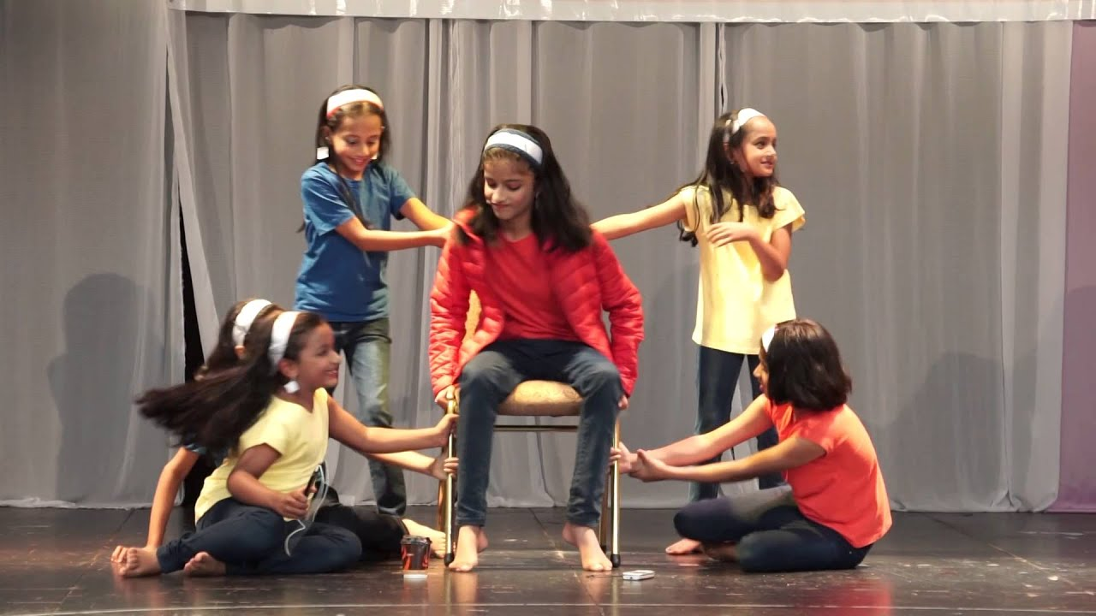
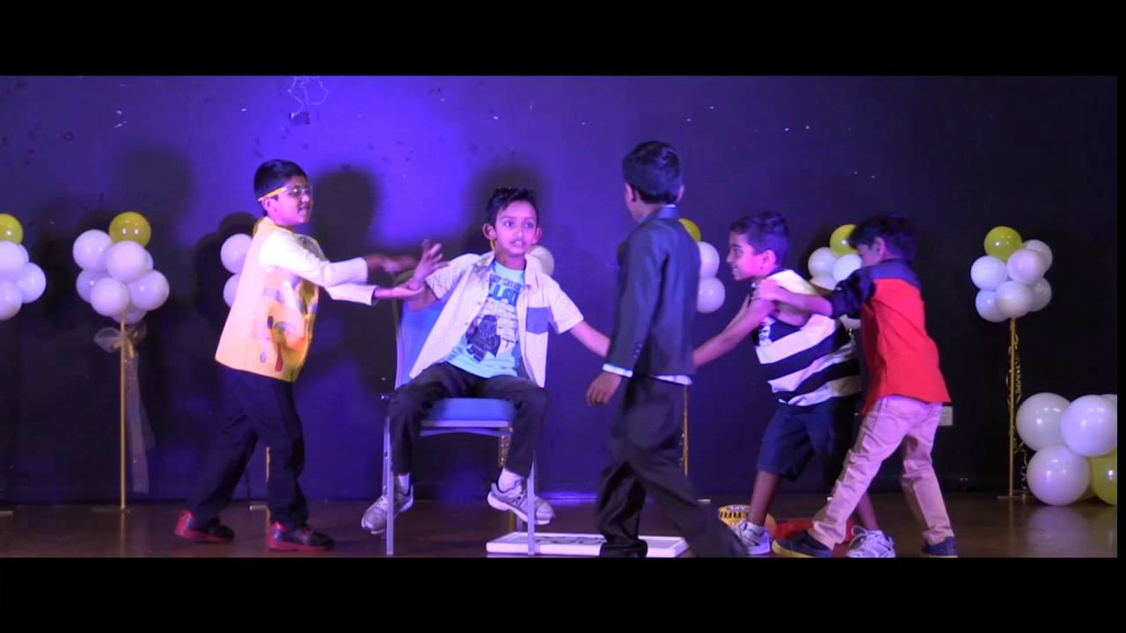
Role Playing

Slide 3
Introducing and Implementing the Activity
Facilitators will introduce the lesson
Ask the group what their understanding is about bullying
Ask the group what they know about role playing
Explain role playing
Introduce the activity
Show the students an example of role playing with your co-facilitators
Give students time for questions
The students will be divided into groups
They will have the opportunity to select their scenarios out of a bag
Students will choose their roles and practice with the assistance of the facilitators
Students will present their scenarios in front of their peers
Students will have the opportunity to come together as a group and have a discussion about the scenarios with their peers
Facilitators will explore with the students the systems of support that are available to them

Slide 4
Example of a Bullying Scenario
A new student started at your school this week, and he is having trouble fitting in. Some of your friends have been laughing behind his back.
What would you do in this situation?

Slide 5
Discussion & Questions
Facilitators and students will talk about the various approaches that were taken to address the bullying scenarios

Slide 6
Discussion & Questions Continuation:
Support Systems
Facilitators will validate the students responses to their support system
In addition, facilitators will provide students with additional options of support
Students will be provided with a hand cut-out to identify their 5 go-to support people that can assist them in situations where they may require help

Slide 7
Vision Boarding

Slide 8
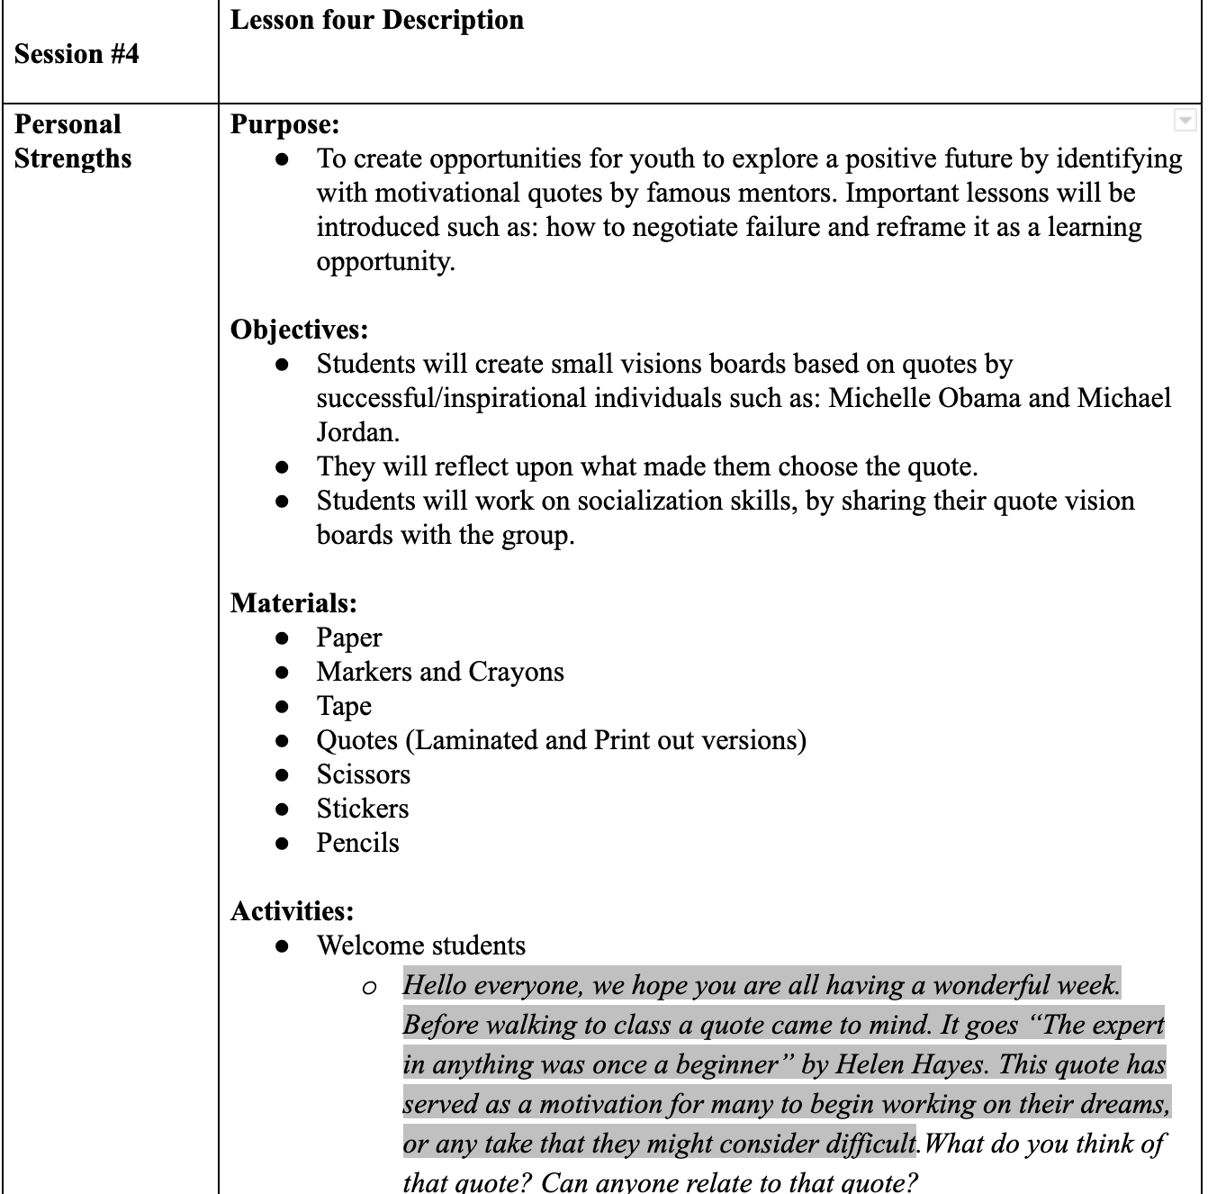
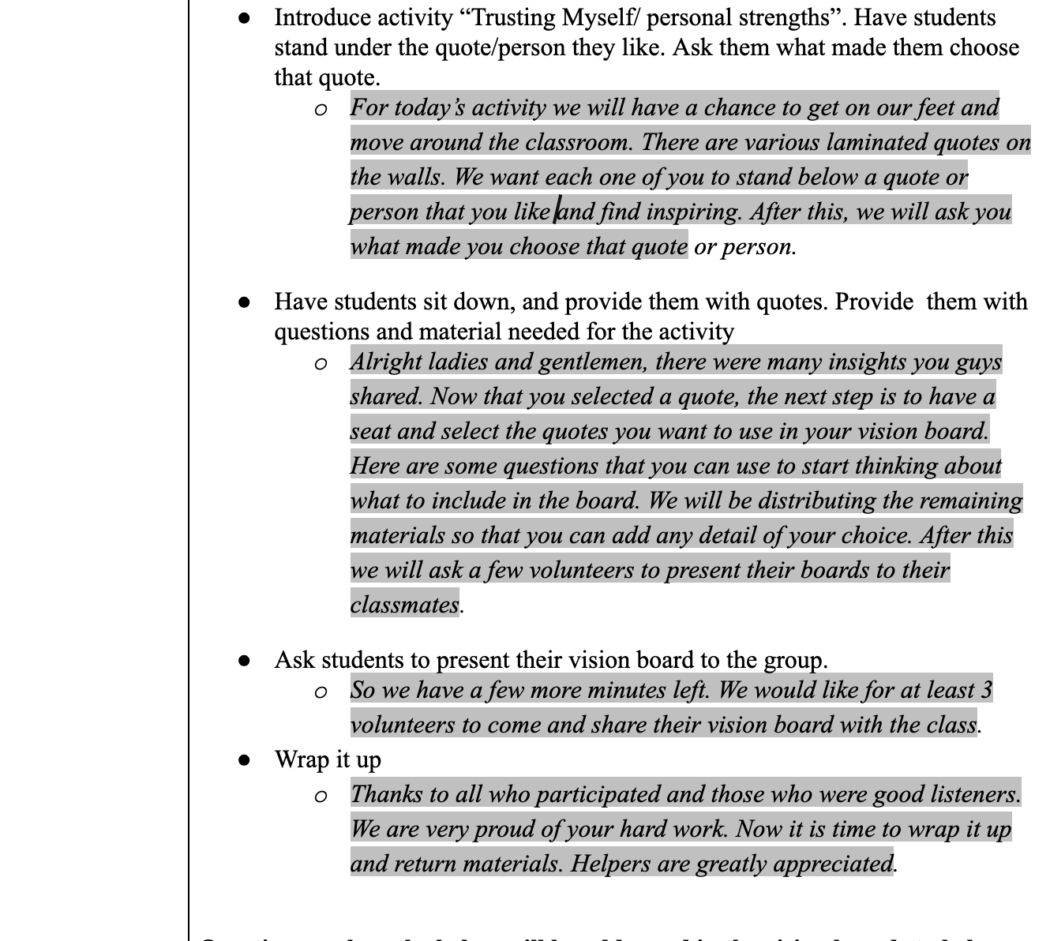

Slide 9
Continued...

Slide 10
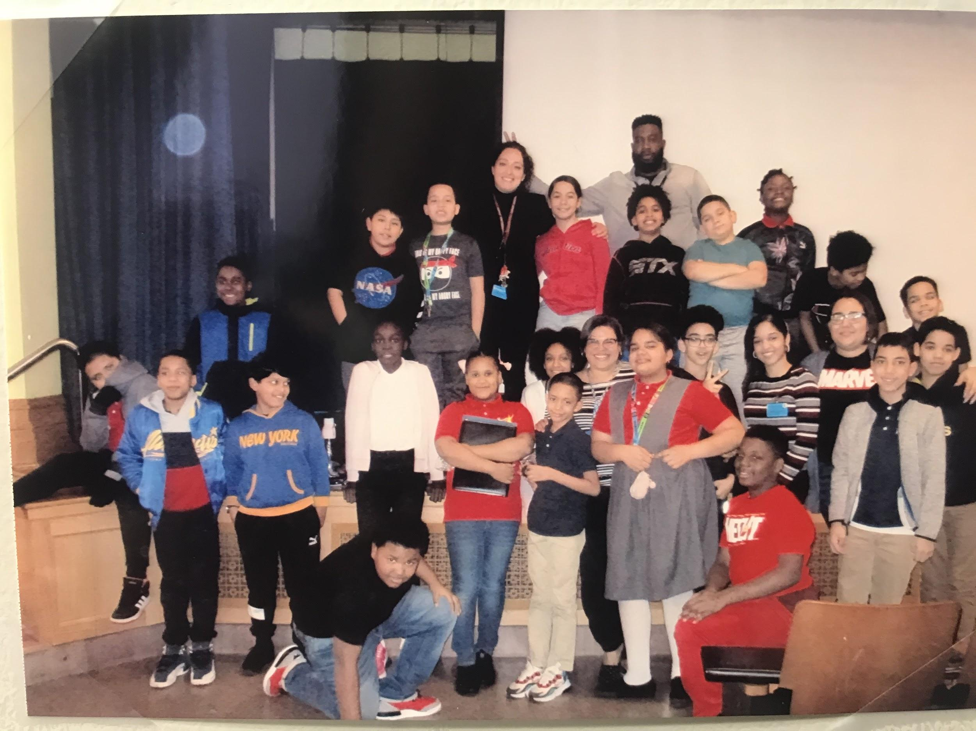
Thank you for giving us your attention and the time to share our work with you all!
We are looking forward to hearing your suggestions and feedback 😊

