Slide 1
Virtual Tools For Real People ACT for Youth 2/25/21

Slide 2
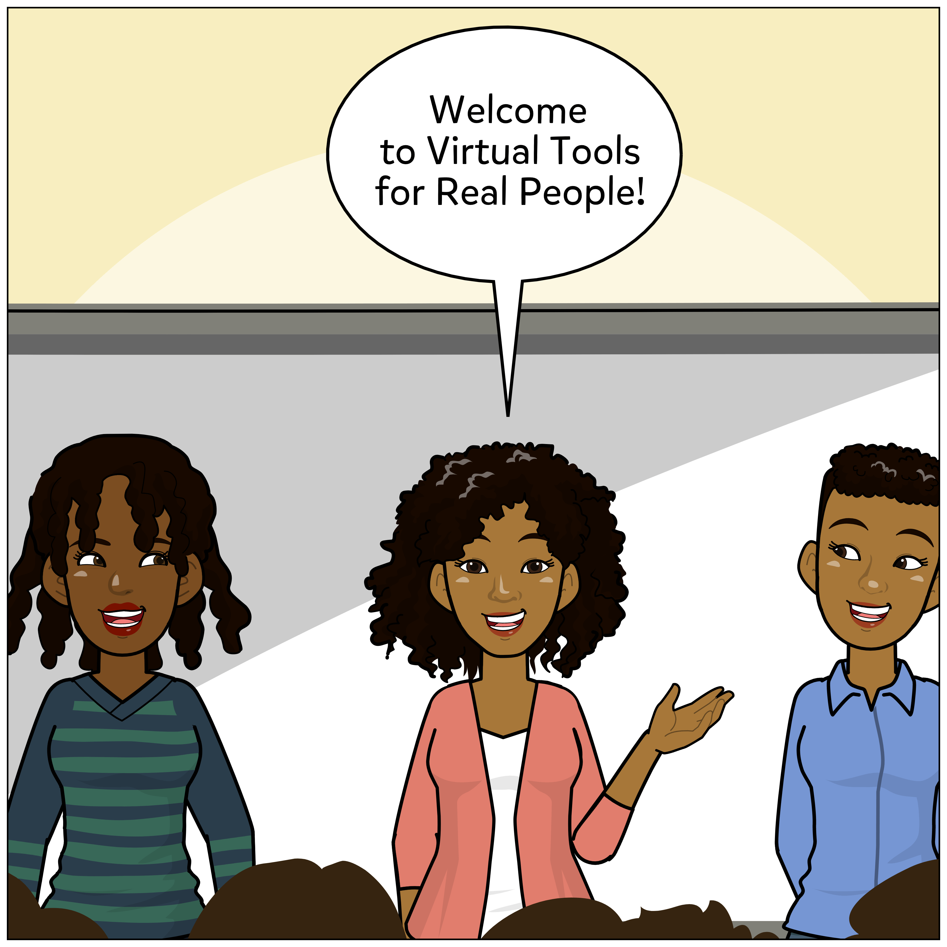

Slide 3
Zoom Keeping
Audio:
Mute when not speaking
Comments & Questions? Use the Chat Box Responsibly
Delays?
Close other browsers
Recording will be available on the ACT site
Participation:
Be willing to SHARE
Ask questions
Use full name name
Notes:
Audio: You have control, but we may mute as well on our end if we hear background noise.
Delays: I will be sharing slides and screens and animated content, so closing other browsers will help
Chat Box: Lots of people, so lessen the side talk when possible or send direct messages
Participation: using your full name helps us keep track of attendance.

Slide 4
Check-In Question: You’re a burglar, but you only steal things to slightly inconvenience your victims. What are you stealing?
Notes:
In the chat

Slide 5
Agenda
Top 100 in workplace and education
Mentimeter~Leonor Perea, NYU Lutheran Family Health Centers
BINGO, Slides and Pixton ...oh my!
Group Work
Notes:
These are all tools suggested by educators or used by us.
We will offer a part 2 next month

Slide 6
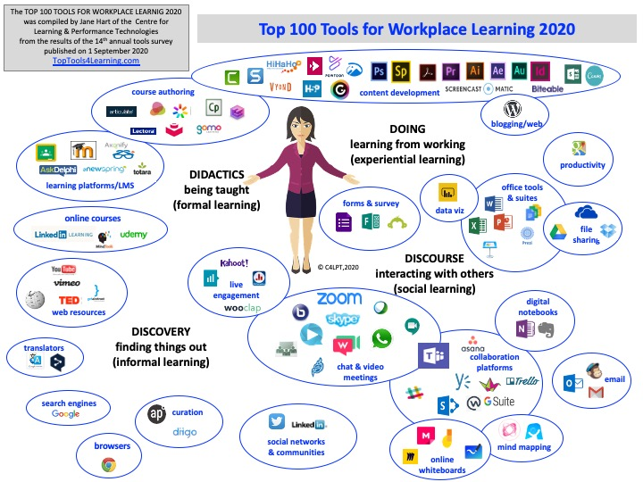
Notes:
Added this because if you are in the education department or known for your facilitation, you may be the Go to person/people/team when it comes to the rest of the organization.
Also, we at ACT are always trying to remember that adult education is different than youth education.

Slide 7
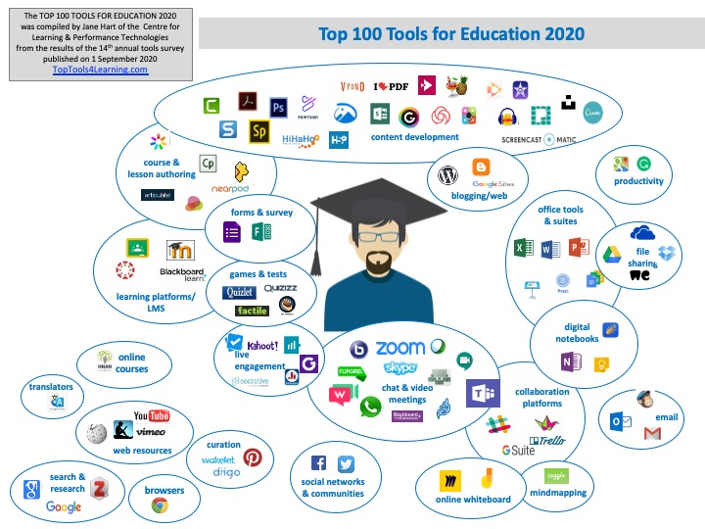
Notes:
Count how many you are familiar with and share your number in the chat.

Slide 8
Leonor Perea
NYU Lutheran Family Health Centers
Mentimeter
Notes:
We have Leonor with us to share Mentimeter

Slide 9
BINGO!
Notes:
https://myfreebingocards.com/
Only up to 30 free
Can do educational Questions as well (if it’s on your card, you can answer for points)

Slide 10
Slides
Notes:
https://www.slidescarnival.com/
https://slidesgo.com/

Slide 11
Pixton
Notes:
How to: https://www.youtube.com/watch?v=QuL6vsI0HyQ&feature=youtu.be

Slide 12
Small group work
1 person record and report back
What are some other tools you’ve found useful?
What tools do you wish existed?
Notes:
Take a picture
Remember your group #

Slide 13
Tips for tools
Consider a “dummy” email
Time
Practice
Patience
Share the load
*And if working with school, make sure the tool isn’t on the “no” list.
Notes:
If you want yourself or your staff to become better and more capable of using these tools, there needs to be time to explore.
Practice, practice, practice! With friends and family as well as coworkers!
Be patient with yourself
If you are on a team of people, have each take on a different tool

Slide 14
Resources
https://www.toptools4learning.com/
Lists 200 tools and platforms most regularly used w/ links to each
https://www.mentimeter.com/
https://myfreebingocards.com/
https://www.slidescarnival.com
https://slidesgo.com
https://www.pixton.com/

Slide 15
THANK YOU!

Slide 16
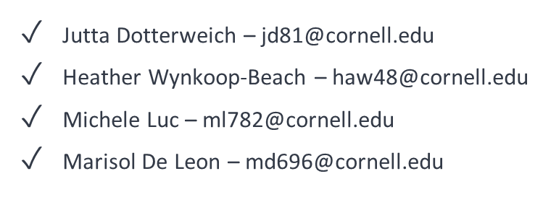
ACT Training Team

