Slide 1
Understanding Trauma and Its Impact
CAPP, PREP and SRAE Webinar
April 14, 2021

Slide 2
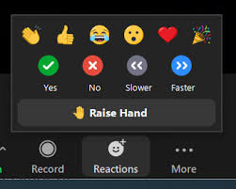
Zoom Keeping/Netiquette
Audio:
Mute when not speaking
Recording will be available on the ACT site
Delays?
Open other browsers
Participation;
- Zoom reaction features →
- If using cell or somebody else’s link, “rename yourself”

Slide 3
Agenda
01
02
03
04
05
06
Defining Trauma, Toxic Stress and its Impact
Checking in
ACEs Studies
How about Resiliency?
Things we can do
References & Resources

Slide 4
Checking-in
When you feel stressed, what do you do to relax and calm down?

Slide 5
Self Care
Do what you need to do to take care of yourself and be fully present during this session.
This Photo by Unknown Author is licensed under CC BY-SA

Slide 6
Defining Trauma
Trauma results from an event, series of events, or set of circumstances that is experienced by an individual as physically or emotionally harmful or life threatening and that has lasting adverse effects on the individual’s functioning and mental, physical, social, emotional or spiritual well-being.
SAMHSA 2014

Slide 7
Trauma can be caused by
Acute Events
Chronic Situations
Assault
School shootings
Accidents
Loss of a loved one
Separations/divorce
Natural disasters
War
Abuse and neglect
Domestic violence
Harassment/bullying
Violent neighborhoods
Vicarious traumatization
COVID-19 creates multiple trauma events

Slide 8
It is important to keep in mind…
It is not just the event, but how the individual experiences it and how they react to it.

Slide 9
Stress Response
Increased
Decreased
Fight, flight, freeze response
Hypervigilance, arousal, paranoia
Perceptual and information processing distortions
Pain tolerance
Emotional blunting
Aggression and irritability
Memory processing and retrieval
Reality testing
Body and emotional awareness
Immune response

Slide 10
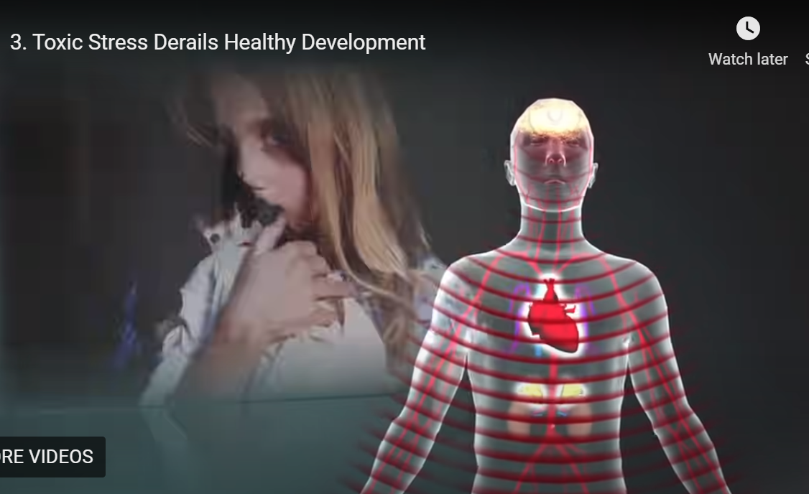
https://developingchild.harvard.edu/science/key-concepts/toxic-stress/

Slide 11
https://developingchild.harvard.edu/guide/a-guide-to-toxic-stress/

Slide 12
Re-Traumatization A situation, attitude, interaction, or environment that replicates the events or dynamics of the original trauma and triggers the overwhelming feelings and reactions associated with them.

Slide 13
Post Traumatic Stress Disorder (PTSD)
Symptoms last longer than a month after event
Intrusive re-experiencing of the trauma, avoiding trauma reminders*, and persistent state of alert
Related emotional and behavioral problems
Co-occurs with other disorders (anxiety, ADHD, oppositional defiant disorder, etc.)
Symptoms vary according to developmental stages
Estimated prevalence: 3.5% of adults, less for children and youth
*Triggers

Slide 14
Effects of Trauma
Behavioral Effects | Cognitive Effects | Social Effects
- Risk taking - Acting out - Rule breaking | Attention Memory Executive functions Verbal abilities Skills development Language Group work Problem solve Transition | Impulsivity Aggression Deviance Withdrawal Challenged relationships
Notes:
What do they internalize?
People will hurt me
I’m helpless to prevent bad things from happening
I’m defective
I don’t matter
I’m helpless
I’m worthless
I can’t trust anyone
You will hurt me

Slide 15
ACEs Study Kaiser Permante
Investigation into childhood experiences and current health status and behavior
17,337 people were surveyed between 1995 and 1997
About the CDC-Kaiser ACE Study |Violence Prevention|Injury Center|CDC

Slide 16
Participants Demographics
Gender
54% Female
46% Male
Race/Ethnicity
74.8% W
4.5% AA
Age
19-29: 5.3%
30-39: 9.8%
Education
- Not HS: 7.2%
- HS grad: 17.6%
- Some college: 35.9%
- College grad: 39.3%
11.2 H
7.2% AP
2.3% Other
40-49: 18.6%
50-59: 19.9%
60 plus: 46.6%

Slide 17
Adverse Childhood Experiences
Physical abuse by a parent
Emotional abuse by a parent
Sexual abuse by anyone
Growing up with an alcohol and/or drug abuser in the household
Domestic violence
Experiencing the incarceration of a household member
Living with a family member experiencing mental illness
Loss of a parent
Emotional neglect
Physical neglect

Slide 18
How common are ACEs?
Adverse Childhood Experiences Resources |Violence Prevention|Injury Center|CDC

Slide 19
https://www.cdc.gov/violenceprevention/childabuseandneglect/acestudy/ace-brfss.html

Slide 20
Prevalence
NCTSN & SAMHSA (2015)
Copeland et al (2007)

Slide 21
Impact of ACEs
https://www.cdc.gov/violenceprevention/childabuseandneglect/acestudy/ace-graphics.html

Slide 22
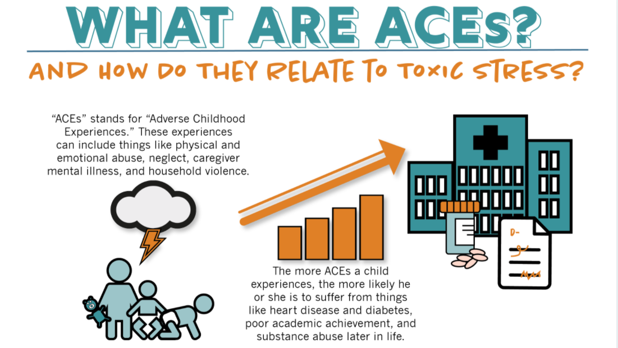
https://developingchild.harvard.edu/resources/aces-and-toxic-stress-frequently-asked-questions/

Slide 23
Work Related Trauma and Stress
Burnout
Vicarious Trauma
Secondary Traumatic
Stress
Compassion Fatigue
{ACT Self Care Webinar – Jan 2021}

Slide 24
How about Resiliency?

Slide 25
Werner & Smith: Classic Resiliency Study
Longitudinal study
698 infants born in 1955
Kauai, Hawaii
Children followed up at ages 1, 2, 10, 18, 32, & 40
One third of sample exposed to at least 4 familial risk factors before age 2.
Poverty
Perinatal health problems
Congenital handicaps
Low parent education
Familial alcoholism
Violence
Instability/discord
Mental Illness

Slide 26
Nurturing Resiliencies
Internal Protective Factors
External Protective Factors
Social Competence
Problem Solving Skills
Autonomy
Sense of purpose, belief in a bright future
Caring Relationships
High Expectations
Opportunities for participation

Slide 27
Strategies
Strategy 1
Strategy 3
Strategy 2
Strategy 4
Provide opportunities to strengthen adaptive skills and self-regulatory capacities
Facilitate supportive adult-child relationships
Build a sense of self-efficacy and perceived control
Mobilize sources of faith, hope, and cultural traditions
Notes:
facilitating supportive adult-child relationships;
building a sense of self-efficacy and perceived control;
providing opportunities to strengthen adaptive skills and self-regulatory capacities; and
mobilizing sources of faith, hope, and cultural traditions.

Slide 28
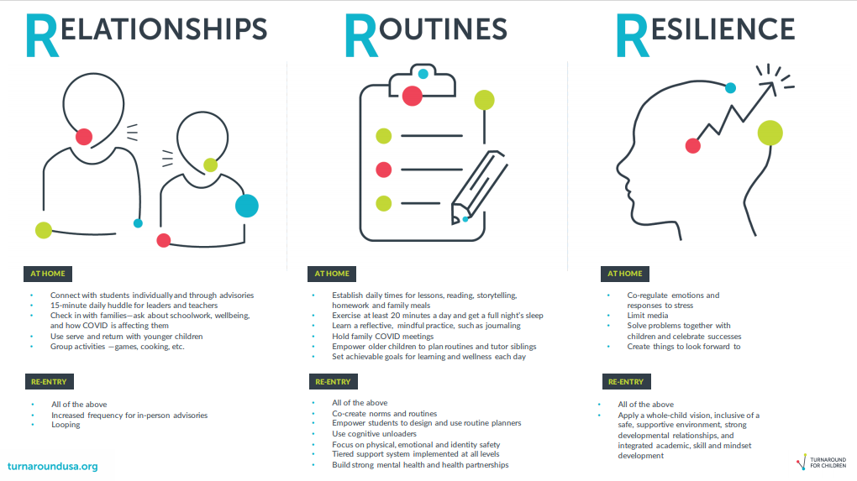
Resources For The New Three Rs: Relationships, Routines and Resilience | Turnaround for Children (turnaroundusa.org)

Slide 29
Build SEL Competencies
Manage emotions
and behaviors
to achieve
one’s goals
Recognize one’s emotions,
values, strengths, and
limitations
Show
understanding
and empathy for
others
Make ethical,
constructive choices
about personal and
social behavior
Form positive relationships, work in teams, deal effectively with conflict
www.Casel.org

Slide 30
Source: Transforming Education: Trauma-Informed SEL Toolkit
https://www.transformingeducation.org/trauma-informed-sel-toolkit/

Slide 31
Any Takeaways?
Questions?

Slide 32
Next Trainings
April 22: Re-Visiting the Guiding Principles of a Trauma- Informed Approach
May 18-21: Provider Meeting – Keynote by Dr. Felitti

Slide 33
References
CDC: Adverse Childhood Experiences Study http://www.cdc.gov/violenceprevention/acestudy/
Copeland, W. E., Keeler, G., Angold, A., & Costello, E. J. (2007). Traumatic events and posttraumatic stress in childhood. Archives of General Psychiatry, 64(5), 577-584.
NCTSN & SAMHSA (2015). Understanding Child Trauma. Retrieved from https://www.samhsa.gov/sites/default/files/programs_campaigns/nctsi/nctsi-infographic-full.pdf
Substance Abuse and Mental Health Services Administration (2014). SAMHSA’s concept of trauma and guidance for a trauma-informed approach. https://store.samhsa.gov/sites/default/files/d7/priv/sma14-4884.pdf
Werner, Emmy & Smith, Ruth. 1992. Overcoming the Odds: High Risk Children from Birth to Adulthood. Cornell University Press. New York
Transforming Education: Trauma-Informed SEL Toolkit https://www.transformingeducation.org/trauma-informed-sel-toolkit/

Slide 34
References/Resources
Center for the Developing Child. Harvard University. A Guide to Toxic Stress A Guide to Toxic Stress - Center on the Developing Child at Harvard University
The National Child Traumatic Stress Network (NCTSN) www.nctsnet.org
CASEL COVID-19 Resources Covid- 19 SEL Resources (casel.org)
Child Mind Institute Child Mind Institute | Transforming Children's Lives.
Act for Youth: Trauma Informed Approach http://www.actforyouth.net/sexual_health/community/capp/trauma.cfm
ACT for Youth: Social and Emotional Learning Toolkit http://www.actforyouth.net/youth_development/professionals/sel/
ACT for Youth: Creating Inclusive Program Environments for Youth with Different Abilities http://www.actforyouth.net/youth_development/professionals/inclusive-environments.cfm

Slide 35
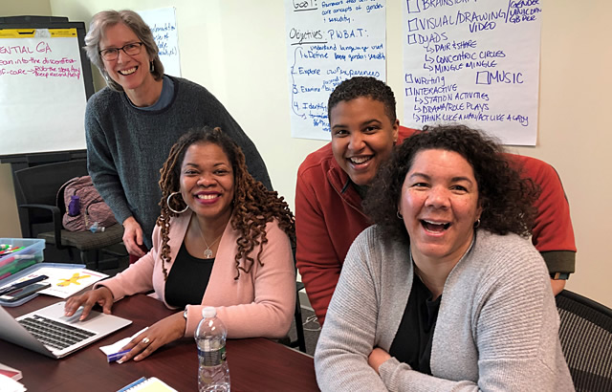
Questions? Thank You!

Slide 36
THANKS
Do you have any questions?
addyouremail@freepik.com
+91 620 421 838
yourcompany.com
Please keep this slide for attribution

