Slide 1
Positive Youth Development V: Youth Work Ethics
ACT for Youth June 22, 2021

Slide 2
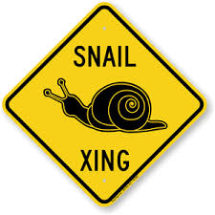
Zoom keeping
Audio.
You control the volume. Please mute yourself during the presentation.
Experiencing delays?
Try closing out the other
programs running on your
computer
Questions?
Use chat function. Post to Everyone.

Slide 3
Agenda
Recap – What is Positive Youth Development?
Youth work – a profession?
Competencies and professional development
Youth work ethics
Resources and questions

Slide 4
Recap: Positive Youth Development
A philosophy or approach that guides communities in the way they organize programs, supports and opportunities so that young people can develop to their full potential.
Focus on building positive outcomes
Youth voice and engagement
Long-term involvement/Developmentally appropriate
Universal/Inclusive
Community-based/Collaborative
Notes:
Recap: We define positive youth development as an approach or philosophy that guides communities in the way they organize services, supports, and opportunities so that all young people can develop to their full potential. There are several key, research‐based principles underlying this approach:
• Focus on positive outcomes: We shift from preventing or fixing problems to creating positive outcomes such as competencies, connections and caring relationships, positive values and expectations, and meaningful participation. This also means that we use a strength‐based approach.
• Youth voice/engagement: We work with young people, not for them. We engage young people as partners, create youth‐adult partnerships, and listen to their expertise and perspective. This usually requires that we as adults become aware of and control the negative assumptions and stereotypes we might have of young people.
• Long‐term, developmentally appropriate involvement: As a community we have to support young people throughout their development – about 20 years – while adjusting to their changing developmental needs. Twelve year olds need different support and opportunities than 16 year olds. We also know that young people need extended exposure to programs and supportive adults to thrive; short‐term programs and opportunities are not as effective.
• Universal/inclusive: As a community we need to provide support and opportunities to all young people, not just to the high risk, targeted groups or the high achieving group. This does not mean, however, that we cannot provide additional support to young people who face extra challenges. In addition, research tells us that universal strategies are often very effective for high risk or high need youth.
• Community‐based/collaborative: As we discussed earlier, young people are interacting with a variety of social environments. For a positive youth development approach to succeed, non‐traditional community sectors such as businesses, faith communities, or civic organizations need to be involved. And this implies that we have to work together collaboratively.

Slide 5
Youth Work – An Unchartered Profession
Notes:
There is no youth work degree in this country. Other countries such as the UK or Ireland do have professional development tracks for youth workers. In this country people come to youth work from different fields, with different degrees. And they have a range of different titles – child worker, educator, advocate, etc.
We consider any professional working with youth a youth worker.

Slide 6
Youth Work Field is Fragmented
No clear definition & professional degree
No clear professional development curriculum & infrastructure for
development
Range of core competencies
Range of settings (youth ages 5-25 in OST)
Pozzoboni & Kirshner. 2016
Malone & Donahue (eds). 2018
Notes:
As we just mentioned there is no clear definition of youth work nor is there a professional degree. There are few colleges in the country that offer a minor in youth development, or in case of the Greater Plains University (online) a masters in youth development.
There is no clear and accepted professional development curriculum. Advancing Youth Development (AYD) in the early 1990s tried to bridge this gap. It was piloted in 10 states, but it was scaled up across the country.
With the explosion of afterschool programming over the past 20 years we saw a range of core competency frameworks emerging, and we will take a look at those.
One complicating factor is that youth work is happening in a range of different settings with youth spanning a wide age range.

Slide 7
What is a Youth Worker?
Youth workers are “individuals who work with or on behalf of youth to facilitate their personal, social and education development and enable them to gain a voice, influence and place in society as they make the transition from dependence to independence” (Stone, Garza & Borden, 2004)
Notes:
Reflecting on this fragmented landscape of youth work Stone, Garza and Borden developed this definition or description of youth workers:
“individuals who work with or on behalf of youth…” (read definition)
This definition has been well accepted and it distinguishes the role of youth workers from teachers or parents. It is closer to the description of developmental relationships which we discussed in the PYD webinar on positive outcomes.

Slide 8
What does it take to be a youth worker?
Skills Knowledge Characteristics
Notes:
If we understand youth workers to support young people, and facilitate their growth, agency and independence, what do you think youth workers have to bring to the table? What competencies, knowledge and characteristics do they need to have?
Usually, in a in-person training we would ask you – in groups - to draw a youth worker.
The picture is a product of a PYD training.
Please chat in –
What skills or competencies?
What topic areas should know about?
What characteristics, attributes should they have?

Slide 9
Frameworks of Core Competencies
http://www.niost.org/pdf/Core_Competencies_Review_October_2009.pdf
Notes:
With the expanding field of afterschool programming (since 2000) several frameworks for core competencies and professional standards of youth
workers have been developed. This 2009 report from the Next Generation Youth Work Coalition provides a good overview of other core competency models.
This is a resource for you to check out on your own.

Slide 10
Competencies: Content Areas
o Curriculum
o Professionalism
o Connecting with Families
o Health, Safety, and Nutrition
o Child & Adolescent Development
o Cross‐cultural Competence
o Guidance
o Professional Development
o Program Management
o Connecting with Communities
o Environment
To be added:
Digital learning
Trauma-informed youth work
Notes:
Here is a list of common competencies mentioned in a range of competency frameworks. It is helpful to youth workers to have skills and knowledge is these areas.
Briefly review the list.
Click:
With the exploding field of digital communication and online learning we should add digital learning and digital literacy – these are important skills to help young people navigate the new digital world.
We also need to add trauma-informed youth work since we have learned that many young people are living with trauma and toxic stress and youth workers need to be aware of impact trauma has on youth, and ways to provide a supportive, safe and inclusive program environment
We added resources for professional development in these areas to the resources list at the end of the presentation.

Slide 11
Ongoing Professional Development
NYS Networks
PASE https://pasesetter.org/
NYS Network for Youth Success https://networkforyouthsuccess.org/
Association of NYS Youth Bureaus https://anysyb.net/
NYS 4-H https://nys4-h.org/
Where do you go?
In-house?
In the community?
Online?
Notes:
Naturally, since we do not have a degree or professional development track in youth work or youth development, we cannot expect new professionals coming into youth work settings to have all these competencies. So where can they go to learn more?
On the slide you see a list of New York State youth networks.
Where else can you go for further professional development?
In-house?
In the community?
Online?
Please chat in …
Summarize: So there are many other local and online sources for professional development. And with continuous changes in our fast moving world we need to be committed to ongoing professional development and learning.

Slide 12
Remember – Adolescents Increasingly Diverse
National Academies of Sciences, Engineering, and Medicine. (2019). The Promise of Adolescence
Diversity Wheel as used at Johns Hopkins University
Notes:
As we have mentioned in earlier PYD webinars the demographics of young people are changing. They are getting increasingly diverse in regards to race and ethnicity, immigrant status, cultural backgrounds, LGBTQ youth, gender identities.
Youth workers have to one-mined to work with diverse youth so it will be helpful to include an exploration of personal biases or stereotypes in professional development efforts.

Slide 13
“Homo Categoricus”
Our mind thinks with the aid of categories
Stereotypes are a consequence or by-product of category making
Group stereotypes are usually not favorable
Stereotypes affect our behavior/ decisions
Banaji, M.R. & Greenwald, A.G. 2013.
Notes:
We all have biases and often we are not even conscious of them.
As we have learned from brain science the human brain makes meaning by organizing information in categories. This enables us to anticipate and predict and thus function in an orderly way.
A byproduct of category making is stereotyping. Group stereotypes in particular are often harmful or negative. All Asians are good in math. Scientists are male…
Stereotypes are based on images in mass media, or reputations passed on by parents, peers and other members of society.
And stereotypes affect our behavior, first impressions and decisions. And because of the fact that our brain most of the time processes and categories on automatic pilot, we are often not aware of them.

Slide 14
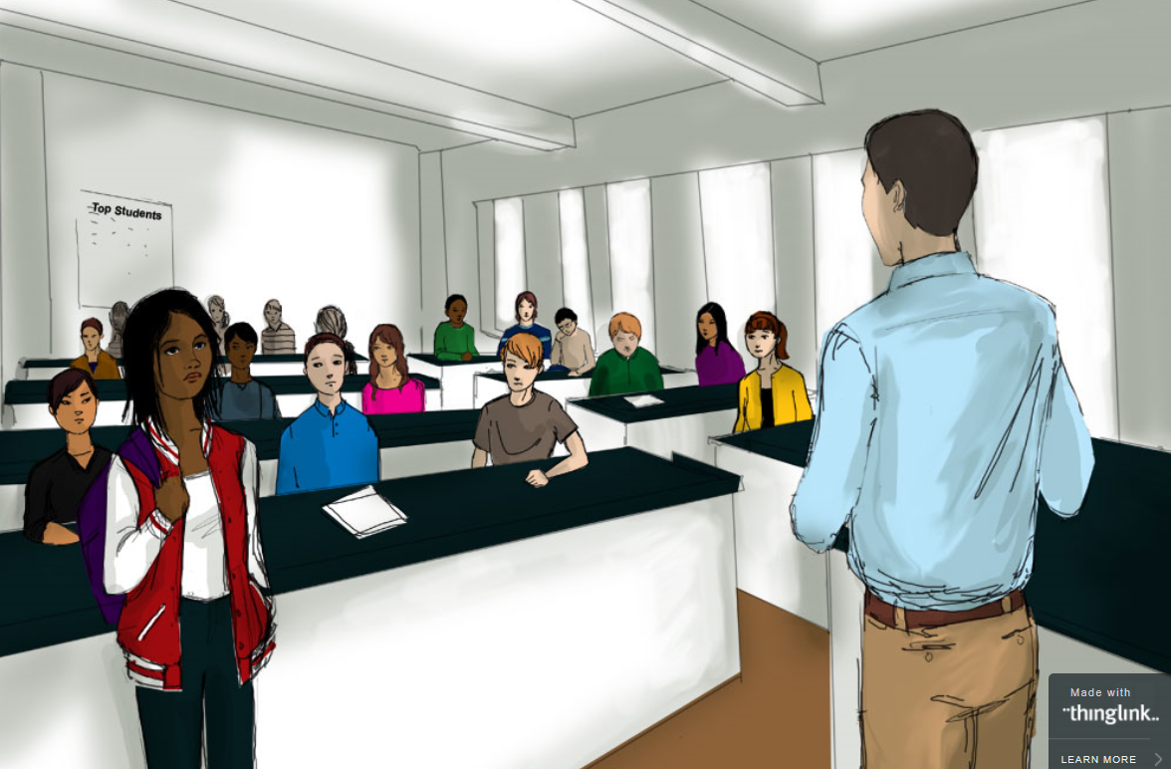
Ways it can impact our work
Microagressions
How else can our biases surface?
https://www.edweek.org/ew/section/multimedia/illustration-microaggressions-in-the-classroom.html
Notes:
Unconscious biases will impact our work. We talked briefly about microagressions – you may remember this picture, web illustration of teacher microaggressions.
Microaggressions are negative often hurtful comments reflecting our biases against a group of people.
How else can our biases interfere with our work?
Chat in

Slide 15
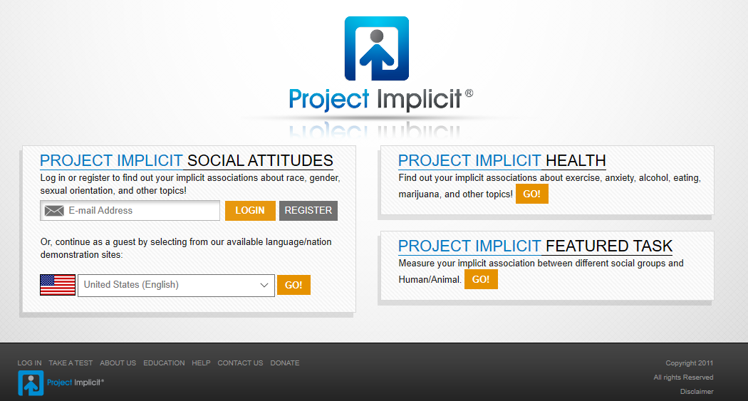
Attitude Check
https://implicit.harvard.edu/implicit/
Notes:
The first step in addressing biases is to become aware of them. Let me introduce you to Project Implicit, an ongoing research project at Harvard University. Millions of people have participated in this project here in the US and all over the world.
You can sign on to the project and check your biases in several dimensions.

Slide 16
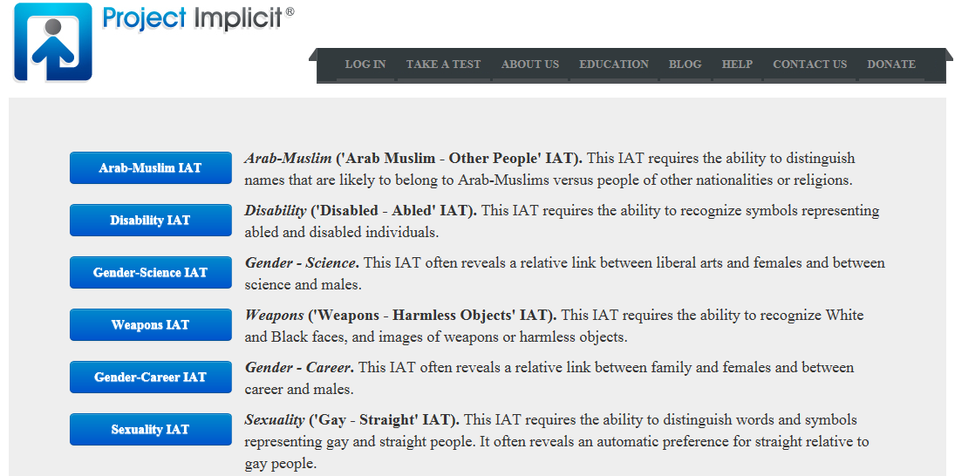
Notes:
Here is a listing of the dimensions you can test yourself – some are about racial/ethnic groups and gender.
Other interesting ones to check are disability, age, sexuality, weight
Briefly review the categories on this slide and the next

Slide 17
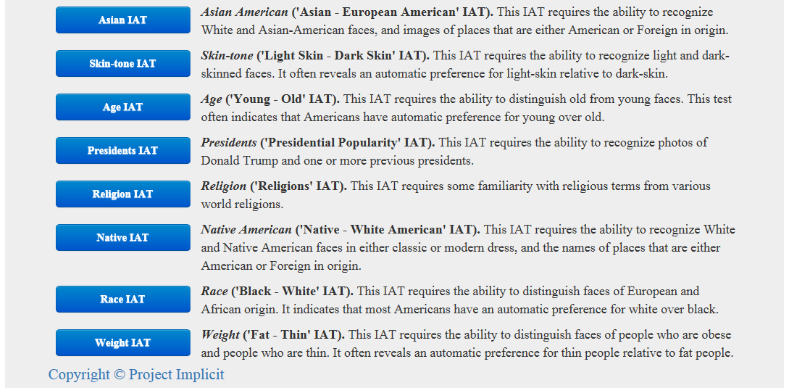
https://implicit.harvard.edu/implicit/selectatest.html
Notes:
Over time some categories have been added or taken down, but many have been there since the beginning in the early 2000s.
The process for doing this attitude check is simple.
You sign onto the website, you register anonymously (some demographics) – you become part of the ongoing research project, part of the data set.
You select the test you want to. They will explain the process. Each test will take only a few minutes. You respond to pictures and adjectives by hitting one of two keys on the keyboard. It’s about reacting immediately, quickly. At the end you’ll receive your score. The rating is done by answers and time taken for answering questions.
I would highly recommend to take several of these tests. It is quite an eye-opener.

Slide 18
Hidden Biases are Robust but also Malleable
Trends
Sexuality IAT: 37% decrease (automatic preference for straight)
Race IAT: 13% decrease (automatic preference for white)
Slight decrease: gender and science IAT (automatic preference for men in science)
Increase: body weight IAT (automatic preference for thin people)
Notes:
Drawing from the Project Implicit Attitude data sets (available online) we have learned that biases are very robust, not easy to change but they can be changed.
Here are a few trends observed:
There has been decrease in the sexuality attitude test; 37% decrease of people expressing a preference for straight over gay
The race IAT also improved; a decrease of 13% of people preferring white over black
A negative trend:
There has been an increase in the weight IAT – more people express a preference for thin over heavy

Slide 19
What can we do as youth work professionals?
Become aware – do the test
Question your decisions/assumptions/first impressions
Be mindful how you engage with young people
Create a sense of belonging in program groups
Build in empathy activities
Assess your program environment/create inclusive environments
Notes:
What can we do?
Becoming aware of your own unconscious biases is the first step. Take one or several of these tests.
Once you are aware of your own biases, question yourself when you make decisions, assumptions or form impressions when interacting with people who are representing the group you have a bias about.
This is really important interaction with young people. Question your preferences, be mindful who you engage with more often, how you feel when you engage with young people…
Be intentional about creating a safe and inclusive program environment, incorporate activities that create a sense of belonging, activities that build empathy and kindness.
Can you think of other strategies?

Slide 20
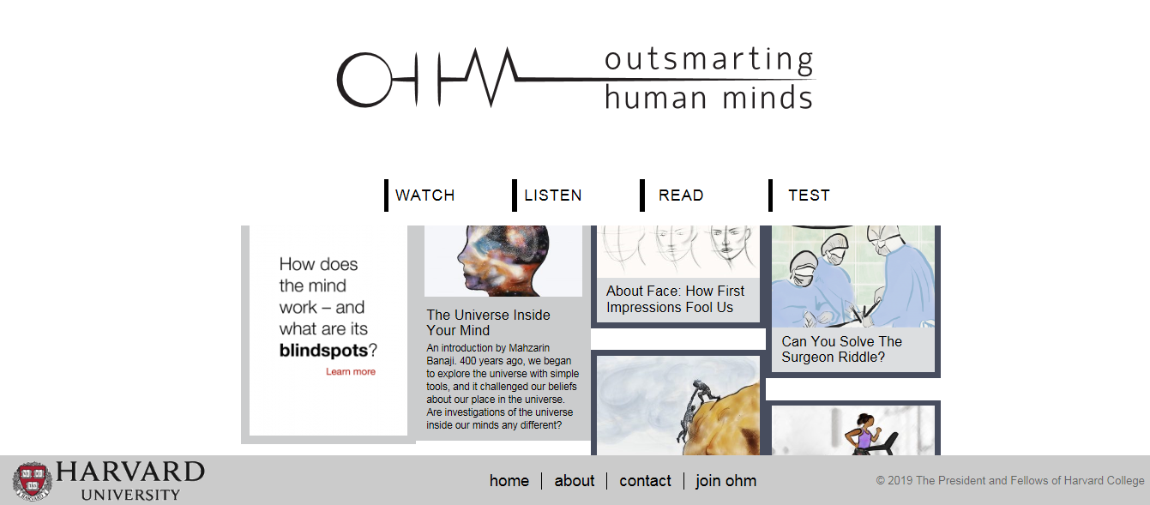
https://outsmartinghumanminds.org/
Notes:
Mahzarin Banaji and her team at Harvard has put together this great website for additional information, research and strategies on countering unconscious biases. This website is well-named: Outsmarting Human Minds.
I highly recommend to spend some time exploring the resources: articles, podcasts, videos etc.

Slide 21
Why talk about youth work ethics?
Notes:
Developing knowledge and competencies is certainly very important for youth work professionals. But it is also important to reflect on professional standards or ethics.
Since we don’t have a professional degree in youth work, we are also missing clear standards and norms. Social workers for example do have clearly defined standards for good social work practice.

Slide 22
Defining Ethics
Principles, norms, and standards of behavior people use to determine what is good or bad, right or wrong in their interactions with other people
Practice ethics – application of ethical standards to problem solving and decision making
Joyce A. Walker et al. 2006. Shaping Ethics: Youth Workers Matter
Notes:
There have been some discussion in the youth work field about this gap. Joyce Walker in Minnesota has down some work on youth work ethics defining it as
Principles, norms, and standards… (read definition)
Youth workers constantly have to make decisions when interacting with youth groups. Just think about young people coming to programming from various backgrounds and settings, bringing with them many stressors and conflicts. Interacting with others may bring many of these issues to the forefront, and youth workers have to be able to problem solve and make good decisions. How do we know if we are making the right decision, take the right approach?

Slide 23
Poll: Boundaries
Sam asks you to borrow $10. He’ll pay you back in a few days.
Jenny is asking you to go with her to the prom.
Shaun invites you to his birthday party.
Trevor asks you for a ride home.
Sara is calling you late at night to talk about problems with her boyfriend.
Nicole wants to befriend you on your personal Facebook account.
Notes:
For example young people’s needs and stressors may lead to conflicts with personal and professional boundaries. Adolescents in particular may look at young youth workers as friends and may push boundaries.
Let’s do a short poll. Here are several situations some of you may have encountered. How would handle each situation? Agree to do what they ask you to do? Or disagree?
Debrief.
Helpful strategies for new people:
Become familiar with agency policies and practices.

Slide 24
Research: Dilemmas of Practice
The Youth Development Experience
113 youth – 661 interviews
25 program leaders – 125 interviews
167 site observations
Resulting in 250 dilemmas
Reed Larson, University of Illinois
www.youthdev.illinois.edu/
Notes:
We discussed that maintaining personal and professional boundaries can make youth work challenging. And why are boundaries constantly pushed? Young people come into the program from many different living situations, bringing with them always‐changing experiences, stressors, and emotions. This can lead
to many dilemmas or situations that require some good decision making and strategizing.
Reed Larson at the University of Illinois has done interesting research in the area of dilemmas of youth work practice. His team interviewed young people and program leaders, and conducted many site observations as well, to identify dilemmas and categories of dilemmas.
They defined dilemmas as challenges or situations that require deliberation on the part of program leaders. Also, there’s not one answer – different leaders respond in different ways to dilemmas. His team identified 250 different dilemmas. This tells us that facing dilemmas is very common. Working with young people requires
constant deliberation about situations, possible outcomes, and next steps.

Slide 25
Categories of Dilemma
Supporting Youth’s Work in Program Activities
Cultivating Norms and Enforcing Rules
Youth’s Personalities and Relationships
Reconciling the Organizational System with Youth Development
Interfacing with External Worlds (ethical, social-cultural)
Notes:
Reed Larson and his team identified several categories of dilemmas.
Supporting youth’s work in program activities. Conflicts arise when young people do not get sufficient support in completing tasks successfully. The underlying tension here is that youth workers are concerned to provide guidance and oversight without undercutting young people’s experience and ownership.
Cultivating norms and enforcing rules. Conflicts arise when group norms, boundaries, and expectations are not clarified and fairly enforced. The underlying tension may be that youth workers want to be youth advocates, not authority figures.
Youth’s personalities and relationships: Young people bring personal dispositions, problems, and interpersonal issues into a program. Conflicts arise from group dynamics and peer relationships as well as young people’s personalities.
Reconciling the organizational system with youth development: Conflicts evolve from policies and practices set by administrators removed from the frontline realities of youth work. Youth workers might not agree with policies or requirements, or they may find themselves dealing with limited and insufficient funding. For example, young people developed a video PSA that uses street language; the agency administration does not approve of the language used.
Interfacing with external worlds: Other dilemmas reflect a conflict between youth program activities and the cultural and real‐world settings young people come from. For example, youth might not be able to consistently attend programming due to family demands (household duties, babysitting, etc.).

Slide 26
Experienced Program Leader Responses
Youth-Centered
Engaged with youth
Turned dilemmas into opportunities for youth’s development
Incorporated youth into the solution
Advocated for youth
Balancing Multiple Considerations
Addressing, accommodating, negotiating, reconciling, integrating
Larson et al. 2009
Notes:
From Larson’s research we learned that experienced programs tend to do better with handling dilemmas which speaks to the importance of experience. Competencies and knowledge are important but experience is critical as well.
Experienced leaders were able to handle dilemmas and resolved by keeping youth engaged and keeping their developmental needs upfront.
They were also able to balance many different considerations and perspectives and able to negotiate solutions.
The takeaways here is that youth workers new to the field need exposure and opportunity to learn from experienced youth program leaders.

Slide 27
http://www.actforyouth.net/youth_development/professionals/competencies.cfm
Notes:
Here is a resource on the ACT website to explore this issue of dilemmas including some tools and strategies.

Slide 28
Self-reflection (reflect on your own values)
Review agency policies on confidentiality, liability, transportation, etc
Discuss scenarios of common dilemmas in staff meetings (& supervision)
Create opportunities to dialogue with colleagues in the community
Moving Forward
Notes:
What have we learned? And how do we move forward?
• Professional competencies and standards are important, but there is more to youth work than having expertise in certain areas.
• We need to expand our competencies by utilizing resources available in our communities. This affects professional development and setting development goals with new youth workers.
• We need to reflect on our own boundaries, and help new youth workers identify boundaries. This means reviewing agency policies and state‐wide regulations concerning rights of young people.
• And we need to be aware of the complexity of program situations and provide opportunities for staff to discuss and learn from dilemmas. This can happen within agencies (in staff meetings and through supervision), but also within youth work networks in the community.
Additional tools and strategies are in the Supervisor’s PYD Toolkit on the ACT website. This is listed in the resources.

Slide 29
Any questions, comments or takeaways?

Slide 30
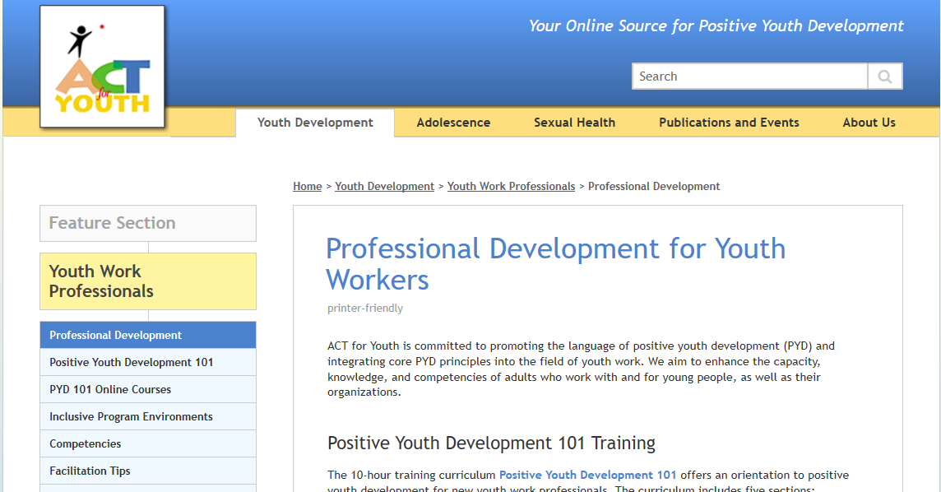
Resources
http://www.actforyouth.net/youth_development/professionals/
Notes:
Open and say that the webinar and the slides will be posted on this page.
Scroll down a bit to PYD Network Webinars.
All the manuals and online courses can be accessed on this page as well.

Slide 31
Resources
Youth Today: OST Hub: Professional Development, Training and Staffing https://youthtoday.org/hub/program-quality/professional-development-training-and-staffing/
University of Minnesota Extension: Center for Youth Development https://extension.umn.edu/working-youth/about-extension-center-youth-development
ACT for Youth: Supervisor’s PYD Toolkit http://www.actforyouth.net/youth_development/professionals/supervisors/
Weikart Center Youth Program Quality http://www.cypq.org/
National Institute on Out-Of-School Time https://www.niost.org/

Slide 32
Resources: Digital Learning
- National Afterschool Association: Tech Toolkit https://naaweb.org/afterschooltechtoolkit
- Common Sense: Education https://www.commonsense.org/education/
- Wide Open School: https://wideopenschool.org/

Slide 33
Resources: Trauma-Informed Approach
- CDC: Adverse Childhood Experiences (ACEs) https://www.cdc.gov/violenceprevention/acestudy/index.html
- ACT for Youth: Using a trauma-informed approach http://www.actforyouth.net/sexual_health/community/capp/trauma.cfm
- Transforming Education: Trauma informed SEL https://www.transformingeducation.org/trauma-informed-sel-toolkit/

Slide 34
References
Stone, B., Garza, P., & Borden, L. (2004, November 16-18). Attracting, developing & retaining youth workers for the next generation. Wingspread Conference Proceedings https://t7-live-cyfar.nyc3.cdn.digitaloceanspaces.com/cyfar.org/files//Stone%202004.pdf
Larson, R. & Walker, K. (2010). Dilemmas of practice: Challenges to program quality encountered by youth program leaders. American Journal of Community Psychology 45, 338-349.
RW Larson, AN Rickman, CM Gibbons, KC Walker. 2009. Practitioner expertise: Creating quality within the daily tumble of events in youth settings New directions for youth development, 2009
Malone & Donahue (eds). 2018. The Growing OUT-OF-SCHOOL TIME Field. Charlotte, NC: Information Age Publishing
Pozzoboni & Kirshner. 2016. The Changing Landscape of Youth Work. Charlotte, NC: Information Age Publishing
Dana Fusco (ed). 2012. Advancing Youth Work. New York: Routledge
Banaji, M.R. & Greenwald, A.G. 2013. Blind Spot. Hidden Biases of Good People. New York: Delacorte Press

