Slide 1
Positive Youth Development IV: Youth development programming
ACT for Youth June 17, 2021

Slide 2
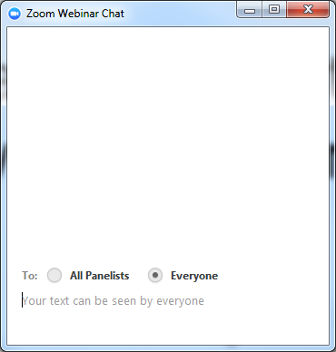
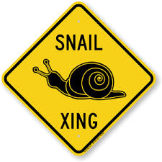
Zoom keeping
Audio.
You control the volume. Please mute yourself during the presentation.
Experiencing delays?
Try closing out the other
programs running on your
computer
Questions?
Use chat function. Post to Everyone.

Slide 3
Agenda
Recap – What is Positive Youth Development?
Effective youth development program settings
Creating safe and inclusive program environments
Promoting youth-centered, active learning
Questions and resources

Slide 4
Recap: Positive Youth Development
A philosophy or approach that guides communities in the way they organize programs, supports and opportunities so that young people can develop to their full potential.
Focus on building positive outcomes
Youth voice and engagement
Long-term involvement/Developmentally appropriate
Universal/Inclusive
Community-based/Collaborative
Notes:
Recap: We define positive youth development as an approach or philosophy that guides communities in the way they organize services, supports, and opportunities so that all young people can develop to their full potential. There are several key, research‐based principles underlying this approach:
• Focus on positive outcomes: We shift from preventing or fixing problems to creating positive outcomes such as competencies, connections and caring relationships, positive values and expectations, and meaningful participation. This also means that we use a strength‐based approach.
• Youth voice/engagement: We work with young people, not for them. We engage young people as partners, create youth‐adult partnerships, and listen to their expertise and perspective. This usually requires that we as adults become aware of and control the negative assumptions and stereotypes we might have of young people. (We call this negative posture “adultism.”) We will focus on youth voice and engagement today.
• Long‐term, developmentally appropriate involvement: As a community we have to support young people throughout their development – about 20 years – while adjusting to their changing developmental needs. Twelve year olds need different support and opportunities than 16 year olds. We also know that young people need extended exposure to programs and supportive adults to thrive; short‐term programs and opportunities are not as effective.
• Universal/inclusive: As a community we need to provide support and opportunities to all young people, not just to the high risk, targeted groups or the high achieving group. This does not mean, however, that we cannot provide additional support to young people who face extra challenges. In addition, research tells us that universal strategies are often very effective for high risk or high need youth.
• Community‐based/collaborative: As we discussed earlier, young people are interacting with a variety of social environments. For a positive youth development approach to succeed, non‐traditional community sectors such as businesses, faith communities, or civic organizations need to be involved. And this implies that we have to work together collaboratively.

Slide 5
Features of Positive Youth Development Settings
Physical and Psychological Safety
Appropriate Structures
Supportive Relationships
Opportunities to Belong
Positive Social Norms
Support for Efficacy and Mattering
Opportunities for Skill Building
Integration of Family, School and Community Efforts
National Research Council (2002)
Notes:
What does the research say about effective youth programming? In 2002, the National Research Council published an important book: “Community Programs to Promote Youth Development.” They reviewed well‐evaluated community‐based programs for young people age 10‐18, programs that had been shown to achieve positive outcomes for youth. Through the review they identified eight features of successful youth development programs. Many of you have probably heard about them. Currently, these eight features serve as a measuring tool or standard for effective programming.
As you can see several of the categories validate the importance of some of the findings we talked about in the previous PYD webinars: caring, supportive relationships, positive social norms, opportunities for meaningful participation (mattering, skill building). It also stresses psychological and physical safety, appropriate structures such as behavior expectations, ways to handle conflict, etc.; opportunities to belong, and being aware and linking to other groups and institutions young people are affiliated with such as families, schools and other community organizations. We will take a closer look at some of these features.

Slide 6
Adolescents Increasingly Diverse
Many youth experience trauma, discrimination and inequities
National Academies of Sciences, Engineering, and Medicine. (2019). The Promise of Adolescence
Diversity Wheel as used at Johns Hopkins University
Notes:
In the previous webinars we have talked about the changing demographics of adolescents. They are increasingly diverse. We also noted that many young people experience or live with trauma, discrimination and inequities. This was not included in the National Research Council rep[ort on the eight features but we will include this here because it has implications for youth programming.

Slide 7
Using a Trauma-Informed Approach
Guiding Principles
Safety
Trustworthiness
Choice
Consider Culture, History, Gender
Collaboration
Empower
ment
SAMHSA 2014
Notes:
Since we are more aware of young people living with trauma, especially now in this pandemic, programs and agencies need to adopt a trauma-informed approach. What does this mean? SAMHSA outlines six guiding principles:
- Safety: Providing a safe environment; checking in with young people to see if they feel safe in your program setting.
- Trustworthiness & Transparency: Being clear and open about the program and your position, how things are done in the agency. Being clear about expectations and program structure.
- Choice & Empowerment: Encouraging young people to take actively participate; giving them choices and building on their strengths.
- Collaboration: Working in partnership.
- Cultural, Historical & Gender issues: Being aware and informed about cultural differences and the history of trauma for special populations (for example, African American and Native American people).
We are introducing this model early in the training because we will build on these principles when we begin to discuss strategies and practices to create inclusive program environments.
How do we integrate these principles in programming?

Slide 8
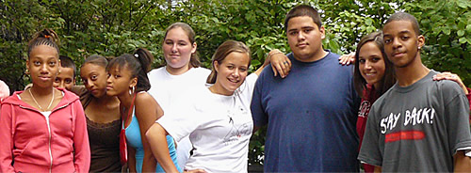
Creating a safe & inclusive program environment - What strategies have you used?
Notes:
Let’s hear from you what you have done to create safe and inclusive program environments?
Please chat it in…

Slide 9
Key Strategies
Group agreements
UDL Guidelines
Transparency and predictability
Promoting belonging
Notes:
We’ll discuss several strategies to create intentionally safe and include program environments
Group agreements – many of you are doing those (may have mentioned them in the brainstorm). This is very good to do – either by writing them down or using pictures as the ones on the screen. The most important aspect is to have young people develop the group agreements.
UDL –which stands for ‘universal design for learning’ may be less familiar to you.
Transparency and predictability is a very important principle of trauma informed care and can be approached in different ways. It may be something you are already doing but may be not intentionally.
Similarly, you may be promoting a sense of belonging in the way you run your program. We’ll talk more about some intentional strategies.

Slide 10
http://www.udlcenter.org/aboutudl/whatisudl
Notes:
First, we will talk about Universal Design for Learning – or UDL – Guidelines. UDL assumes that learners are very diverse. Everybody has different interests, talents, and strengths, and each of us learns in a unique way. UDL promotes using a wide range of modalities to reduce learning barriers and engage all learners.
Open the link
The Universal Design for Learning approach distinguishes between the “what,” the “how,” and the “why” of learning.
- “What” refers to the content or material you want young people to learn. To reach diverse learners we want to present material in many different modalities – written word, spoken word, visuals, music, art, and so forth.
- “How” refers to the strategies young people use to show what they learn, how they engage with the material – write an essay, describe a solution, draw a picture, etc.
And “why” refers to young people’s engagement, interest, and motivation. We build on strengths, optimize choices, and provide feedback and praise to create and sustain motivation.
A key message here is to be very intentional in providing content and information in many different modalities and give young people many different ways to act and engage. Are there any questions?

Slide 11
Transparency & Predictability
What strategies have you used?

Slide 12
Transparent & Predictable
Schedules & Routines
Ease transitions
Room set up
Calm Zone
Notes:
Schedule and Routines: Young people may feel safer and more comfortable if they know what to expect when they come to a program. A schedule and a regular sequence of activities help young people prepare themselves for activities ahead. It also allows them to make choices if the program topics may be too uncomfortable for them. Keeping UDL guidelines in mind – specifically, using different modalities – posting a schedule and timetable is beneficial.
What else can you do to be transparent and up front about programming?
Possible answers: Review the schedule and activities when young people arrive for programming; review schedule and activities for the next program session at the end of program time; generate a schedule and write it down on newsprint at the beginning of the session.
Ease Transitions: Ending one activity and switching to another can be tough for young people. Give young people time to transition from one activity to another. Alert them that an activity is coming to an end (such as a 5-minute alert) and give them a bit extra time to get ready to move into a different activity. Do you have any other ideas for easing transitions?
Room Setup: Comfortable chairs arranged in a circle can go a long way in creating a sense of welcome and ease. How do you set up your program area?
Calm Zone: A calm zone is a space within the program area where young people can go to calm down and regulate themselves. It does not have to be as elaborate and fancy. Depending on your program space, you may identify a quieter corner you can decorate with comfortable chair, blanket, and poster. More importantly, add a bag with small, manipulable materials such as play-doh, squeeze toys, or fidget toys that provide sensory input. Or you might provide headphones and music. Have you experimented with a calm zone?

Slide 13
Promoting Belonging
Promote belonging by changing the environment
- Emphasize similarities
- Build empathy (expand circles of belonging)
- Practice inclusivity, participation, and mutual respect
- Create formal and informal ways for youth and adults to learn about each other’s interests, aspirations and culture
- Create a welcoming environment (incl. physical environment)
Notes:
Belonging is one of the foundational needs we humans have. It is the feeling of being an accepted, valued, and legitimate member of a group. Whenever we come into a room, we immediately check who is there: do we know them, do we like them, do we have something in common, right? We constantly monitor this feeling of belonging. And we all have had the experience of not having this feeling, which leads to discomfort and pain. A feeling of exclusion can have serious psychological impact.
There are several ways we can intentionally promote belonging. For one, we can integrate activities that emphasize what young people have in common. There are many energizers and team-building activities that highlight commonalities. Secondly, we can be more intentional and careful in the way we interact and engage with young people and model respectful behavior. We can also integrate more ways to learn about each other and find out what participants’ interests and aspirations are. Remember sparks and strengths? We discussed ways to find out and build on strengths in the previous webinar on positive outcomes. And finally, we can take a closer look at our physical environment to see if we can make this a welcoming place.

Slide 14
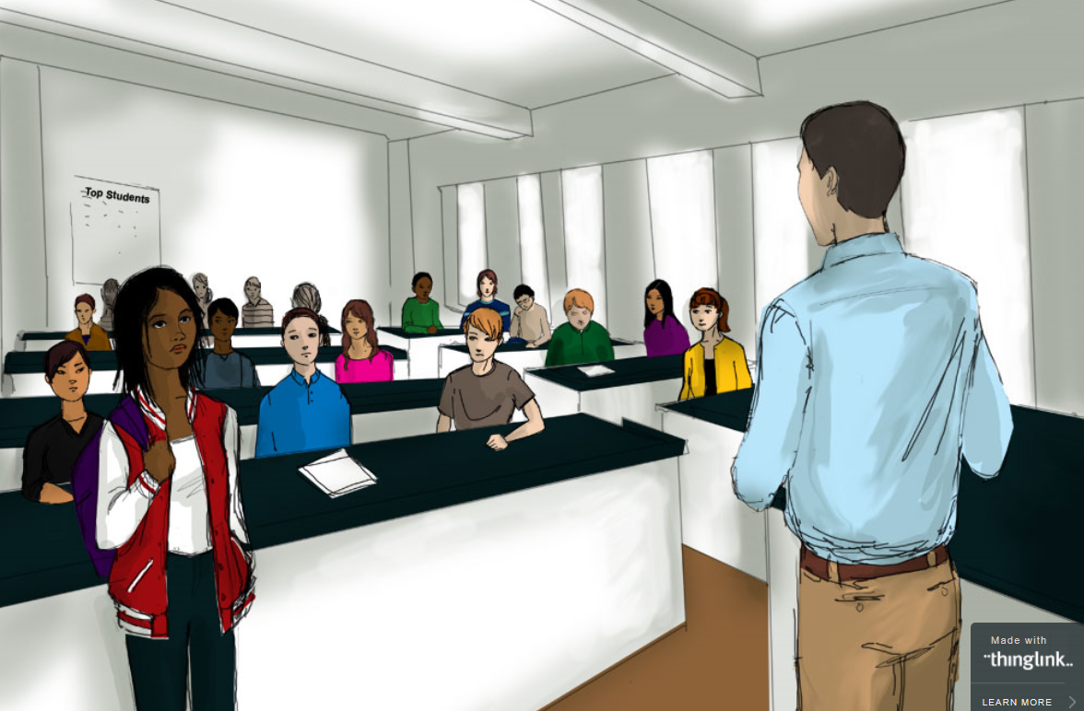
Beware of
Microaggressions
https://www.edweek.org/ew/section/multimedia/illustration-microaggressions-in-the-classroom.html
Notes:
The next strategy we mentioned is the practice of inclusivity, participation, and mutual respect. As program leaders we are role models, so we need to be extra careful that we do not fall into the trap of making assumptions and stereotyping young people. Microaggressions are brief, everyday exchanges that send denigrating messages to certain individuals because of their group membership. People who belong to socially marginalized groups are generally the target of these remarks. Comments may be made intentionally or unintentionally.
Let’s go to this website and see how this could play out in an educational setting.
Open the link, scroll over the picture. Scrolling over the black dots will cause a window to pop up with a scenario/comment made by the teacher. It will also identify the stereotype. Have participants respond to the scenarios.
The scenarios described here may be a bit extreme, but I am pretty sure we have heard similar comments. Small, often unintentional slights can be insulting and painful.

Slide 15
Micro-affirmations
Nodding and making eye contact with youth while they’re talking
Making sure to call on all youth equally
Referring to every young person by their name
Using inclusive language — for instance, talk about “families” instead of “parents”
Openly giving praise for a wide-range of actions, from answering a question right to sitting still during a lesson
Staying enthusiastic when interacting with youth
https://www.gse.harvard.edu/news/uk/16/12/accentuate-positive
Notes:
In contrast to microagressions that exclude people, researchers at Harvard University highlight the power of microaffirmations. Focus on the positive can go a long way. Learners will pay attention and show increased engagement in the classroom. We can transfer this to the out-of-school settings you are working in.
Microaffirmations are simple, affirming strategies such as nodding and making eye contact when you are talking with youth, calling them by their names, and making sure to call on everybody. Using inclusive language. Reinforcing and affirming positive behaviors. Showing enthusiasm when interacting with young people – this sounds simple but can be challenging, since all of us have days when we struggle with stress and the demands of life, and we might not feel so energized and enthusiastic about our work with young people.
Optional: Show the brief animation video (1 minute) and refer to the website.

Slide 16
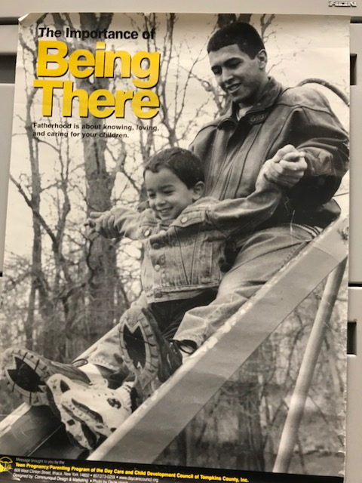
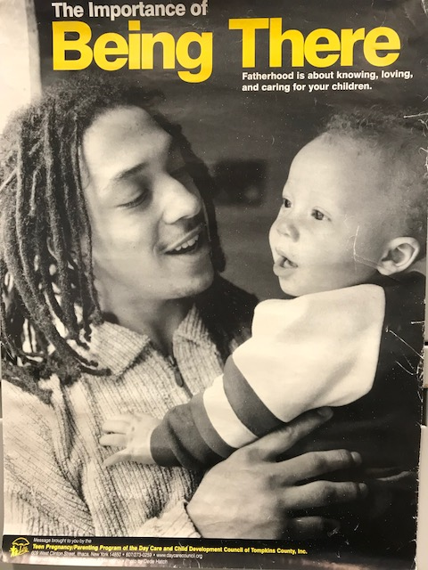
Physical Space
Notes:
Finally, I would like to hear from you about what you have done in your settings to create a welcoming and youth-friendly space. What have you done to the physical space to make it welcoming to all young people? Think about the décor, posters, and the like.
You see some examples of inclusive welcoming symbols and posters from the 4-H Office and the two posters “Being There” from a teen pregnancy and parenting program sending an positive, welcoming message to teen dads (instead of blaming them).

Slide 17
Vygotsky’s Zone of Proximal Development
End Point
Starting Point
Learning Zone
Notes:
One of the features of effective youth development programming is providing opportunities for skill building, learning new skills. Scaffolding is teaching strategy that works for all ages and learning any skill set.
Scaffolding evolved out of a learning theory originally proposed by Russian
psychologist Lev Vygotsky in the 1930s.
Click through while talking
The optimal place or time for learning occurs when a student can build on skills or knowledge he or she already has to successfully advance to a new level. The student can’t do it alone, though; they need the support and guidance of a more knowledgeable person such as a teacher. The circle describes what Vygotsky calls “the proximal zone of development.” We might also call it the optimal learning zone.
You start where the young person is at and provide guiding support to move them forward.

Slide 18
Scaffolding Process
Feedback
Explaining
Modeling
Notes:
Here is what scaffolding looks like.
First you assess where the young person is at, then discuss with the youth the goal, the skill level they want to reach
Click to start (it moves up automatically)
The you provide support: you model or demonstrate - you explain - you provide feedback - you solicit ideas for the next step

Slide 19
Scaffolding Process
Feedback
Prompting
Youth teaching steps
Notes:
Click to start the reverse (it happens automatically)
You provide feedback - you prompt (no need to demonstrate any more) - once the young person is comfortable with the skills, they can teach it back
Any questions about scaffolding? As I mentioned earlier it is a great teaching strategy because it can be done with youth of any age and for teaching really any skill.

Slide 20
Key Elements of Scaffolding
Break down complex skills into smaller units/steps
Assess the young person’s skill level
Provide guided support, gradually fade it out
Ensure a positive ending
Notes:
Key elements of scaffolding are:
- Breaking down complex skills into smaller tasks or steps.
- Assessing the young person’s existing skill level: identifying where they are with respect to the skill, their strengths, interests, etc.
- Working closely with the youth to provide guided support; using techniques such as modeling, verbal rehearsing and talking through, prompting, providing feedback, etc.
- Ensure a successful ending: You want to set a goal that is challenging but also attainable to make it a positive experience. This can be part of the initial assessment process and should be done jointly with the young person. This ensures motivation to engage and learn a new skill.

Slide 21
Feedback
Feedback is specific and descriptive, not interpretive or judgmental
Corrective Feedback
Describe the behavior and offer an alternative action or elicit an alternative from the young person, asking what they could do differently.
Positive Feedback
Describe the behavior emphasizing the young person’s strengths, skills, and the outcome.
Notes:
Providing feedback is part of the scaffolding process. The ability to provide accurate feedback is an important skill for any teacher or facilitator.
There is more to feedback than saying “good job” or “not that way.” Feedback needs to be concrete, descriptive, and behavior‐specific. The focus is on the behavior, not the person.
Review slide. This is sometimes hard to do. We often find ourselves saying quickly and often without thinking: “good job” or “you are so smart.” This sounds more like a judgment, and it does not provide young people (or adults) with any information about their performance. For young people to learn and improve their skills, concrete feedback – positive and corrective – is critical.
We have handouts to practice giving feedback in the PYD 101 manual

Slide 22
Praise: Promoting Growth - Mindset
Intelligence?
Chooses easier tasks
Gives up faster with challenging tasks
Effort?
Chooses difficult tasks
Handles failure
Video: Carol Dweck at Google: https://youtu.be/-71zdXCMU6A
Notes:
Providing praise can actually be harmful. Be intentional about what you praise.
Carol Dweck, a researcher at Stanford University, has done extensive work on the question of what motivates children to learn. Her research demonstrates that there is a huge difference between saying “you are so smart” (praising intelligence) and “you worked hard” (praising effort). Children who were praised for their intelligence chose easier problems and gave up faster; children who were praised for
effort chose harder problems and showed less frustration with failure. In her book Mindset, Dweck develops the concept of fixed versus growth mindsets based on this research.
Think about how you use praise with young people or your own children. How often have we said “you are smart … you can do this”? Praise is good, but let’s be intentional about using praise effectively.
To learn more about growth mindset and using praise effectively, go to the Carol Dweck talk at Google (longer video).

Slide 23
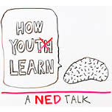
Active Learning
WKCD: How Young
People Learn
http://www.whatkidscando.org/featurestories/2013/01_how_youth_learn/
Notes:
What motivates young people to participate in a program? What type of programming engages them?
We will explore this question with Ned’s help. Developed with the young people of What Kids Can Do, this short video will give us some good ideas.
Show video – afterwards ask what they take away from the video.
As you listen to volunteers report takeaways, reinforce Ned’s points when they come up.
I need to feel OK (not hungry, etc., not worried or stressed)
2. It matters – real world stuff, my passions, I can pick my assignment
3. It’s active – fun, hands‐on, collaborative learning
4. It stretches me – doable, but taken to a new level
5. I need a coach – access to help, time to make mistakes
6. I have to use it – use it or lose it, pop quiz works
7. Thinking back on it – I grow, reflect on it
8. I plan next steps – how to use it

Slide 24
Active Learning Strategies
Involve youth in planning activities and programming
Hands-on learning/experiential learning
Focus on the process: reflection and critical thinking
Collaborative learning
http://www.actforyouth.net/youth_development/professionals/manual.cfm
Notes:
Following Ned’s advise we have several strategies and tools to share with you, all focused on experiential and active learning. In the PYD 101 Manual you’ll find handouts on experiential learning, youth involved in planning and reflection, and collaborative learning.

Slide 25
Promoting Critical Thinking
Beverly Daniel Tatum: Raising Resisters*
Critical Thinking as Defined by the National Council for Excellence in Critical Thinking, 1987
Critical thinking is the intellectually disciplined process of actively and skillfully conceptualizing, applying, analyzing, synthesizing, and/or evaluating information gathered from, or generated by, observation, experience, reflection, reasoning, or communication, as a guide to belief and action. (The Foundation for Critical Thinking)
Teaching Tolerance - https://www.tolerance.org/
Common Sense Media: Digital Citizenship https://www.commonsense.org/education/digital-citizenship
Notes:
Taking a lead from Beverly Daniel Tatum (Why are all the Black Kids Sitting Together in the Cafeteria) effective youth programming needs to include efforts to teach young people critical thinking skills. We need to raise “resisters” young people who question the realities they experience, ask why and learn how to navigate real life problems. Young people recognize the …isms, speak up about it, and they do not internalize them.
The slides lists a few additional resources on teaching critical thinking.

Slide 26
Any questions, comments or takeaways?

Slide 27
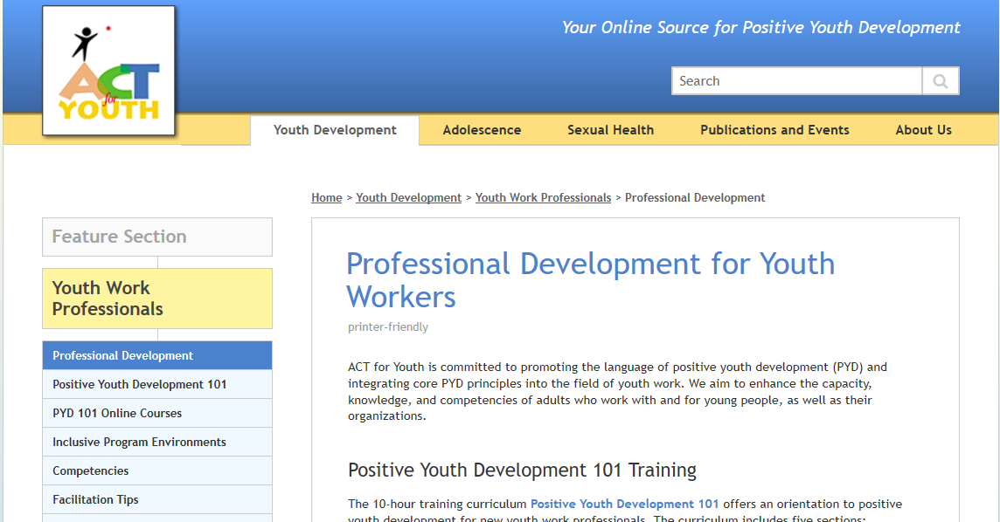
Resources
http://www.actforyouth.net/youth_development/professionals/

Slide 28
Resources
ACT for Youth: Creating Inclusive Program Environments for Youth with Different Abilities http://www.actforyouth.net/youth_development/professionals/inclusive-environments.cfm
ACT for Youth: Social and Emotional Learning Toolkit http://www.actforyouth.net/youth_development/professionals/sel/
ACT for Youth: Supervisor’s PYD Toolkit http://www.actforyouth.net/youth_development/professionals/supervisors/
Mindset Kit - https://www.mindsetkit.org/
Belonging for Educators - https://www.mindsetkit.org/belonging
Character Lab: Growth Mindset Playbook https://characterlab.org/playbooks/growth-mindset/
What Kids Can Do: How Young People Learn - http://www.whatkidscando.org/featurestories/2013/01_how_youth_learn/

Slide 29
References
Eccles, J., & Gootman, J. (Eds.). (2002). Community programs to promote youth development. National Research Council Institute of Medicine. Washington, DC: National Academy Press. http://www.nap.edu/catalog.php?record_id=10022
Substance Abuse and Mental Health Services Administration (2014). SAMHSA’s concept of trauma and guidance for a trauma-informed approach. https://store.samhsa.gov/sites/default/files/d7/priv/sma14-4884.pdf
National Academies of Sciences, Engineering, and Medicine. (2019). The Promise of Adolescence: Realizing Opportunity for All Youth. Washington, DC: The National Academies Press. nap.edu/catalog/25388/the-promise-of-adolescence-realizing-opportunity-for-all-youth
Hogan, K., & Pressley, M. (1997). Scaffolding student learning: Instructional approaches & issues. Cambridge, MA: Brookline Books.
Dweck, C. S. (2008). Mindset. New York: Ballantine Books.
Beverly Daniel Tatum Book Talk: Why Are All the Black Kids Sitting Together in the Cafeteria? https://www.youtube.com/watch?v=RXGlYh0ejlA&feature=youtu.be
The Foundation for Critical Thinking - https://www.criticalthinking.org/pages/defining-critical-thinking/766
T

