Slide 1
Positive Youth Development II: Positive Youth Outcomes
ACT for Youth June 10, 2021

Slide 2
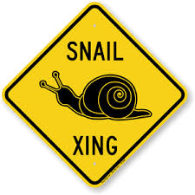
Zoom keeping
Audio.
You control the volume. Please mute yourself during the presentation.
Experiencing delays?
Try closing out the other
programs running on your
computer
Questions?
Use chat function. Post to Everyone.

Slide 3
Agenda
Recap – What is Positive Youth Development?
Positive Youth Outcomes (different frameworks)
Using a strength-based approach
Developmental relationships
Takeaways & Resources

Slide 4
Recap: Positive Youth Development
A philosophy or approach that guides communities in the way they organize programs, supports and opportunities so that young people can develop to their full potential.
Focus on building positive outcomes
Youth voice and engagement
Long-term involvement/Developmentally appropriate
Universal/Inclusive
Community-based/Collaborative
Notes:
“Positive Youth Development is a philosophy or approach that guides communities in the way they organize programs, supports, and opportunities so that young people can develop to their full potential.”
Recognizing that young people grow up in families, schools, neighborhoods, and communities, PYD is a community-based approach. We know from research that social context matters greatly for development. Supportive relationships and environments that offer opportunities to learn and grow are essential.
There are several key principles:
- PYD aims to go beyond addressing and preventing problem behaviors. Instead we want to focus on building positive outcomes for young people – knowledge, skills, confidence, character, values, and connections that prepare them adulthood. Recognizing and building on their strengths will empower and motivate them to grow.
- Engaging youth – giving them a voice – is a key principle of PYD. We work with young people, not for them. We engage young people as partners, create youth‐adult partnerships, and listen to their expertise and perspective. This principle recognizes young people’s need to matter, to have agency.
- As a community we have to support young people throughout their development – about 20 years – while adjusting to their changing developmental needs. Twelve-year-olds need different support and opportunities than 16-year-olds.
- As a community we need to provide support and opportunities to all young people, not just to the “high risk,” targeted groups or the high achieving group. This does not mean, however, that we should not be aware and address inequities and access issues.
- Young people are interacting with a variety of social environments. For a positive youth development approach to succeed, non‐traditional community sectors such as businesses, faith communities, or civic organizations need to be involved. And this implies that we have to work together collaboratively.

Slide 5
Positive Youth Outcomes: What are we thinking of?
Source: www.NCCP.org
Notes:
In this session we will focus on positive youth outcomes.
When we hear the term ‘positive youth outcomes’ what are we thinking of? What comes to mind? Chat it in
Possible answers are
high school graduation, going to college – all achievements
No drugs, no teen pregnancy – all prevention outcomes
We want to think about competencies, values, etc
Examples: confident, life skills, happy, healthy decision making, social skills, has goals

Slide 6
Karen Pittman
“Problem free is not fully prepared”
“Fully prepared is not fully engaged”
Forum for Youth Investment
Ready by 21
Notes:
Let’s take a brief look at history, going back to the 1990s. Karen Pittman of the Forum for Youth Investment, who is considered by many to be the mother of Positive Youth Development, used two statements to distinguish youth development from prevention and to make the point that we need to go beyond prevention to help young people thrive.
“Problem free is not fully prepared”
Imagine a young person coming to you for job and telling you: “I don’t drink, smoke, or use drugs. I am not in trouble with the law. I don’t have pre-marital sex. Please give me a job.” This does not tell you anything about their skills, competencies, values, strengths. You don’t know if they are prepared and have the basics skills for the job. The statement makes it clear that we need to prepare young people for school, work, and life--we need to build skills, not just prevent problem behaviors.
“Fully prepared is not fully engaged”
This statement recognizes the need to prepare young people to be active and engaged citizens and care for the community and society they live in.

Slide 7
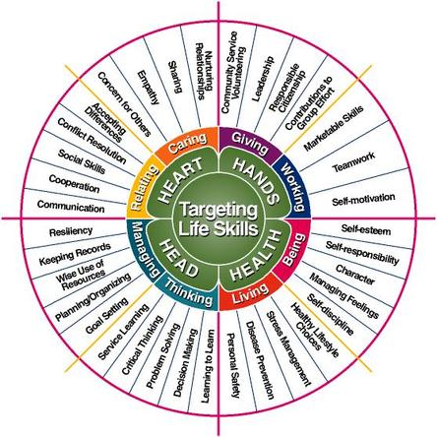
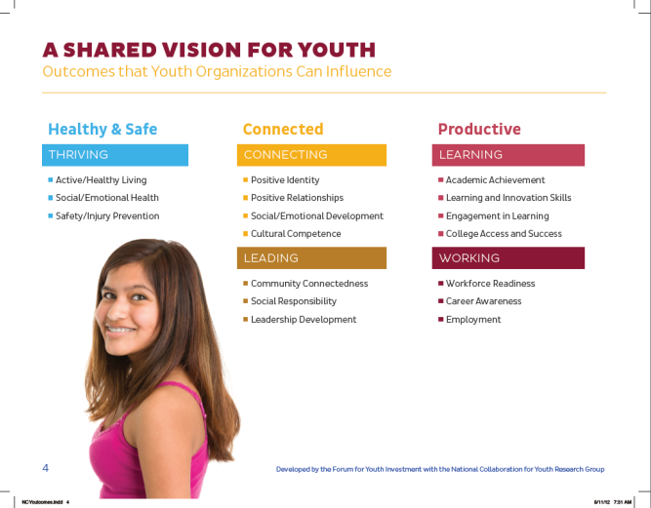
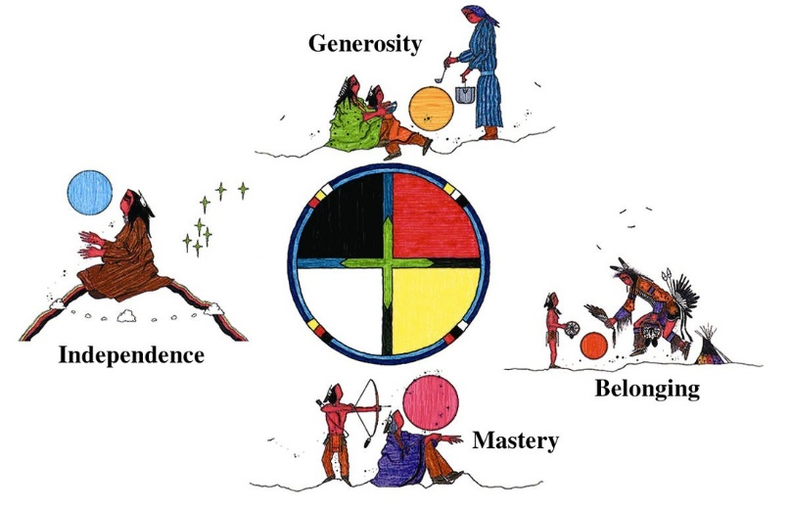
Outcome Models
Notes:
There are several other models of positive youth outcomes that touch on the same concepts but use
different language. Some are probably very familiar to you.
Click to move from one model to the next:
26
• Targeting Life Skills model, from Iowa 4‐H, is a popular model within 4‐H groups across the
country.
• Essential Elements of 4‐H Youth Development is an outcome model that builds on the Circle of
Courage: Mastery, Independence, Generosity, and Belonging.
• 40 Developmental Assets is a popular model developed by the Search Institute.
• Ready by 21, Karen Pittman’s organization, promotes a shared vision of outcomes and
indicators: “healthy and safe, connected and productive in life, school, and work.”
• Circle of Courage merges educational theory and practice with Native American philosophy.
We don’t have time to review these models here, but your “Section 2: Resources & References”
handout includes resources on all of them.

Slide 8
6 Cs
Confidence
Competence
Caring
Character
Connection
Contribution
Notes:
The Cs emerged in the 1990s with contributions from many researchers and practitioners. Based on
research, this framework provides us with a vocabulary to describe what young people need to succeed:
• Competence – the ability to act effectively in school, social situations, and at work. This includes
academic, cognitive, social, emotional, and vocational competencies.
• Confidence – a sense of overall self‐worth and efficacy.
• Connection – a sense of belonging, positive bonds with people and social institutions.
• Character – respect for society and cultural rules, an inner moral compass.
• Caring – a sense of sympathy and empathy for others, a commitment to social justice.
• Contribution – active participation and leadership, giving of oneself to bring about change in
social and civic life.

Slide 9
Competence | Confidence | Character | Caring | Connection | Contribution
Intellectual | Sense of mastery & future | Sense of responsibility & autonomy | Sense of sympathy & empathy | Sense of membership & belonging | Active participation & decision-making
Emotional | Sense of self- efficacy | Sense of spirituality |  | Sense of safety and structure
Civic & social |  | Self-awareness
Physical
Cultural
Work readiness
Notes:
Taking a closer look at the 6 Cs.
There are lots of skills for young people to develop in different area: cognitive/intellectual…
Young people need to develop confidence, a sense of mastery, a sense of elf-efficacy, a sense of the future (setting goals)
And so on

Slide 10
Embedded: SEL Core Competencies
Recognize one’s emotions,
values, strengths, and
limitations
Manage emotions
and behaviors
to achieve
one’s goals
Make ethical,
constructive choices
about personal and
social behavior
Show
understanding
and empathy for
others
Form positive relationships, work
in teams, deal effectively with conflict
www.casel.org
Notes:
The social and emotional learning field as represented by CASEL, the Collaboration of Academic, Social and Emotional Learning, has identified core competencies that we all need to navigate and do well in this world. This helps flesh out the social emotional competencies mentioned in the 6 Cs.
Self management…
Self awareness…
Responsible decision making…
Relationship skills…
Social awareness…
ACT for Youth has a lot of resources, activities and strategies to promote these competencies in the Social and Emotional Learning Toolkit on their website. We get top this is a few minutes.

Slide 11
How do we build/ support the 6 Cs?
Notes:
Thinking about these 6 Cs how do we help and support young people to develop these?
Think about your program strategies and activities
Any organizational practices such as recognition and rewards for example
Any policies?
Let’s take a look at confidence. How do we build confidence in youth? What have you done?
Program activities, opportunities, policies, other strategies?
Please chat them in
Examples
Skillbuilding plus positive feedback, recognition for achievements
Creating opportunities to learn new skills and succeeding in mastering skills
Roleplays to practice new skills, feedback

Slide 12
Services-Opportunities-Supports
Conducted with youth
Relationships and resources to support emotional wellbeing; structure and guidance; access to info and resources
Provided to or for youth
Intended to enhance health, safety, performance, and other forms of essential wellbeing and physiological functioning
SERVICES
SUPPORTS
OPPORTUNITIES
Done by youth
Meaningful opportunities to practice and expand on what youth know and learn – either through work, service, or advanced learning
Notes:
Let’s take a step back and think about young people’s social context. It helps to take a look at Karen Pittman’s framework of Services – Opportunities – Supports (SOS). This model incorporates the reality that young people might have needs that must be addressed before they can learn and thrive. (Remember we talked about Maslow’s hierarchy of needs) It also reflects a core principle of youth development: Youth development is community‐based. Young people grow up and develop in interaction with various social groups and institutions within a community, not just in programs.
Services: Services are the efforts done to or for youth in order to enhance health, safety,
performance, and other forms of essential well‐being and physiological functioning (going back
to Maslow’s hierarchy of needs). These are the traditional services provided by public health
systems, school districts, and other providers.
• Supports: Supports include processes and strategies undertaken with young people that
facilitate access to interpersonal relationships and resources. Taken as a whole, supports
promote a positive climate within which development occurs. Pittman identified three different
categories of support: Emotional support facilitates a sense of safety, nurturing, and friendship.
Motivational support provides positive expectations, guidance, and developmentally
appropriate boundaries. Strategic support facilitates access to needed resources and
information.
• Opportunities: In this model, opportunities are done by young people. It is within the realm of
opportunities that youth become actors rather than recipients. Youth are provided meaningful
and real opportunities to practice and expand on what they know and learn – either through
work, service, or advanced learning. Opportunities in which youth are encouraged to exercise
meaningful decision‐making roles ultimately demand and foster the greatest number of
competencies in young people.

Slide 13
Family
Peers
Education
Safety
SERVICES
SUPPORTS
YOUTH
Community organizations
Businesses/ Employment
OPPORTUNITIES
Youth service organizations
Notes:
It is not the responsibility of one agency to provide all of the services, opportunities, and supports a young person needs to grow. Using an ecological approach we understand that all social groups and institutions a young person is connected with will participate in providing services needed as well as creating supports and opportunities to nurture this youth. We are all responsible for the youth in our community. This is also a reminder to collaborate with other programs and agencies and jointly create opportunities for young people.
Think about a young person you have worked with, a young person who needed extra support. Support that your agency or program could not supply. What community services and supports have you reached out to or worked with to provide additional support to a young person?
Please share…
Thinking about new opportunities for youth – have you worked with other groups or agencies in your community to create new opportunities for youth?
Please share
Example: Community service projects? Apprenticeships…

Slide 14
Using a Strength-Based Approach
People are active participants in the helping process (empowerment)
All people have strengths, often untapped or unrecognized
Strengths foster motivation for growth
Strengths are internal and environmental
Source: Saleebey, Dennis. 1992.
Notes:
Building positive outcomes means also using a strength based approach. It shifts our work from a problem focus to a positive outcome focus that builds on strengths. What do we mean by “building on strengths” or “using a strength‐based approach”?
Emerging from the field of social work and supported by resiliency research, a strength‐based approach is a powerful set of ideas, assumptions, and techniques:
- People are not recipients but active participants in the helping process, which is very empowering. Let’s remember Bronfenbrenner as well who stated that young people are agents in their development.
- All people have strengths, but often they are not used or even recognized. As all of you have probably experienced, if you ask young people what their strengths are, they don’t know what to say.
- Being able to use your strengths creates motivation to grow and learn. The converse is also true: We all know that it is not very motivating to focus on your weaknesses and work on improving your weak spots.
- Finally, we know from resiliency research that we have internal strengths such as abilities and talents, and external strengths such as relationships and opportunities to matter, to be responsible for something.

Slide 15
2 Core Strategies
Create supportive and caring environments
Nurture individual strengths
Notes:
There are two core strategies for building on strengths

Slide 16
Identify and Nurture Internal Strengths
Social Competence | Problem Solving | Autonomy | Sense of Purpose & Belief in the Future
-Responsiveness -Communication skills -Could recruit support -Empathy and caring -Compassion and forgiveness -Pro-social behavior | -Ability to plan -Flexibility -Insight -Critical thinking -Resourcefulness | -Positive Identity -Internal locus of control -Mastery and self efficacy -Adaptive distancing and resistance -Self-awareness and mindfulness -Humor | -Goal direction, achievement motivation and educational aspirations -Special interest, creativity, imagination -Optimism and hope -Faith, spirituality and sense of meaning
Bonnie Benard. 2004
Notes:
Reviewing findings from resiliency research Bonnie Benard created this breakdown of internal resiliencies or protective factors. Young people may not demonstrate all of these traits and skills, but some of them. This is a great framework to keep in mind to help identify internal resiliencies and help young recognize their assets. As we just discussed often young people do not know or recognize their own strengths. So it is our role to make them aware of the strengths they have.
Review a few examples

Slide 17
Build on Internal Strengths
You believe that young people have strengths (attitude)
You identify personal strengths (you look beyond the problems)
You teach them that they have strengths (name them, show them how they are being used, suggest how they can use them in the future)
You give it time – you persist
Nan Henderson
Home - Resiliency in Action | Nan Henderson, M.S.W., Ph.D.
Notes:
How do we use the strength we see in young people? Nan Henderson who is a social worker and trains on this topic across the country identifies these simple strategies.
Believing that young people have strengths is especially important when working with young people who are struggling and who may be very negative and self-defeating. They may never have heard anybody, any adult say that they have skills and strengths.
If you are working with young people in the juvenile justice system or foster care you are looking at them with a bifocal lens. They are often described and identified by their problems, so it is important see beyond that and look at their resiliencies and strengths.

Slide 18
Sparks
"A spark is something that gives your life meaning and purpose. It’s an interest, a passion, or a gift.“
Dr. Peter Benson.2008
http://www.search-institute.org/sparks
Video - https://www.youtube.com/watch?v=3YFw8oif_qU
Notes:
https://www.youtube.com/watch?v=3YFw8oif_qU
Peter Benson, former director of the Search Institute coined the term “sparks,” bringing concrete meaning to this concept of strengths.
Peter Benson called a special quality, skill, or interest that we are passionate about a “spark.” Sparks originate from inside a person. When we express it, we feel alive, useful. Life has a purpose.
All young people have one or more sparks. Sparks are more than just things we like to do. They’re a prime source of meaning, self‐directed action, and purpose.
If the word “sparks” doesn’t work for the youth you are working with, you can talk to them about their strengths, interests, passions, or purpose.
Maybe show the video clip and debrief.

Slide 19
https://www.search-institute.org/wp-content/uploads/2018/01/IE-Spark-Nov-2010-Brief.pdf
Notes:
The Search Institute did some research sparks and young people identifying their sparks.
Summarize the findings

Slide 20
What were your sparks?

Slide 21
Poll: Who were your spark champions?
Notes:
Create a poll:
Who were your spark champions? (Multiple choice)
Parent
Teacher
Coach
Youth program leader
A friend’s parent
Older sibling
Debrief afterwards. People can share a special champion.

Slide 22
Activities to Explore Strengths
Strengths inventory
Activity/interest lists/questions
Multiple intelligences
Explore strengths by
Drawing a picture
Taking photos
Exploring career interests/vision of your future
Social and Emotional Learning Toolkit
http://www.actforyouth.net/youth_development/professionals/sel/self-awareness.cfm
Notes:
There are other strategies to explore young people’s strengths such a strengths survey or survey on multiple intelligences. Some are available online.
Create a list of activities or interests. Young people can indicate what they enjoy doing.
Instead of surveying youth you can develop program activities where they can explore interests and skills by drawing a picture or taking photos, creating a collage.
Or explore career interests planning for a possible future.
(click)There are more strategies and activities available in the social and emotional toolkit on the ACT website (link provided).

Slide 23
Iceberg Activity
Provide each youth with a large piece of paper and markers;
Explain iceberg:
Ask them to list all the things people can see about them above the surface and all their internal characteristics, talents, etc. below the surface
Hang up pictures and debrief with the group
Notes:
Here is another activity for youth to explore their strengths and talents.

Slide 24
Build a Supportive Environment
Increase bonding or connectedness
Set clear and consistent boundaries
Teach life skills
Provide caring and support
Set and communicate high and realistic expectations
Provide opportunities for meaningful participation
Nan Henderson
Home - Resiliency in Action | Nan Henderson, M.S.W., Ph.D.
Notes:
The second core strategy for building on strengths is creating a supportive environment. Nan Henderson calls it the resiliency wheel. These strategies are based on resiliency research, the findings of external or environmental resiliencies. The most imported is the presence of a caring adult; relationships are key.
Others focus on clear and consistent boundaries and high/realistic expectations as well as opportunities for meaningful participation.

Slide 25
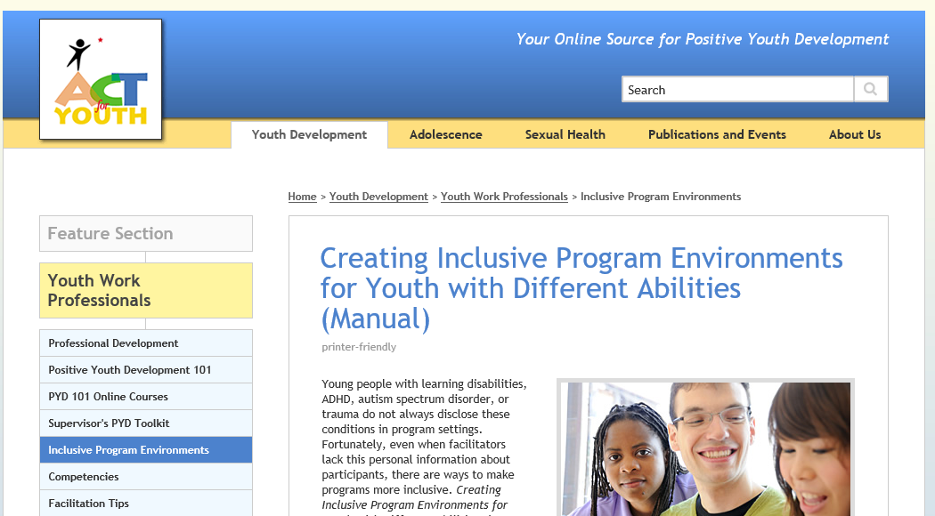
http://www.actforyouth.net/youth_development/professionals/inclusive-environments.cfm
Notes:
Here is one resource that addresses many aspects of building a supportive environment. The curriculum: Creating inclusive program environment for youth with different abilities, was developed with youth in mind who may struggle with learning disabilities, ADHD, or chronic stress, but it provides a lot of resources, activities and strategies that will be helpful for any youth program setting.

Slide 26
Developmental relationships Developmental Relationships
Developmental relationships are the active ingredients of effective interventions.
They are characterized by
attachment/connection
reciprocity
- progressive complexity
balance of power
Simple interactions are the building blocks; relationships emerge from accumulated interactions.
Li & Julian. 2012
Notes:
Since relationships are very critical for a supportive environment, let’s take a look at a couple of couple of frameworks. Li & Julian see developmental relationships as the active ingredients of effective intervention. They looked at how adults interacted with children and youth and identified several types of interactions that are critical
Interactions that create connection
There is reciprocity. Interactions are initiated by both, not just by the adult and the youth follows.
Interactions challenge how people to learn skills, grow
Interactions that promote inclusion (they refer to that as balance of power)
Simple interactions are the building blocks; relationships emerge from these interactions. It is an inclusive, strength based approach.

Slide 27
Simple Interactions Tool
https://www.simpleinteractions.org/
Notes:
They build a simple tool to help staff recognize and reflect on their interactions. For staff development they recommend to videotape interactions and then jointly review the video and discuss the interactions. There are great resources on the website, the tool is available for download along with brief animations to clarify the different scales.

Slide 28
Developmental Relationship Framework
Search Institute. 2017.
Relationships First
Notes:
Search Institute created this developmental relationships framework which describes and operationalized different dimension of a relationships
Expressing care…
Challenging growth…
Providing support…
Sharing power…
Expanding possibilities…
Describe the categories a bit.

Slide 29
Notes:
Highlight the findings of Search Institute’s research on developmental relationships.

Slide 30
Notes:
Review the chart briefly and ask participants to respond – any surprises or reactions to the findings?

Slide 31
Building Developmental Relationships
Sparks: What are your talents and passions?
Strengths: What are your abilities and values?
Struggles: What keeps you up at night?
Supports: People and places where you can be yourself?
4Ss interview: https://www.search-institute.org/wp-content/uploads/2019/08/4-Ss-Interview-download.pdf
Kent Pekel’s Ted Talk: https://www.ted.com/talks/kent_pekel_getting_relationships_right
Notes:
To learn more about developmental relationships Ken Pekel, Director of the Search Institute did a Ted Talk on the topic (link provided).
Search also developed an interview guideline that can help youth program leaders get to know young people joining a program. In this 15 minute interview you ask young people about their talents and passions, their strengths, abilities and skills, but also about their struggles and supports, the people and places where they can be themselves.

Slide 32
Any questions, comments or takeaways?
Thank you!

Slide 33
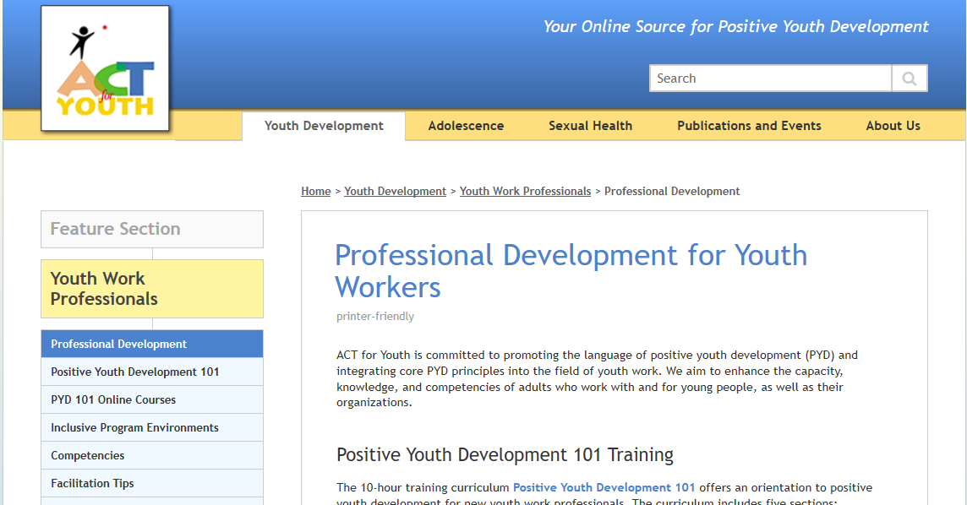
Resources
http://www.actforyouth.net/youth_development/professionals/
Notes:
This section of the website is dedicated to professional development of youth workers. This is where a lot of PYD material is archived. This webinar (recording and slides) will also be archived on this page.

Slide 34
Resources
ACT for Youth: Youth Work Professionals http://www.actforyouth.net/youth_development/professionals/
Peter Benson: Sparks: How Youth Thrive (TED Talk) https://www.youtube.com/watch?v=TqzUHcW58Us
Simple Interactions https://www.simpleinteractions.org/
Search Institute: Developmental Relationship Framework https://www.search-institute.org/developmental-relationships/developmental-relationships-framework/

Slide 35
References
ACT for Youth: Services, Opportunities, and Supports http://www.actforyouth.net/youth_development/communities/
Saleebey, Dennis. 1992. The Strengths Perspective in Social Work Practice. White Plains, NY: Longman
Peter Benson. 2008. Sparks: How Parents Can Ignite the Hidden Strengths of Teenagers. New York: John Wiley and Sons
Benard, Bonnie. 2004. Resiliency: What we have learned. San Francisco: WestEd.
Nan Henderson. Resiliency in Action Home - Resiliency in Action | Nan Henderson, M.S.W., Ph.D.
Li & Julian.2012. Developmental Relationships as the Active Ingredient: An Unifying Working Hypothesis of “What Works” Across Intervention Settings. American Journal of Orthopsychiatry. Vol 82, No. 2, 157-166
Search Institute: Relationships First. Creating Connections that Help Young People Thrive https://www.search-institute.org/wp-content/uploads/2017/12/2017-Relationships-First-final.pdf

