Slide 1
Positive Youth Development I: Foundations
ACT for Youth June 8, 2021

Slide 2
Agenda
Checking in: What is PYD?
Review of theoretical foundation and supportive research
Defining positive youth development
Themes of adolescent development
References
Notes:
Good morning and thanks for joining us. Today we’re beginning our month long series of webinars on Positive Youth Development, starting with a review of the foundations, research, definitions and themes that guide this approach.
To get us started, let’s check in with a poll.
When you hear the words, “Positive Youth Development” what do you think of? I’ll launch the poll now and we’ll give everyone a minute to chose what comes to mind.

Slide 3
What is Positive Youth Development (PYD)?
Poll: When you hear the words ‘positive youth development’, what do you think of?
Child and adolescent development
Youth services and programs
A philosophy or approach of working with
young people
Notes:
The term “positive youth development” often generates several different responses. Most commonly people hear “youth development” and think of child and adolescent development, meaning biological, social, emotional, and cognitive development. Or they think of youth services, all the programming and services communities provide to young people to address their needs and foster their growth.
In our work, we understand Positive Youth Development as a distinct approach or philosophy of interacting and working with young people, one that informs programming and promotes adolescent development and guides communities in
the way they organize services, supports, and opportunities so that all young people can develop to their full potential.

Slide 4
PYD Foundation
Theories and Research
Notes:
So, let’s dig in to the theories and research that provide the foundation for this approach

Slide 5
Ecological Model of Development
Laws/Norms
Economics
Peer
Family
Role models
School
Youth
Reciprocal process
Agency
Faith Communities
Work
Neighborhood
Media/Internet
Notes:
One important theoretical foundation piece for positive youth development is Urie Bronfenbrenner’s (1979) ecological framework of human development. Bronfenbrenner noted that child and adolescent development occurs in interaction with a set of social systems. Young people grow up in families, peer groups, school, work settings, neighborhoods, and within societal
structures and norms. And now with the Internet, we can add a global dimension. It is through interaction with various social groups or systems that young people develop competencies and values.
Bronfenbrenner also stated that the interaction between young people and their environment is reciprocal. This means that development does not just happen to children and adolescents. They are actively involved in shaping their own development. Youth are participants, not just recipients. He used
the term “agency” to denote the ability to direct or influence events. This is an important concept that we will revisit when we talk about youth voice and engagement.

Slide 6
Maslow’s Hierarchy of Needs
Notes:
Another important theory embedded in positive youth development is Abraham Maslow’s 1943 Hierarchy of Needs, focused on the question of what individuals need in order to thrive or do well.
Maslow showed that for healthy development to occur, human beings need to meet foundational needs such as food, water, shelter, and safety. If these are not met, human beings are occupied with survival and not directed toward healthy development. Beyond this, human beings thrive when they feel:
• loved and part of a larger group,
• competent and capable,
• able to understand and meet the basic requirements of their environment,
• capable of finding symmetry, order, and beauty in their environment, and
• self‐actualization and transcendence.
He defined this last need, self‐actualization, as the perception that one has realized their potential and has achieved a high level of personal growth and awareness. Maslow indicated that not all individuals reach the highest level and that healthy development can occur without this need being met.
We know from research that children and youth who don’t have their foundational needs met – are preoccupied with survival and unable to focus on learning or engage in other social interactions. In addition, more recent brain research indicates that belonging is another foundational or essential need to add to the pyramid
(Garbarino, 1995; Scales & Leffert, 1999).

Slide 7
Social Toxicity
HOMOPHOBIA
VIOLENCE
SEXUAL EXPLOITATION
Social factors that poison youths’ well-being and healthy development
HEALTH THREATS
SEXISM
DISRUPTED FAMILY RELATIONSHIPS
POVERTY
RACISM
LACK OF BENEVOLENT ADULT AUTHORITY
Notes:
James Garbarino coined the phrase “social toxicity” in 1995 to describe the social factors that interfere with young people’s healthy development. Although some of these social issues have improved over the years, they still have impact on the lives of young people. Most of them are well known.
• Racism: leads to a gap in academic performance for African American and Hispanic children, and youth of color are overrepresented in special education classes and in the justice system.
• Poverty: leads to fewer opportunities and less support; youth who grow up in poverty often face additional problems such as violence and disrupted family relationships.
• Sexual exploitation: refers to the increasingly over‐sexualized representation of young children and youth in the media, social media, and commercial marketing.
• Health threats: Exposure to drugs and alcohol leads to early experimentation with substances, potentially resulting in substance abuse and violent behavior.
• Lack of benevolent adult authority: Garbarino has pointed out that many young people lack role models who promote positive social and moral values. Many celebrities, who youth may consider role models, promote wealth and materialism.

Slide 8
Inequity and Adolescence
Outcomes for Poor, Black, Latinx and LGBTQ Youth
Lower High School & College Graduation
Poor Health Outcomes (pregnancy, STI, HIV, substance abuse)
Higher Rates in Detention Rate, Foster Care Placement
National Academies of Sciences, Engineering, and Medicine. (2019). The Promise of Adolescence
Notes:
The social toxicity of our society leads to inequities. A 2019 National Academy report: The Promise of Adolescence: Realizing Opportunity for All Youth shows negative trends for poor young people, Black and Latinx youth and LGBTQ youth in outcome areas we usually measure. Their high school graduation and college attendance rates are lower than white middle class youth. Their health outcomes are poorer in the areas of teen pregnancy, STI and HIV infection, and substance abuse. Their detention rate is higher, and so are the chances of being placed in foster care.

Slide 9
Supportive Research: Prevention
Risk Factors
in
Community
Family
School
Peer/
Individual
Protective
Factors
School drop out
Delinquency
Substance abuse
Teen pregnancy
Violence
Notes:
There are three bodies of research that have supported the positive youth development approach and its theoretical foundation.
One - Prevention science has investigated the question: How can we predict and prevent negative behaviors? By identifying risk factors – conditions that increase the likelihood of negative outcomes such as teen pregnancy, substance use, delinquency, school drop out and violence – and protective factors, which buffer against these negative effects. Prevention science has informed many interventions and programs.
Risk factors can be in the community such as living in a violent neighborhood, in the family such as domestic violence, or in school within a peer group.

Slide 10
Supportive Research: Resiliency
Protective Factors
Internal:
Social Competence, Purpose, Autonomy
External:
Caring Adult, High Expectations, Participation
School drop out
Delinquency
Substance abuse
Teen pregnancy
Violence
Risk Factors
Notes:
Resiliency research has shifted to the question: Why do many young people do well despite the negative environment in which they live and the risk factors they face? Much of this research is based on longitudinal studies that have followed groups of individuals over years from childhood to adulthood.
Click – Protective factors can be internal such as social competence, sense of purpose and autonomy, or external such as having a caring adult in your life, clear and feasible expectations, and opportunities to make contributions and matter.

Slide 11
Interplay of Risk and Protective Factors
3 and more risk factors
increase likelihood of
problem behaviors
Low number of risk factors associated with lower prevalence of problem behaviors
Protective Factors buffer risk factors
Notes:
We know from research that protective factors buffer and counter risk factors; the strongest protective factor is having a caring adult. We also know that a high number of risk factors increase the likelihood of negative behavior – 3-4 risk factors can be the tipping point.

Slide 12
About the CDC-Kaiser ACE Study |Violence Prevention|Injury Center|CDC
Notes:
The Adverse Childhood Experiences (ACEs) studies has shown that child abuse and neglect and other risk factors in early childhood can have a lasting impact on development, health and wellbeing. The more risk factors the stronger the impact. The study also taught us it is far more common for people to experience adverse and toxic stress during childhood than we ever thought.

Slide 13
Supportive Research: Youth Development
Developmental Assets
Reduction of Risk Behaviors
The more, the better
The more, the better
Promotion of Thriving
Notes:
A more recent body of research has taken a different direction and has investigated the question: What makes young people do well or thrive? The Search Institute synthesized the research on adolescent development and identified 40 assets or
building blocks that young people need to thrive – to become successful, productive adults. We refer to this as youth development research. Based on their research administering surveys to young people in a community, we have learned that the more assets young have the better they do in school performance and healthy behavior choices. We also learned that roughly 50% of youth in a community have only about 20 assets, half of what they need to thrive.

Slide 14
Emerging Science of Learning and Development (SOLD)
Malleability
Experience dependent growth
Context
Brain Development
Pamela Cantor et al. 2018
Notes:
In recent years we have seen an integration of learning, development and brain science. The old debate of nature versus nurture has been decided. The brain is highly malleable and plastic. It can wire and rewire in interaction with the environment. This makes us very adaptable. We learn and grow through experience, through interacting with our environments. And this happens in social context, in relationships. It’s less about genes and our genetic make up; it is more about nurturing and relationships. This supports Bronfenbrenner’s model of human ecology.

Slide 15
Defining Positive Youth Development
A philosophy or approach that guides communities in the way they organize programs, supports and opportunities so that young people can develop to their full potential.
Focus on building positive outcomes
Youth voice and engagement
Long-term involvement/Developmentally appropriate
Universal/Inclusive
Community-based/Collaborative
Notes:
We define positive youth development as an approach or philosophy that guides communities in the way they organize services, supports, and opportunities so that all young people can develop to their full
potential. There are several key, research‐based principles underlying this approach:
• Focus on positive outcomes: We shift from preventing or fixing problems to creating positive outcomes such as competencies, connections and caring relationships, positive values and expectations, and meaningful participation. This also means that we use a strength‐based approach.
• Youth voice/engagement: We work with young people, not for them. We engage young people as partners, create youth‐adult partnerships, and listen to their expertise and perspective. This usually requires that we as adults become aware of and control the negative assumptions and stereotypes we might have of young people. (We call this negative posture “adultism.”)
• Long‐term, developmentally appropriate involvement: As a community we have to support young people throughout their development – about 20 years – while adjusting to their changing developmental needs. Twelve year olds need different support and opportunities than 16 year olds. We also know that young people need extended exposure to programs and supportive adults to thrive; short‐term programs and opportunities are not as effective.
• Universal/inclusive: As a community we need to provide support and opportunities to all young people, not just to the high risk, targeted groups or the high achieving group. This does not mean, however, that we cannot provide additional support to young people who face extra challenges. In addition, research tells us that universal strategies are often very effective for high risk or high need youth.
• Community‐based/collaborative: As we discussed earlier, young people are interacting with a variety of social environments. For a positive youth development approach to succeed, non‐traditional community sectors such as businesses, faith communities, or civic organizations need to be involved. And this implies that we have to work together collaboratively.

Slide 16
Adolescent Development - A Time of Vulnerability and Opportunity
Notes:
Let’s take a look of what’s happening in adolescence, a time of change, vulnerability and opportunity.

Slide 17
It All Starts with Puberty
Average age Variation in
Female: 8-10 - Timing
Male: 10 -12 - Tempo
Notes:
The onset of puberty varies with each individual in both timing and tempo.
Some early puberty has been linked to environmental exposures/chemicals in utero or early childhood, body mass index can also be a factor, and a recent study by the adolescent lab at Cornell explored a connection to childhood sexual abuse. Growing under stressful conditions can lead to accelerated development because being able to reproduce was an early survival strategy.

Slide 18
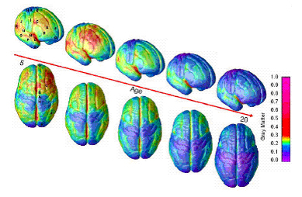
Timeline of Brain Development
Birth to 3 -- Time of rapid intellectual, emotional & physical growth of brain & brain “wiring”
By age 6 -- 95% of brain development completed
By age 10-12 -- 2nd major brain growth spurt
Adolescents (13-20s) Pruning and organizing
Notes:
Over the past 20 years with the onset of new technologies we have learned a lot about adolescent brain development. We see an early growth spurt between birth and age 3. At age 6 the brain structures are developed. And for a long time we thought that brain development was completed. Now we know that with the onset of puberty there is another growth spurt. The brain is making new connections, but also making those connections more efficient. Basically connections that are being used are getting faster and more efficient; connections that are not used much are being cut off.
Consequently adolescence is a great time for learning new skills and getting really proficient in some skills.

Slide 19
Adolescent Brain Development
https://www.youtube.com/watch?v=dISmdb5zfiQ
Notes:
Here is a short video clip exploring adolescent brain development.
Ask after the video
What did you hear or takeaway from the video?

Slide 20
Adolescent Brain Development
Period of growth
Brain centers still maturing
Imbalance: Emotional brain in the driver’s seat
Notes:
It is important to remember that adolescent brain development is a period of growth, a great time for skill development and exploration. But the brain is still maturing, some brain centers are not fully functioning yet. The prefrontal cortex, the seat of rational thinking and self-control, is not fully developed until age 25. The emotional system, the ah-myg-dala, may be in the driver’s seat. Rewards, excitement, thrill may be hard to resist. Risk taking especially within a peer group can be expected and considered normal.

Slide 21
Vulnerability & Opportunity
Increased injury/morbidity
Increased risk taking and thrill seeking, substance and alcohol use, mental health issues
Trying out new things, developing own identity
Civic engagement; create social change
Early adapters; innovation focused
Skills become more efficient
Notes:
Because of this imbalance adolescence is a time of vulnerability but also of opportunity.
On one hand young people are more vulnerable to injury, morbidity and substance use. Adolescence is often the onset for mental health issues that may last a life time.
On the other hand this is the time to try out new things, explore, learn new skills, become competent in some areas;
If we can connect pleasure with positive activities – having fun, learning exciting things, making meaningful contributions, and doing something for others, we can counter some of the need to take risks or use substances (as a way of feeling excited and good)

Slide 22
Tasks of Adolescence
Develop/apply abstract
thinking skills
Develop/apply more
complex perspective
taking
Adjust to maturing
bodies and feelings
Renegotiate
relationship with
adults
Develop/apply new coping skills
Sense of purpose, agency
& autonomy
Take on increasingly
mature roles and
responsibilities
Identify moral
standards, values, and
beliefs
Develop identity
(different aspects)
Form friendships that
are close and supportive
Understand/express more
complex emotional experiences
Notes:
Reviewing adolescent development as we just did, we realize that adolescents face many tasks and challenges during this time.
• They need to adjust to bodies that nearly double in size and acquire sexual characteristics. This also includes establishing a sexual identity and developing the skills for romantic relationships.
• Their cognitive skills change gradually but profoundly, allowing abstract and hypothetical thinking.
• They acquire the ability to see things from another person’s perspective, increasing their ability to resolve problems and conflicts in social situations and relationships.
• As they confront and handle all the changes that are occurring, adolescents acquire new abilities to cope with risk, stress, and conflict.
• They develop a more complex, personal, and moral belief system that will guide their decisions and behavior.
• They develop more competent and sophisticated ways to understand and handle emotions.
• The quality of their friendships changes; the focus shifts from interests and activities to feelings and understanding.
• They explore and form a stable sense of self. Core roles that are explored are gender, sexual orientation, and race/ethnicity.
• They take on the roles and responsibilities of adulthood with respect to work, family, community, and citizenship.
• They negotiate a new relationship with parents and adults, balancing independence and ongoing connection.

Slide 23
Identity Formation
Self-identity is how you see yourself
Social identity is how others see you.
A Process of Exploration and Commitment
Resource: http://www.actforyouth.net/adolescence/identity.cfm
Notes:
One key theme of adolescent development is identity formation. The process of figuring who you are and how you fit in begins in childhood but gains great importance during adolescence. We don’t have time to go into depth here, but we have great resources on the website about this.

Slide 24
Multiple Social Identities
Youngest of 4 kids
3 older brothers
Female
Lebanese
Guitar player
Middle class
College-bound
Notes:
This is a good time to think back to your adolescence – your middle and high school years. And think about the hats you wore, the social identities others recognized in you. We all have many dimensions that identify us.
Thinking back about my adolescence I see..

Slide 25
Activity
Reflect on your social identities as an adolescent
Notes:
What about you? Go ahead and chat in some of the things that made up your identity as an adolescent.

Slide 26
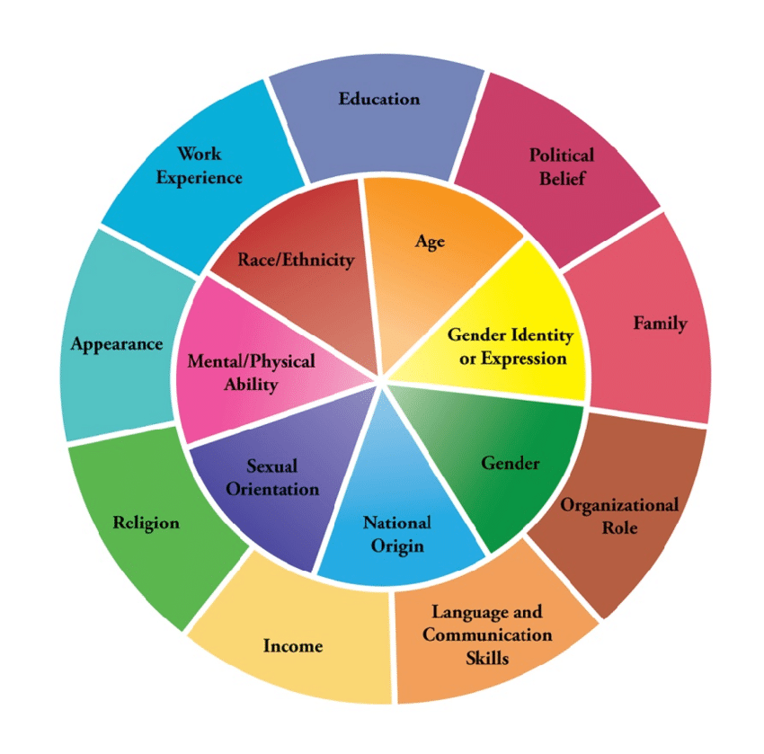
Multiple Social Identities
Adolescent population is increasingly diverse
LGBTQ Youth come out earlier; identities continue to evolve
National Academies of Sciences, Engineering, and Medicine. (2019). The Promise of Adolescence
Diversity Wheel - Johns Hopkins University Diversity Leadership Council
Notes:
Identity is so multidimensional, and the adolescent population is increasingly diverse. Beliefs about how individual ethnic and racial background relates to each person’s self-definition is very personal. This is more complex for immigrant youth, negotiating their own culture with the culture in a new country
Research shows that young people with cross-racial friendships do better with differences, social and emotional competence and wellness
Adolescence may be a prime time to expose youth to differences, a time for transforming social cognition

Slide 27
Sense of Self
A cohesive, congruent sense of self is linked to
Self-esteem
Goal-setting
Emotional well-being
How can you support young people in their exploration of identity?
Notes:
A sense of self is linked to self esteem, goal setting and emotional well-being. Let’s take a couple of minutes and reflect on some strategies you have used to support a positive sense of self in the youth you work with. Go ahead and chat in some examples. How can you support young people in their exploration of identity?

Slide 28
The New Digital World
The average 8 to 12 year-old American kid spent four hours and 44 minutes looking at screens each day in 2019
American teens, ages 13 to 18, used entertainment screen media for an average of seven hours and 22 minutes each day in 2019
https://www.commonsensemedia.org/social-media-social-life-infographic
Notes:
Adolescents are leaders in adapting to the new digital world. Recent reports indicate that close to 90% of adolescents have access to smart phones. Now driven by the pandemic it may have reached 100%.
And they are spending a lot of time online. What are the implications for adolescent development?

Slide 29
Impact?
Research ambivalent
Youth with low social and emotional stability more likely to experience negative impact
Changes in
Connection
Focus
Rest
Christine Carter. 2020
Notes:
The research about the impact of screen time and online engagement on mental health is still ambivalent. (Some researchers argue that the increasing suicide rate among adolescents has to do with the increased use of digital technology.)
Christine Carter in her new book discussed several areas of concern:
connection - Many teens report loneliness, exclusion and feeling pressured by comparing themselves to people online
focus – a decrease in deep learning, toxic overuse inhibits dopamine function which increases risk for depression and anxiety
rest - cognitive overload leads to sleep deprivation Adolescents require 9 hours of sleep; many youth do not get enough sleep. Lack of sleep in turn can lead to depression, anxiety and daily functioning problems.

Slide 30
Questions? Thank you!
Notes:
That was a lot! I’m going to stop for a minute and take some questions. While we do that, here’s where to find the Positive Youth Development 101 manual on our website

Slide 31
http://www.actforyouth.net/youth_development/professionals/manual.cfm

Slide 32
References
Bronfenbrenner, U. (1979). The ecology of human development: Experiments by nature and design. Cambridge, MA: Harvard University Press.
Huitt, W. (2007). Maslow’s hierarchy of needs. Educational Psychology Interactive. Valdosta, GA: Valdosta State University. http://www.edpsycinteractive.org/topics/conation/maslow.html
Garbarino, J. (1995). Raising children in a socially toxic environment. San Francisco, CA: Jossey‐Bass, Inc.
Hamilton, S. F., Hamilton, M. A., & Pittman, K. (2004). Principles for youth development. In S. F. Hamilton & M. A. Hamilton (Eds.), The Youth development handbook: Coming of age in American communities. Thousand Oaks: Sage Publications, Inc. http://ecommons.library.cornell.edu/bitstream/1813/21945/2/PrinciplesYD.pdf

Slide 33
References
National Academies of Sciences, Engineering, and Medicine. (2019). The Promise of Adolescence: Realizing Opportunity for All Youth. Washington, DC: The National Academies Press. nap.edu/catalog/25388/the-promise-of-adolescence-realizing-opportunity-for-all-youth
Pamela Cantor et al. 2018. Malleability, plasticity, and individuality: How children learn and develop in context. Full article: Malleability, plasticity, and individuality: How children learn and develop in context1 (tandfonline.com)
ACT for Youth. Adolescent Identity Development. http://www.actforyouth.net/adolescence/identity.cfm
Christine Carter. 2020. The New Adolescence. Raising Happy and successful Teens in an Age of Anxiety and Distraction. Dallas: BenBella Books, Inc.

