Slide 1
What’s Going on With Girls?
Heather Wynkoop Beach
ACT for Youth

Slide 2
Chat Box Check-In
One word that describes how you are feeling today?

Slide 3
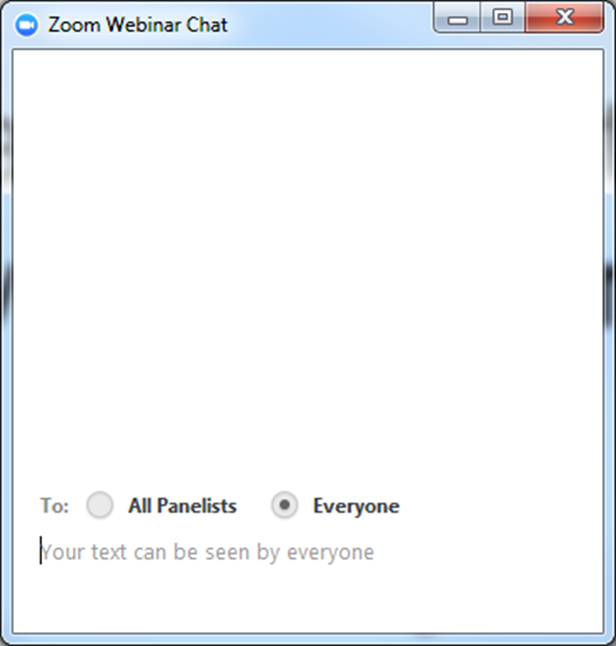
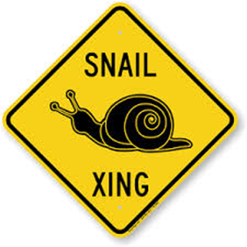
Housekeeping
Experiencing delays?
Try closing out the other
programs running on your
computer.
Audio Problems?
1.855.880.1246 or
1.877.369.0926
ID 919 4229 0638
Notes:
Some housekeeping:
You are automatically muted.
Delays?
Audio… you may have to log out and log back in.
And if you use the chat, please make sure you send it to everyone. Just know that if everyone replies to something at once, it may be difficult for us to catch it.
Michele and Marisol will monitor chat room
Use full screen

Slide 4
Like a Girl
Notes:
https://www.youtube.com/watch?v=XjJQBjWYDTs
After Video…
What is your reaction to the video?

Slide 5
To be a girl
“Between the ages of 8 and 11 years, girls tend to be androgynous. They view themselves as strong and confident and are not afraid to say what they think. However, as they cross over into adolescence, girls begin to experience pressure toward more rigid conceptions of gender roles; they become more concerned with how women are ``supposed to behave'' and with their physical and sexual attractiveness. Although research shows that self-esteem decreases for both sexes after elementary school, the drop is more dramatic for girls. Compared with boys of the same age, adolescent girls are more anxious and stressed, experience diminished academic achievement, suffer from increased depression and lower self-esteem, experience more body dissatisfaction and distress over their looks, suffer from greater numbers of eating disorders, and attempt suicide more frequently.”
A New Look at Adolescent Girls: www.apa.org/pi/families/resources/adolescent-girls

Slide 6
In the chat
What are some beliefs/stereotypes we hear about girls?

Slide 7
So what IS going on with girls?

Slide 8
State of the Girl- 2017
26 million girls living in the US (5-17)
Between 2007 (start of the Great Recession) and 2017
More girls live in single-parent families today (34%) compared with (32%) before the recession.
In 2015, nearly 1 in 5 (19%) of girls lived in poverty, compared to 17% in 2007.
41% lived in low-income families, compared to 38% in 2007. (highest among Girls of Color)
The percent of girls ages 12 to 17 who reported they were victims of bullying declined from 34% in 2007 to 25% in 2013. (Increase in cyberbullying though)
Girls who regularly participate in community affairs or volunteer work increased from 31% to 39%
The State of Girls 2017: Emerging Truths and Troubling Trends, Girl Scout Research Institute
Notes:
Girl Scouts of America recently looked at the state of girls, reviewing national research.
Poverty is different than low-income. The poverty level for a family of four with two children was $24,300.
“Low-income” is a term for families that earn less than twice the federal poverty line. In 2016, the low-income threshold for a family of four with two children was $48,600.
The economic impact of the pandemic has yet to be fully seen, but it is safe to assume it will be significant
Hispanic/Latina girls (61 percent), black/African American girls (58 percent), and American Indian girls (61 percent).
It’s not all bad!

Slide 9
Developmentally
Growth spurts start/puberty
Move toward independence
Increased media presence (cell phones, computer time)
“Girls (particularly pre-pubescent ones) also have greater sensitivity to noise and tone of voice. As a result, some girls may hear yelling when there is only firmness in an adult’s voice, or take feedback on their work as negative criticism, even when it’s constructive.” ~JoAnn Deak, Ph.D.
Notes:
So…what IS going on with girls. Well, let’s look at some of the developmental changes that happen at this time.
How do you see the girls in your program moving toward independence? Give examples.
Think about the last point. Can you recall a time when a girl you were working with thought someone was “yelling” at her and that person didn't really agree?

Slide 10
Remember the brain…
Not simply “hormones”
Under construction
“Gong” rather than a “chime”
Impacts how we interact with and respond to girls entering adolescence
Notes:
We know that the brain development can extend into the early 20’s. It’s important to remember though, that it also means that many of the challenges faced by girls in particular that have traditionally been blamed on “hormones”, is actually more about brain development.
In the book Untangled by Lisa Damour, she explains that Updates to the limbic system heighten the brain’s emotional reactions with research indicating that the feeling centres beneath the cortex are actually more sensitive in teens than in children or adults. For example, one study used an MRI to watch teenage brains respond, in real time, to emotional input. The research team showed images of fearful, happy and calm faces to children, teens and adults while monitoring the activity of the amygdala, a key player in the emotional reactions of the limbic system. Compared to the brain activity of children and adults, the teens’ amygdalas reacted strongly to fearful or happy faces. In other words, emotional input rings like a gong for teenagers and a chime for everyone else.
So think about how this may have an impact on the social and technological aspects

Slide 11
Social
From “Can Ava come over to play?” at 9 years old to “Can Ava come over to hang out?” at 12.
Increasingly aware of social “norms”
Increasingly self-conscious and self-centered
Peers > Family
Experience feelings of insecurity and begin to doubt previous self-confidence. Often experience a significant drop in self-esteem. ESPECIALLY IN GIRLS
Notes:
Remember the video we just watched
Have you seen this in the girls in your program?

Slide 12
Technology
Researchers at the University of California, Los Angeles, found that the areas of teens’ brains focused on reward processing and social cognition are similarly activated when they think about money and sex – and when they view a photo receiving lots of likes on social media. ~NYT
Common Sense Census: Media Use by Tweens and Teens, 2015
Notes:
What are the implications?

Slide 13
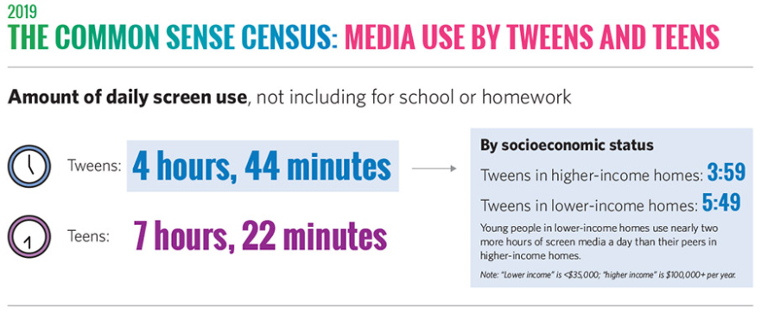
Technology

Slide 14
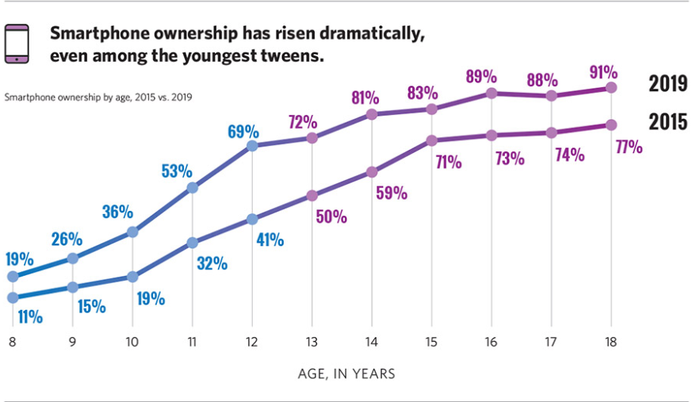
Smart phones

Slide 15
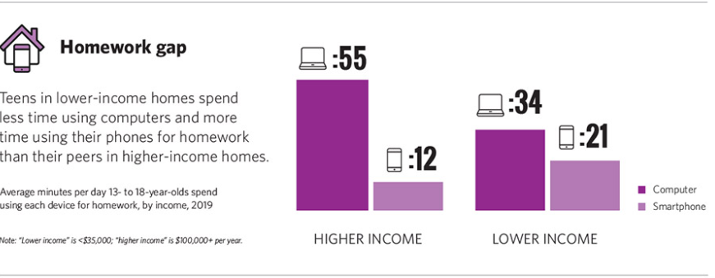
Tech and academics
Notes:
What is the impact?

Slide 16
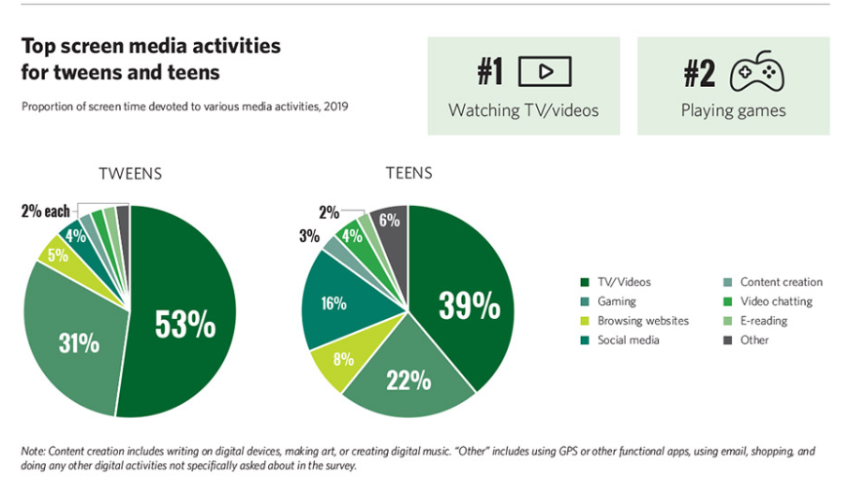

Slide 17
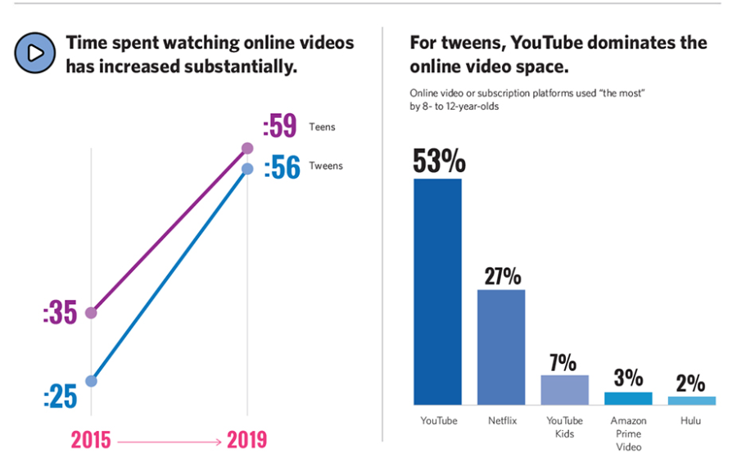
Notes:
What does this mean for your programming?

Slide 18
Racism and Dipartites
“The impact of racism has been linked to birth disparities and mental health problems in children and adolescents. The biological mechanism that emerges from chronic stress leads to increased and prolonged levels of exposure to stress hormones and oxidative stress at the cellular level. Prolonged exposure to stress hormones, such as cortisol, leads to inflammatory reactions that predispose individuals to chronic disease.”
The Impact of Racism on Child and Adolescent Health
Maria Trent, Danielle G. Dooley, Jacqueline Dougé, Pediatrics August 2019, 144 (2) e20191765; DOI: https://doi.org/10.1542/peds.2019-1765
Notes:
Racism is a public health issue we cannot ignore

Slide 19
For Girls of Color
“Girls of color face structural barriers in nearly every aspect of their lives. Over 60 percent of girls of color are born to families living on low incomes or below the poverty line. Sexual violence is pervasive in the lives of all girls and often goes neglected, especially for girls of color. What's more, girls of color who face harm are often unfairly penalized. Black girls, for example, are six times more likely to be suspended in school than their white peers — and are disproportionately represented in the juvenile justice system.:
~NoVo Foundation

Slide 20
Preparing for the teen years like…
Notes:
Why is this type of information important? Well, because if we see the teen years as a time we are preparing them for “adulthood”, then these years…the ones between 9-12, should be a preparation for the teen years.
So it’s not just knowing the statistics and processes of what is happening with girls, its what you do with that information.

Slide 21
What does it mean to be “Girl Friendly”?
You’ve taken the time to look at your program through the lens of the girls that are a part of it.
Identifying, addressing and reducing gender stereotyping
Language and Communication: “Guys”; “Strong boys”; “Girls don’t/shouldn’t…..” “like a girl”
Does your program have gender-specific rules (such as clothing)?
Encourage and model, strong positive female relationships
Is girl-hood celebrated?
Notes:
How do you make your program girl friendly?
Think about your program from the time a girl comes to the time she leaves, with all of the challenges she may face before getting to you. What does it feel like when she comes in?
Gender stereotyping is just has harmful as any other stereotyping. What is the language that is used within the program, not only by participants, but staff as well?

Slide 22
Child Trends, August 2012
Synthesized findings from 106 random social interventions that targeted female children or co-ed programs with separate data for girls.
9 outcome areas including: Academic Achievement; Delinquency; Mental Health/Internalizing (Depression); Self Sufficiency; Social Skills and Substance Use
Either: Found to Work, Mixed Findings or Not Found to Work
Notes:
Other areas included : Social Skills, Substance Use, Externalizing or Acting Out Behaviors (behavior problems such as aggression or hyperactivity) ▪ Physical Health and Nutrition (healthy eating, body mass index (BMI), weight or physical activity) ▪ Reproductive Health & Sexuality (such as sexual activity, condom and contraceptive use, pregnancy or births) Can find full report in resources.

Slide 23
Academic Achievement
Mixed Findings Gender-specific programs. Three of the four programs designed specifically for girls had mixed impacts on academic outcomes. The fourth program had no impact for girls.
Delinquency
Of the 11 programs that measured delinquency outcomes for girls, only one was found to have a positive impact, two had mixed impacts, and eight were not found to work for girls.
Mental Health/Internalizing (Depression)
Cognitive-behavioral skills training, Short-term programs and Qualified professionals and parent involvement were all found to work
Self Sufficiency
Mostly mixed finings, with Vocational training and/or support; Individual counseling or therapy and Life skills training.
Notes:
CBT helps change patterns of thinking or behavior that are behind people's difficulties, and so change the way they feel.
Short-term programs. Three out of the four programs that lasted six weeks or less had
positive impacts girls’ mental health
Mixed Findings: Parent training. Of the eight programs that included parent training, three had positive impacts and three had mixed impacts on mental health.
Life skills training. Three out of the eight programs that taught participants life skills (any practical skill such as decision-making or resistance strategies) had positive impacts on mental health. One program had mixed impacts.
Teacher-provided interventions. Three of the six programs that were provided by the participants’ teachers

Slide 24
What advice would you give your pre-teen self?
“Not to worry as much. Things are temporary”
“It’s ok if friendships aren’t permanent”
“It does get better…”
“It also gets worse”
“Being kind goes a long way”
“Pay attention to your body and mental health”

Slide 25
Helping Parents
Researching and sharing resources
Creating communication opportunities
Celebrating developmental milestones!
Notes:
1. This includes events and opportunities in the community i.e presentations, girls only events, check with your local girls scouts, girls inc, girls who code
2. Communication opportunities are just that. Sending girls home with “homework” or something that is part of a larger project that fosters communication between them and their adult caregiver. This could be a journal with “interview” questions,
When children are little, parents are constantly monitoring and getting positive feedback on milestones. Ohh, she held her head up…ohh, she’s crawling…ohh…she’s talking…tying her own shoes and so on. While these are generally things most humans accomplish by the time they become adults, we still celebrate with great enthusiasm. When do we stop celebrating the developmentally appropriate milestones and why? Why not send home note that says “Michelle pushed some boundaries and took healthy risks today and it was GREAT!”…
Ok…it may not be THAT easy, but letting parents know what behaviors are developmentally appropriate can help them navigate what the girls in their lives are experiencing.
This also includes
Readings/hand outs
Websites
Discussion groups (with food!)
FUN Homework that requires connection

Slide 26
What other things can you think of?

Slide 27
Resources
American Psychological Association
A New look at Adolescent Girls
https://www.apa.org/pi/families/resources/adolescent-girls
Pew Research Center
The way U.S. teens spend their time is changing, but differences between boys and girls persist
Girls Health
https://www.girlshealth.gov/
A Mighty Girl
A collection of books, toys and movies for smart, confident, and courageous girls.
https://www.amightygirl.com/
Girl Scouts USA
The State of Girls 2017 (PDF)
https://www.girlscouts.org/content/dam/girlscouts-gsusa/forms-and-documents/about-girl-scouts/research/GSUSA_State-of-Girls-Report_2017.pdf
American academy of Pediatrics:
The Impact of Racism on Child and Adolescent Health
pediatrics.aappublications.org/content/144/2/e20191765
.

Slide 28
Resources Continued
Like a Girl Commercial: https://www.youtube.com/watch?v=XjJQBjWYDTs
The Representation Project: organization dedicated to gender equality by exposing harmful gender stereotypes in media and culture. http://therepresentationproject.org/film/miss-representation/
http://www.colorlines.com/articles/new-study-exposes-barriers-block-girls-color-opportunity

